Slide 1
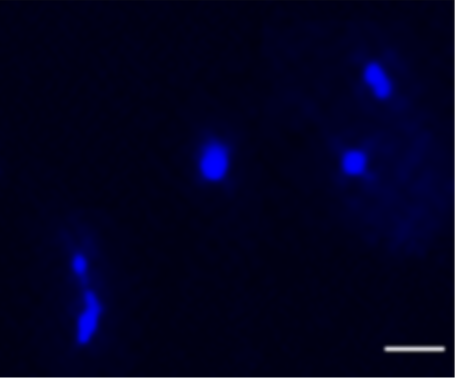
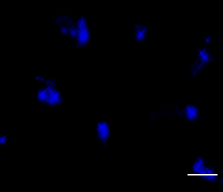
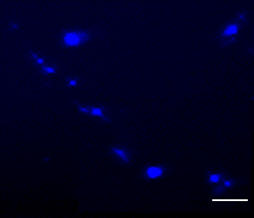
FIGURE 2D source data-DAY 0- 1 to 3
Vitamin A autofluorescence
Brightfield

Slide 2
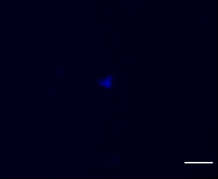
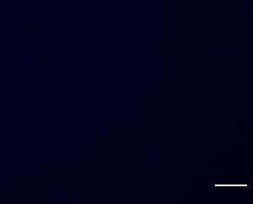

FIGURE 2D source data-DAY 5- 1 to 3
Vitamin A autofluorescence
Brightfield

Slide 3
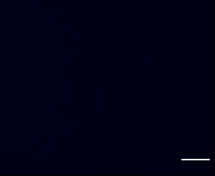

FIGURE 2D source data-DAY 5+SaCas9- 1 to 3
Vitamin A autofluorescence
Brightfield

Slide 4
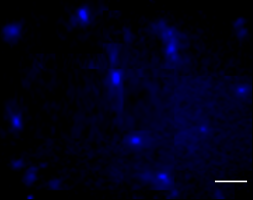
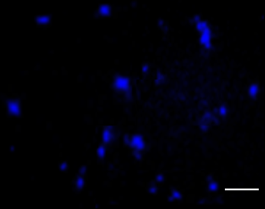
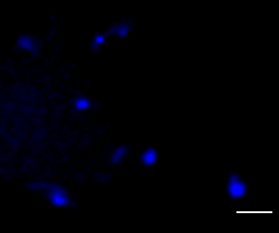
FIGURE 2D source data-DAY 5+HDR- 1 to 3
Vitamin A autofluorescence
Brightfield

