Slide 1
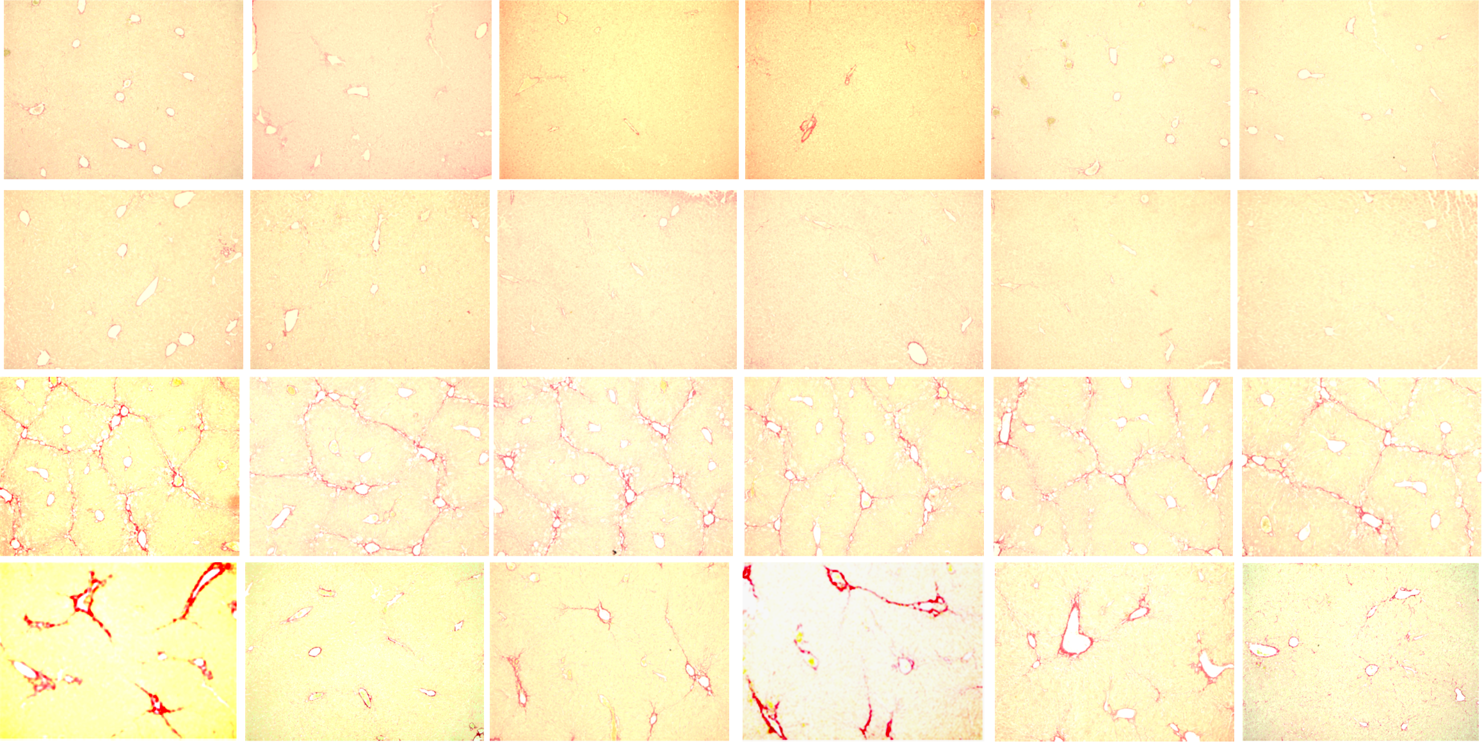
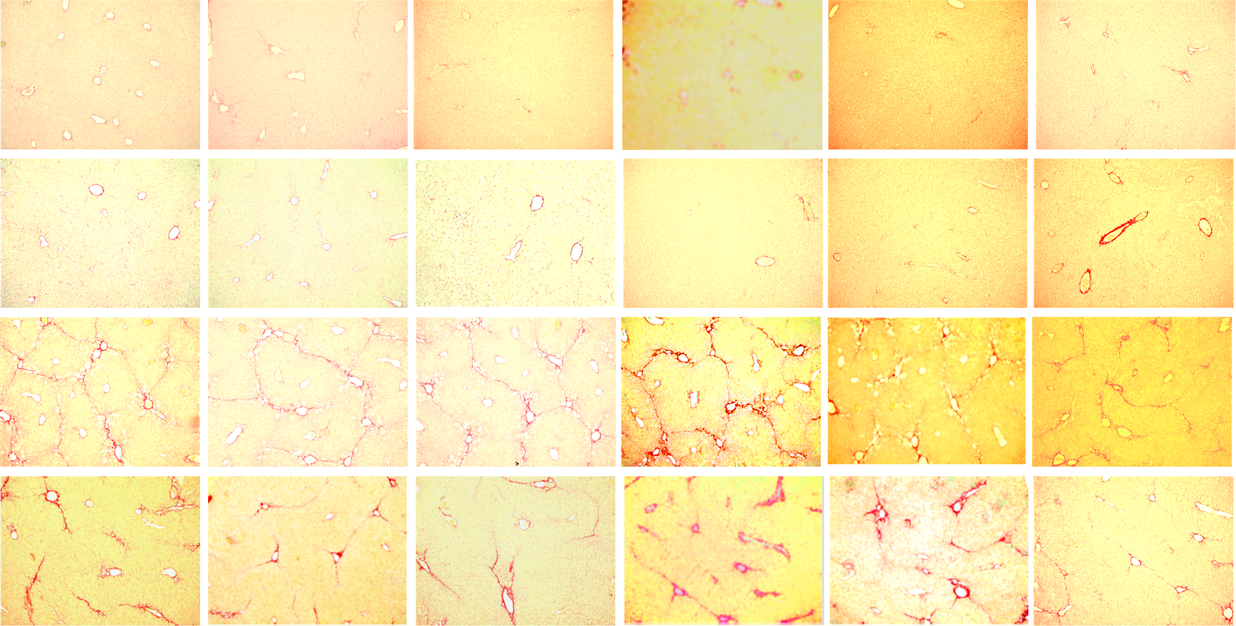
Figure 5-source data 2
PDEL
1
2
3
4
5
6
OIL+EV
OIL+CR
CCL4+EV
CCL4+CR
PMUT
ORIGINAL PMUT done with PDEL
NEW PMUT
1
2
3
4
5
6
OIL+EV
OIL+CR
CCL4+EV
CCL4+CR

