Slide 1
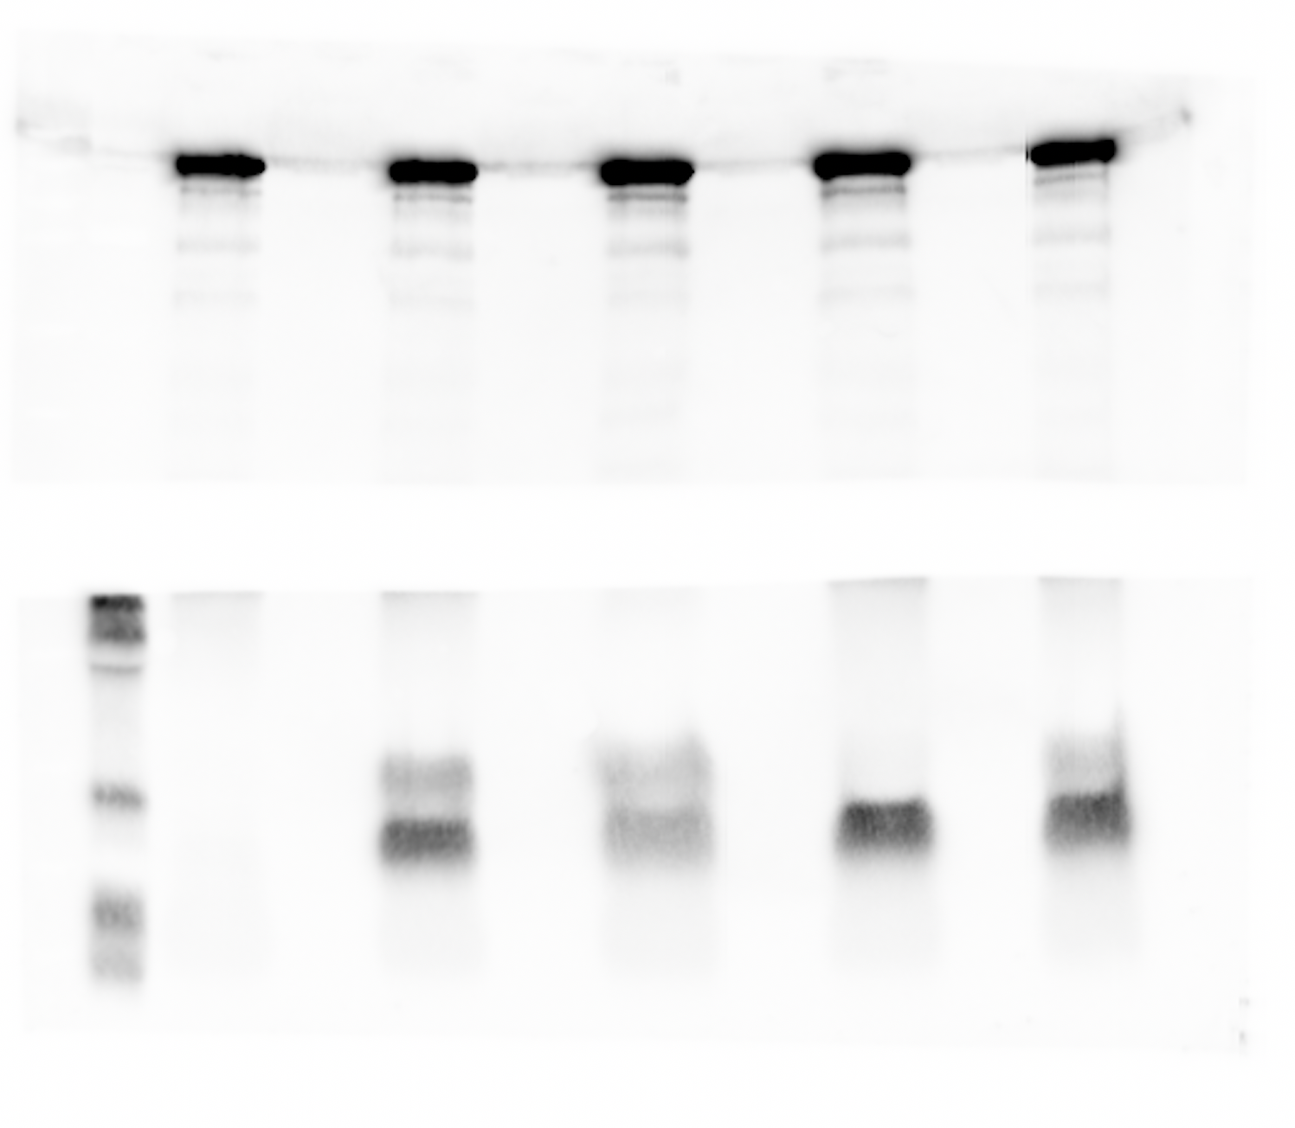
aRNAP
1-vector
2-Tae1 WT
3-Tae1 L21S
4-Tae1 G48S
5-Tae1 G56S
aTae1
1
2
3
4
5

Slide 2
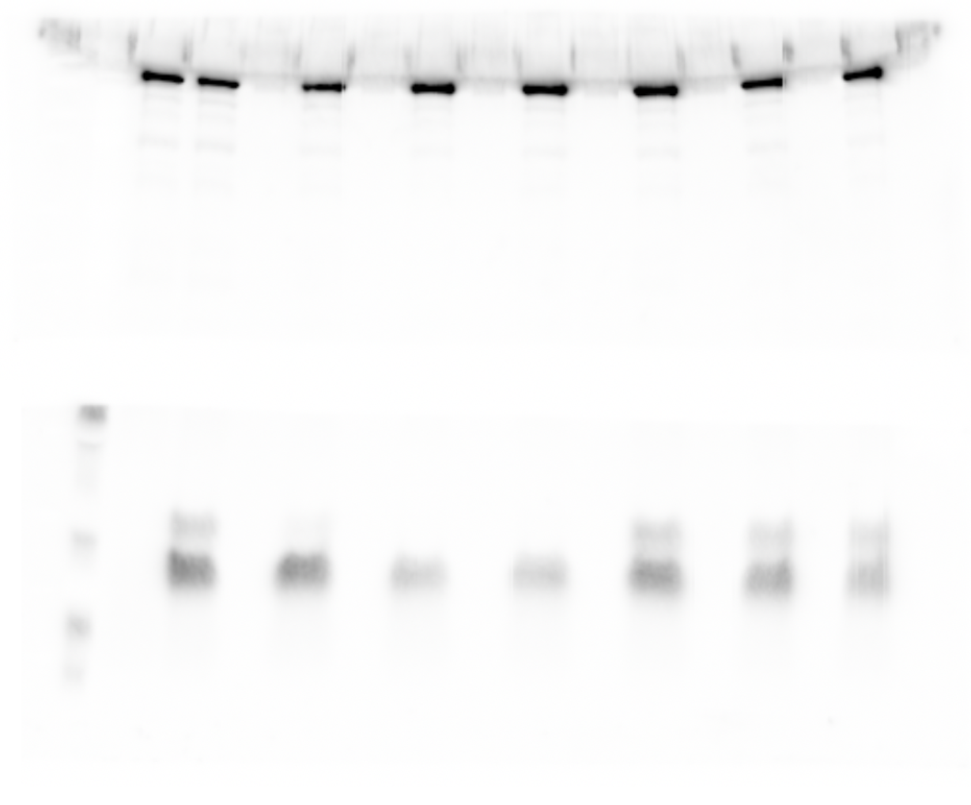
aRNAP
1-vector
2-Tae1 WT
3-Tae1 G42S
4-Tae1 V43S
5-Tae1 A52P
6-Tae1 S144A
7-Tae1 S147A
8-Tae1 S149A
aTae1
1
2
3
4
5
6
7
8

