Slide 1
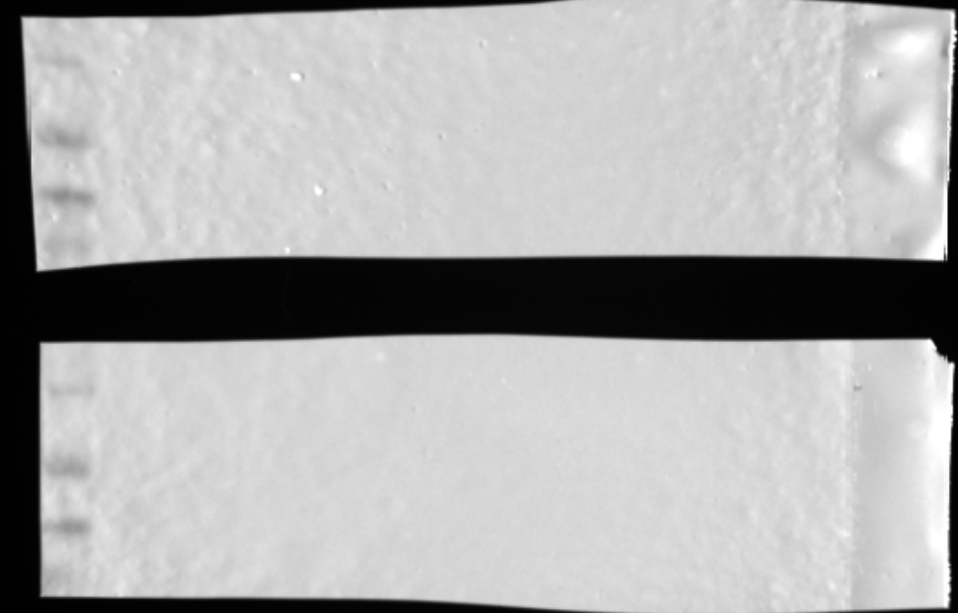
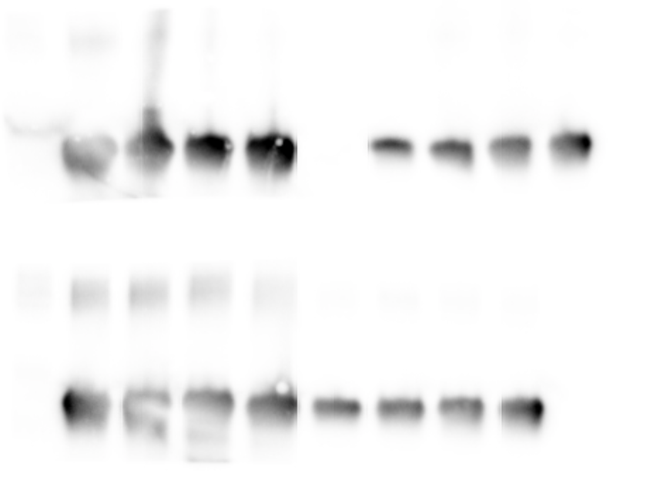
kDa
MW marker
25
1 uM Tae1
0.1 uM Tae1
20
Pull-downs with
PG from plain media
15
10
1
2
3
4
1
2
3
4
25
20
1 uM Tae1
0.1 uM Tae1
15
10
Pull-downs with
PG from D-Met media
1
2
3
4
1
2
3
4
kDa
Blot image
Lanes:
1-Tae1 WT
2-Tae1 C30A
3-Tae1 G48S
4-Tae1 S144A
Both Tae1 G48S and Tae1 S144A
are LOF variants
25
20
15
10
25
20
15
10

Slide 2
1 µM Tae1
0.1 µM Tae1
Bait for pull-down:
Plain media sacculi
WT
C30A
G48S
S144A
WT
C30A
G48S
S144A
1 µM Tae1
0.1 µM Tae1
Bait for pull-down:
D-Met media sacculi
WT
C30A
G48S
S144A
WT
C30A
G48S
S144A

