Slide 1
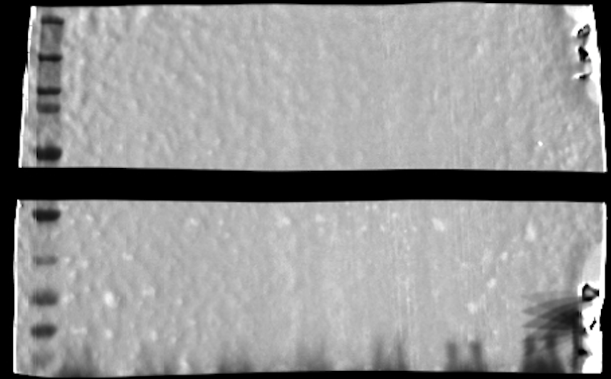
aRNAP
Raw images:
-MW marker
aTae1
1
2
3
4
5
6
7
1 – vector
2 – WT
3 – C30A
4 – C110S
5 – A116T
6 – D134N
7 – S147I
Raw images:
-WB
WB - lysis assays in
D-Met media

Slide 2
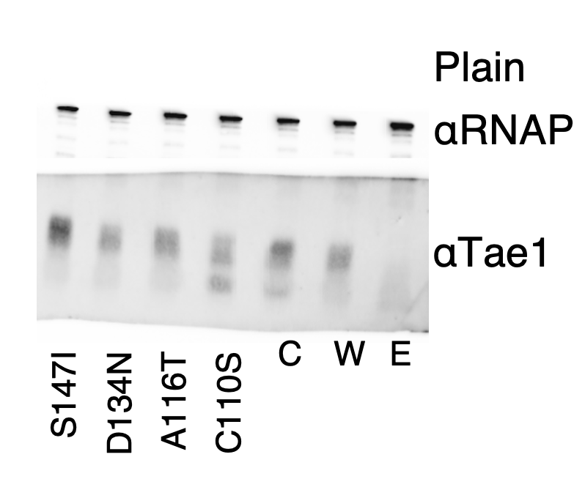
WB - lysis assays in
plain media

