Slide 1
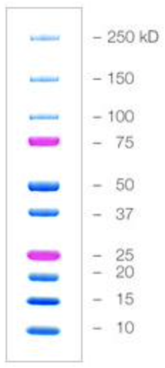
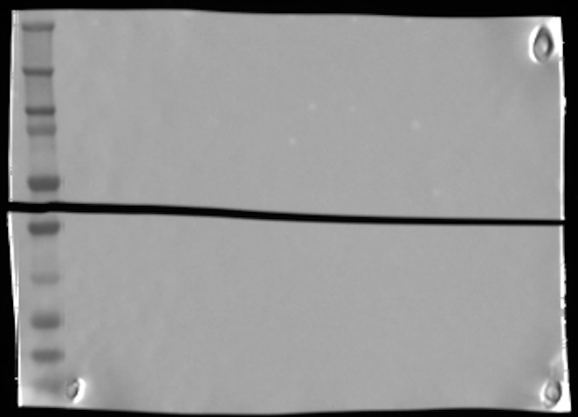
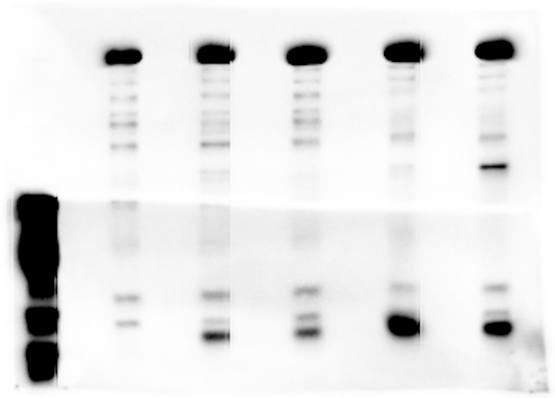
Raw image - MW marker
aRNAP
aTae1
1
2
3
4
5
PA liquid culture:
(PA cells alone grown
in liquid media)
1 – PA ∆Tae1
2 – PA WT
3 – PA C110S
4 – PA ∆icmF
5 – PA C30A
Raw image - WB
WB - PA liquid growth
-to test Tae1 expression levels
in PA cells
-included ∆Tae1 here as
a negative control for the WB

Slide 2
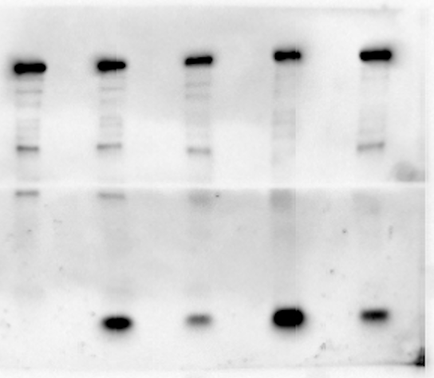
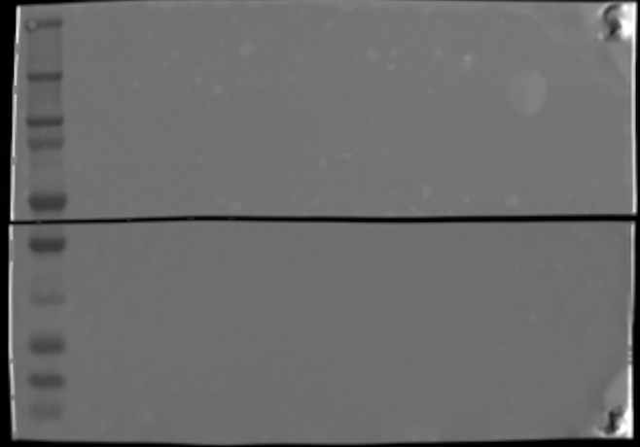
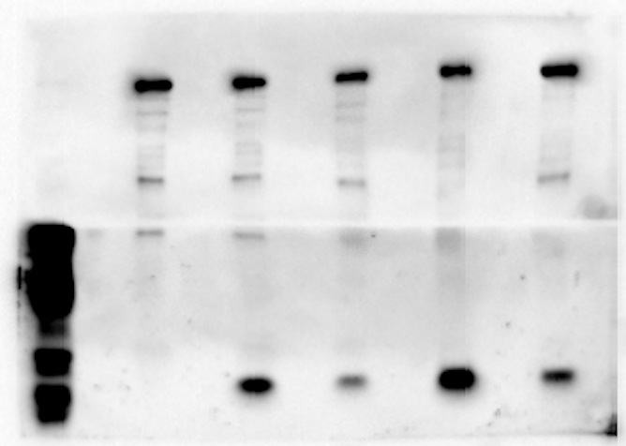
Raw image - MW marker
aRNAP
aTae1
1
2
3
4
5
PA fitness assays:
(PA cells alone on
a membrane on agar)
1 – PA ∆Tae1
2 – PA WT
3 – PA C110S
4 – PA ∆icmF
5 – PA C30A
WB - PA fitness assays
-to test Tae1 expression levels
in PA cells
-included ∆Tae1 here as
a negative control for the WB
Raw image - WB

Slide 3
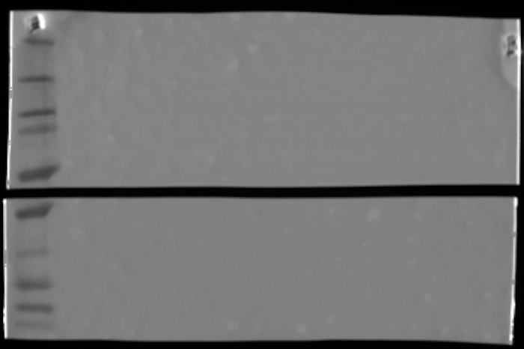
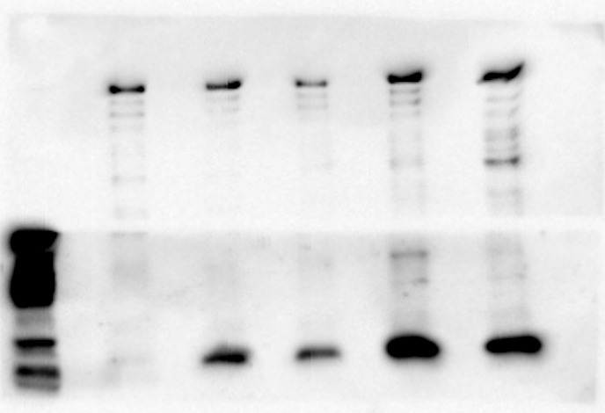
Raw image - MW marker
aRNAP
aTae1
1
2
3
4
5
Competitions against E. coli:
(PA and E. coli cells on
a membrane on agar)
1 – PA ∆Tae1
2 – PA WT
3 – PA C110S
4 – PA ∆icmF
5 – PA C30A
Raw image - WB
WB - competition assays
-to test Tae1 expression levels
in PA cells
-included ∆Tae1 here as
a negative control for the WB

