Slide 1
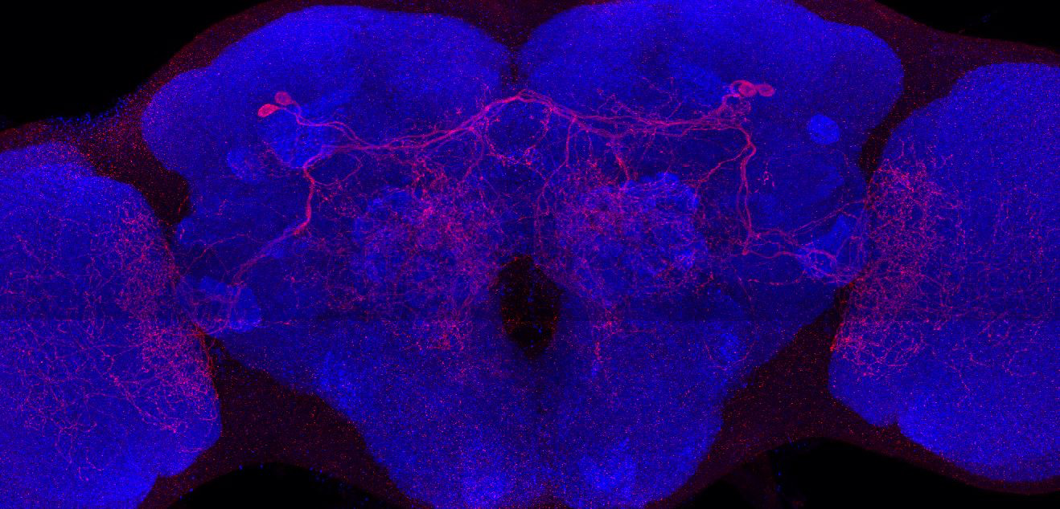
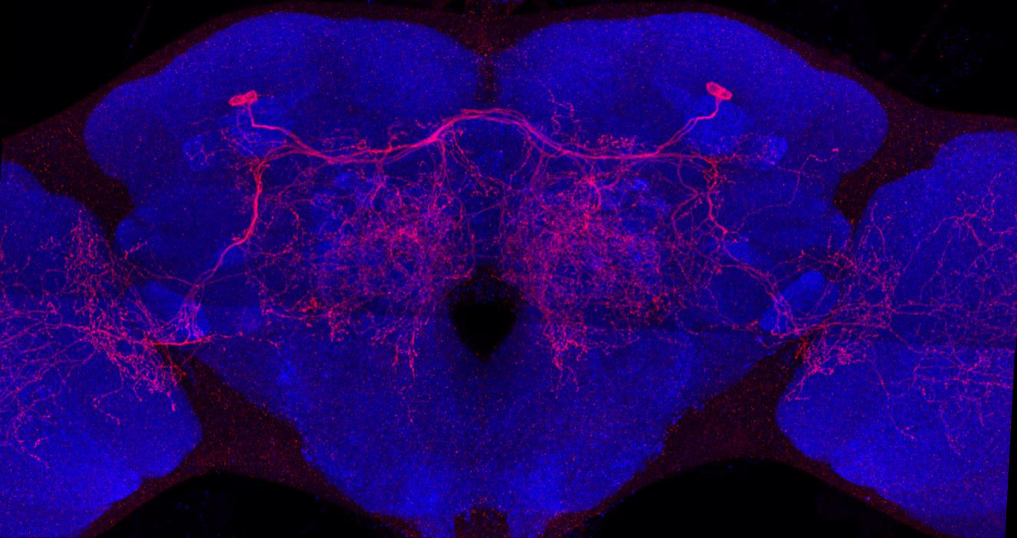
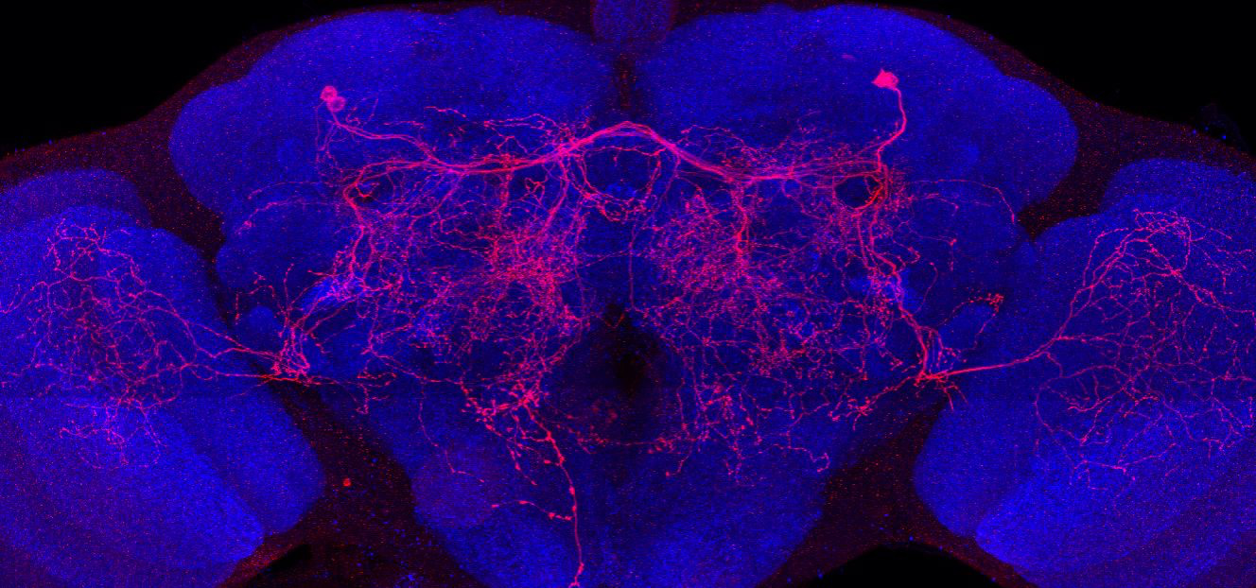
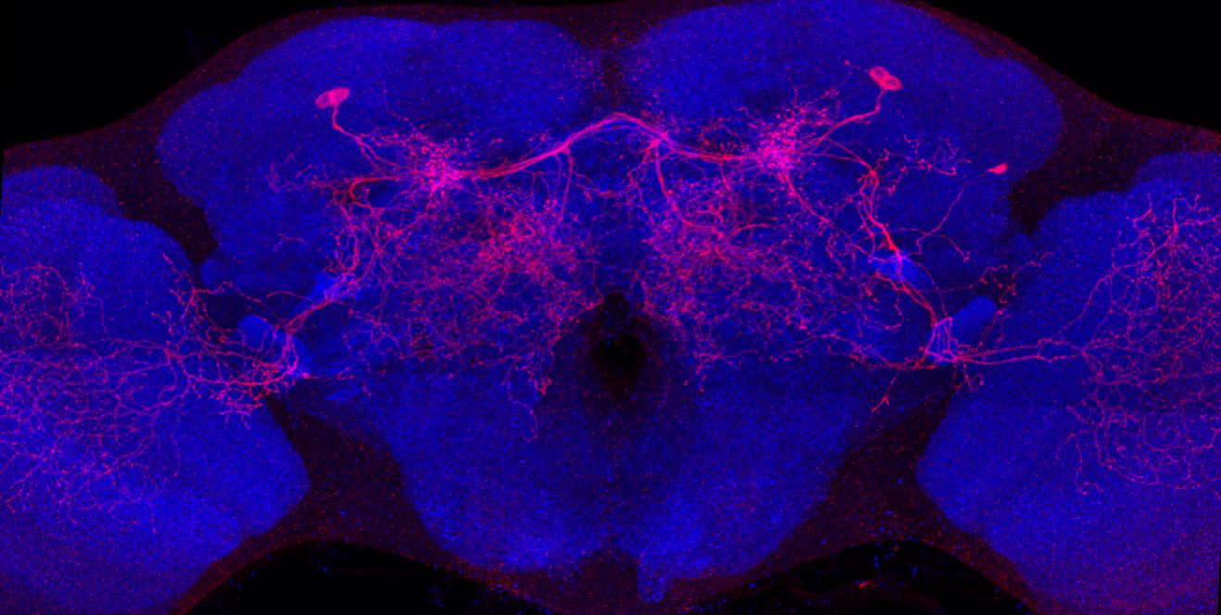
Adult immortalized anatomy of larval neurons MBIN-b1 and -b2
SS21716_Brain 1
SS21716_Brain 2
SS21716_Brain 3
SS21716_Brain 4

