Slide 1
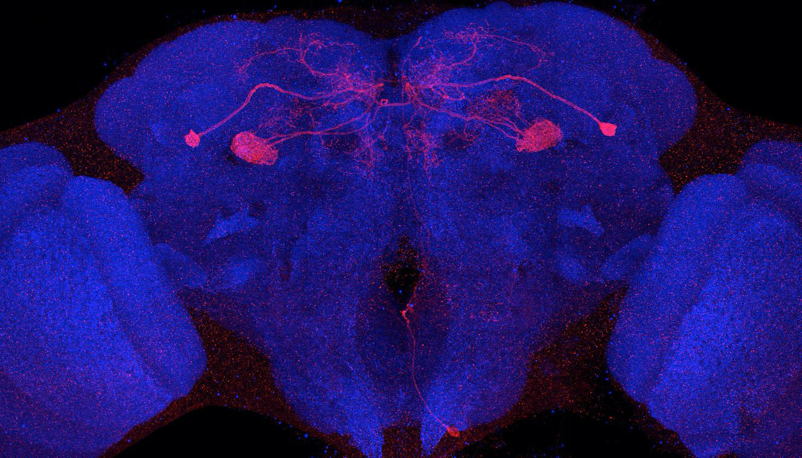
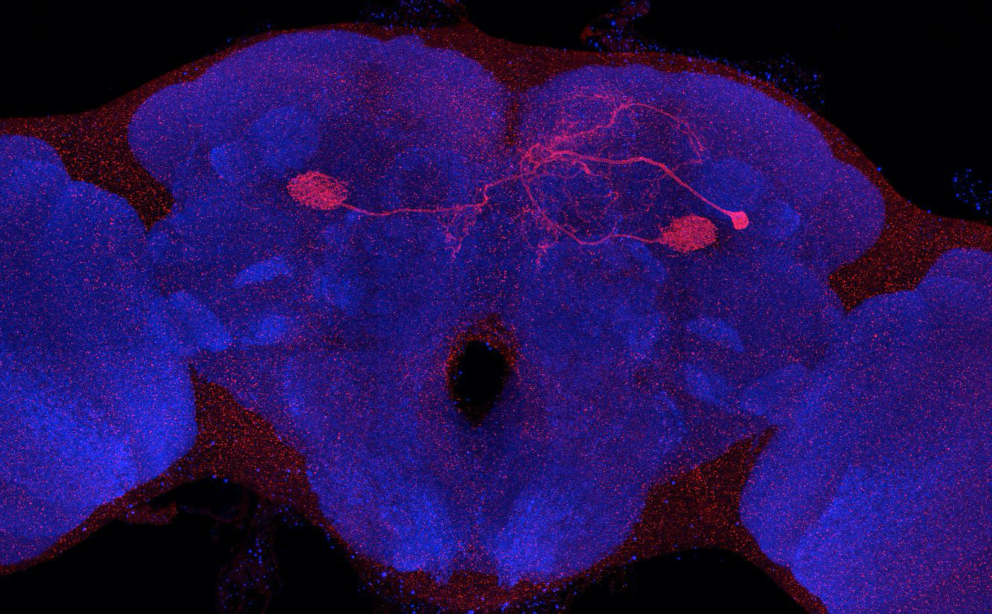
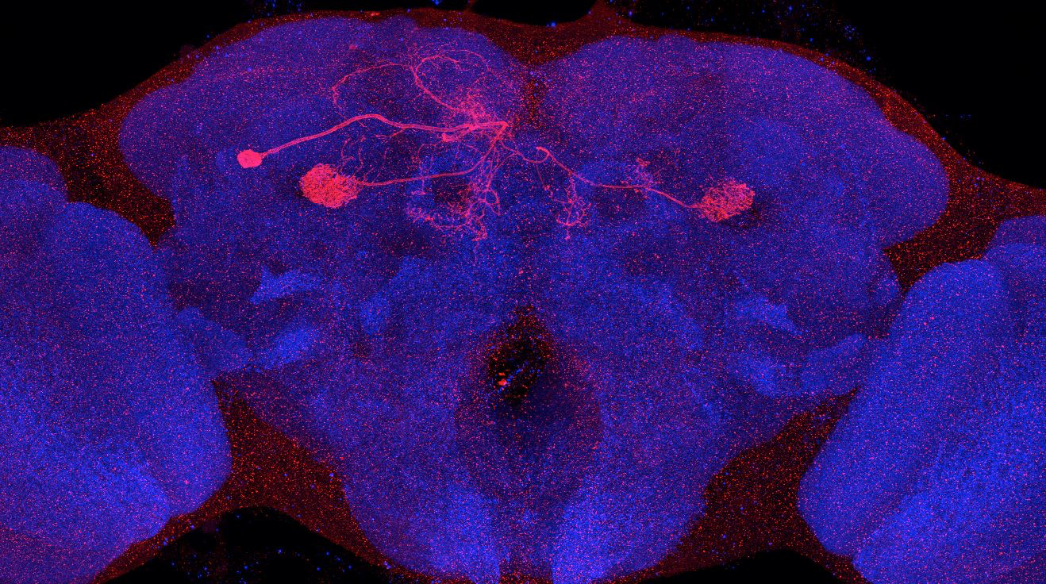
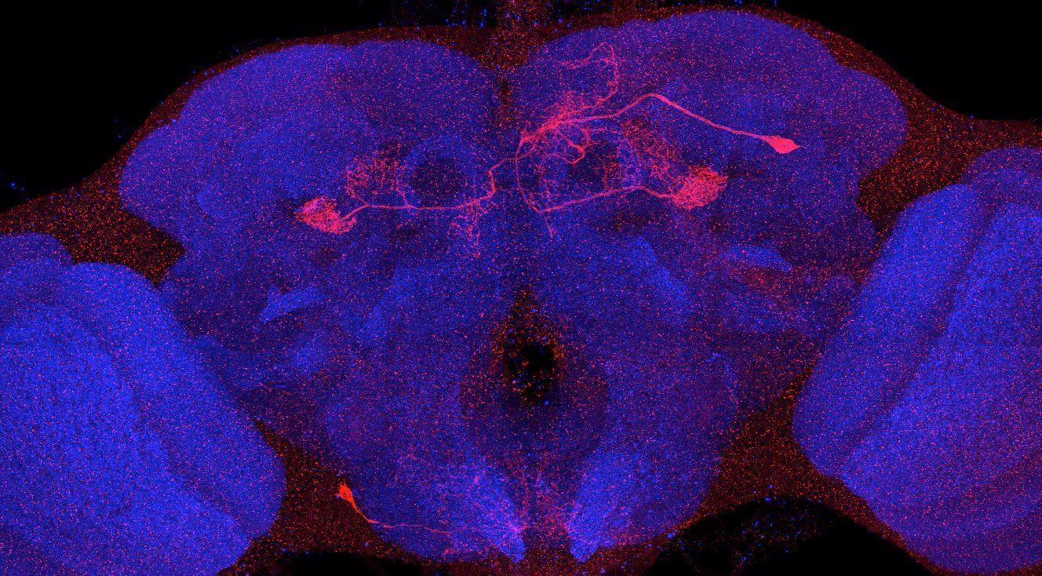
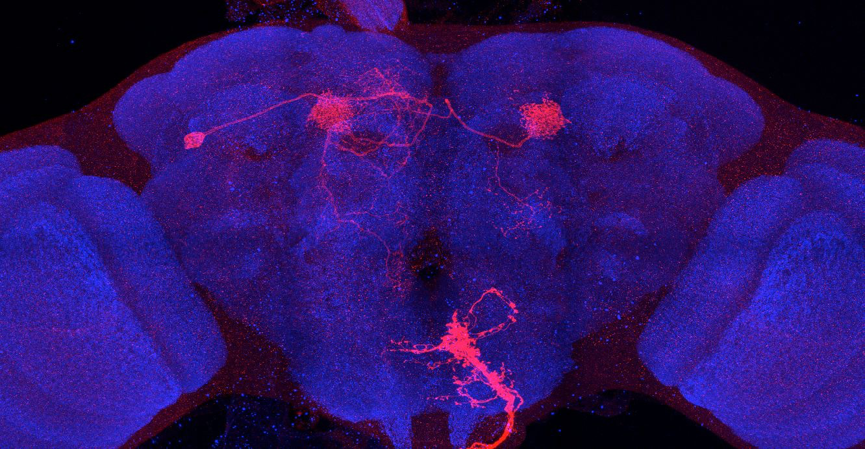
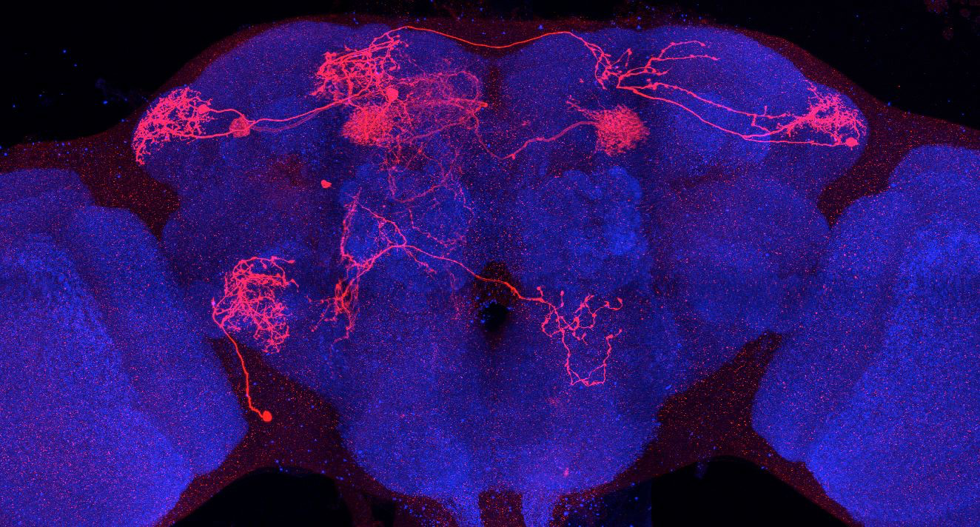
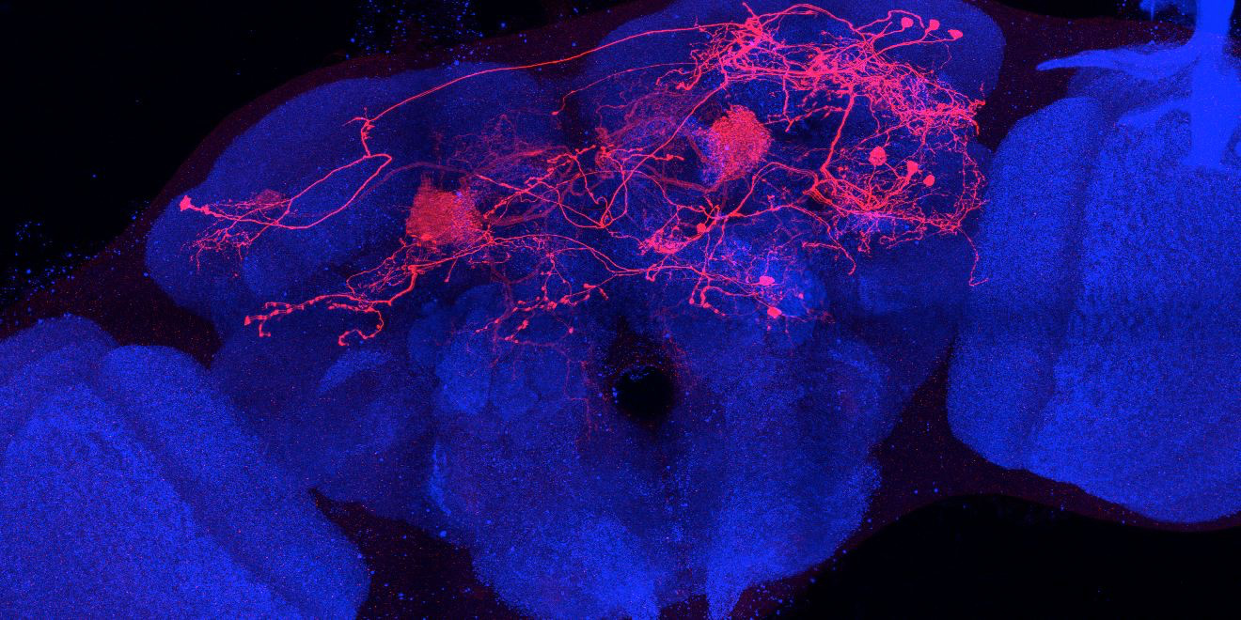
Adult immortalized anatomy of larval neuron DAN-c1
MB586B_Brain 3
MB586B_Brain 2
MB586B_Brain 1
Adult immortalized anatomy of larval neuron DAN-d1
MB586B_Brain 4
DAN-d1: axon tufts
DAN-d1
DAN-d1
MB328B_Brain 1
MB328B_Brain 2
MB328B_Brain 3

