Slide 1
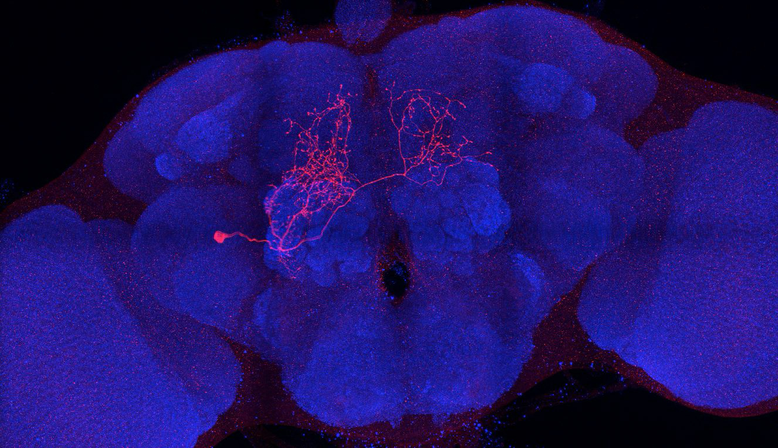
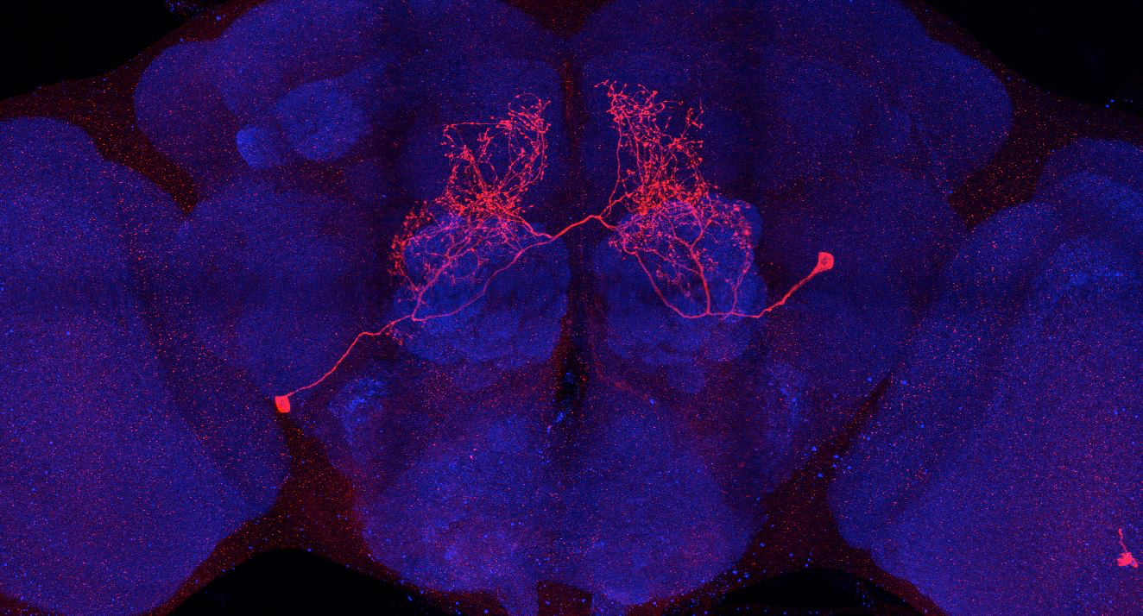
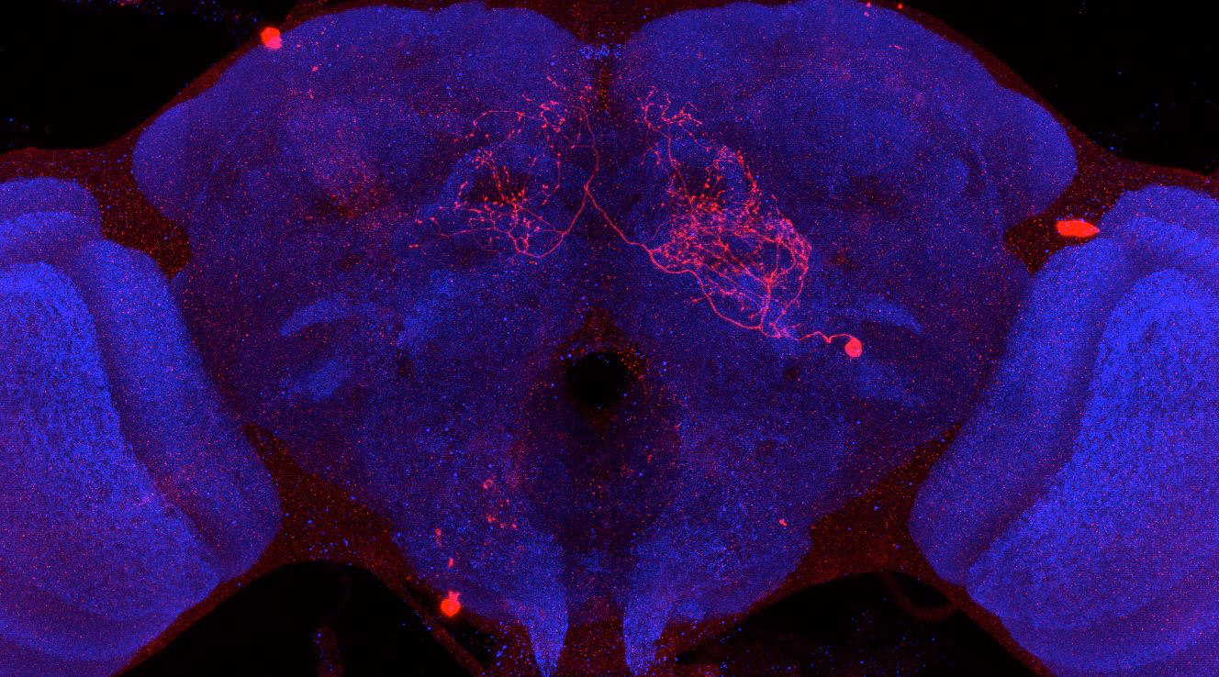
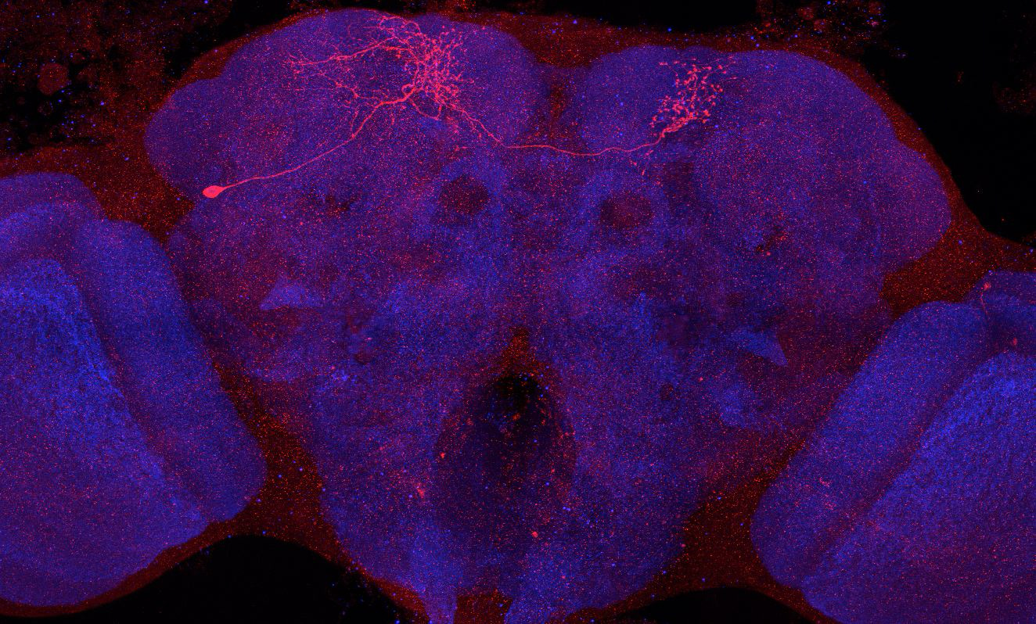
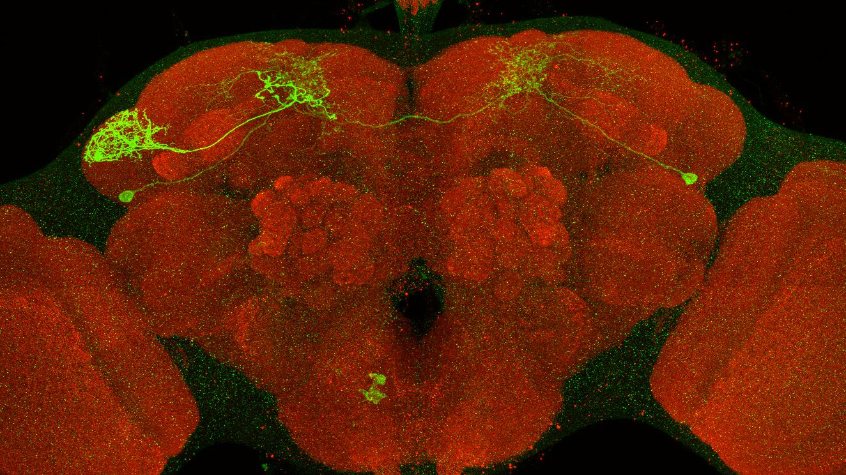
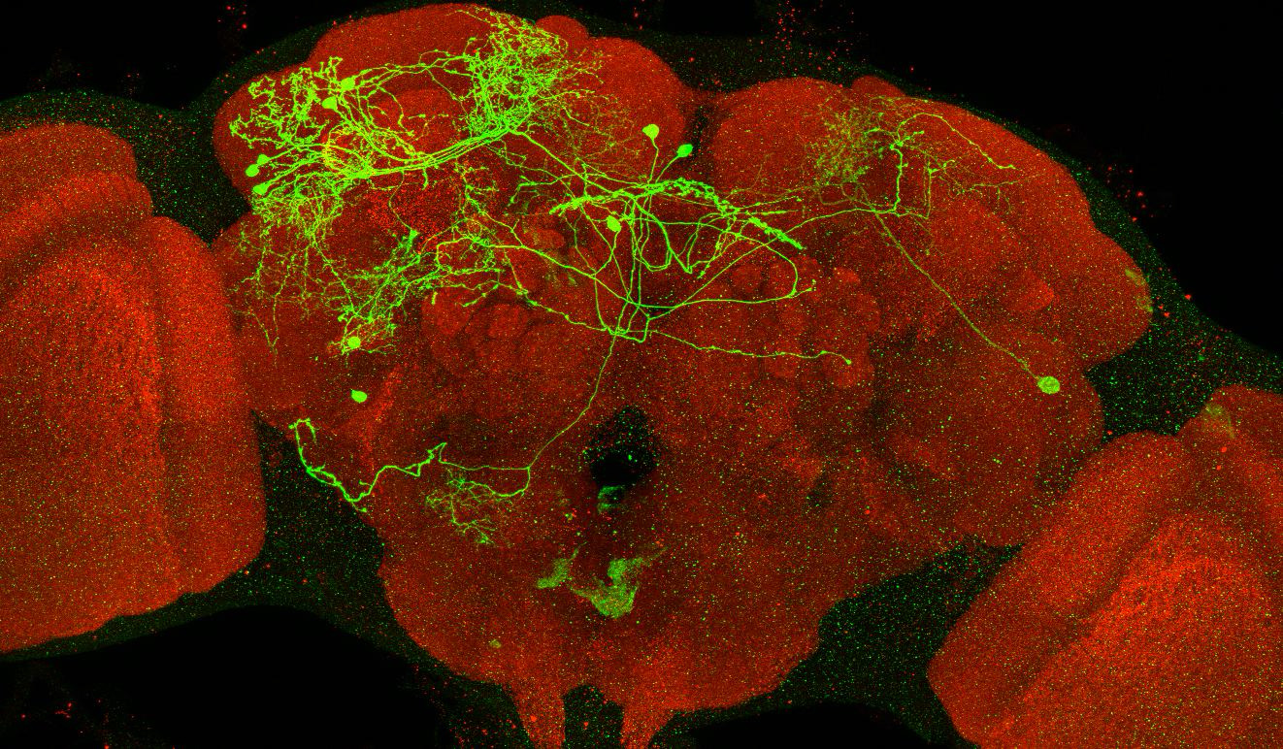
Adult immortalized anatomy of larval neuron MBIN-l1
DAN-d1: axon tufts
DAN-d1
SS04484_Brain 1
SS04484_Brain 2
SS01624_Brain 1
Adult immortalized anatomy of larval neuron DAN-f1
DAN-f1
DAN-f1
DAN-f1
MB065B_Brain 1
MB145B_Brain 1
MB145B_Brain 2

