Slide 1
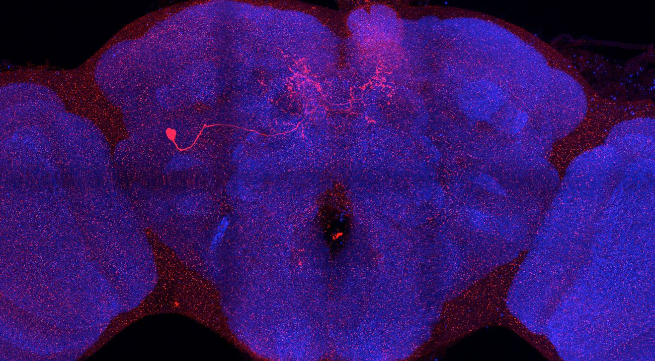
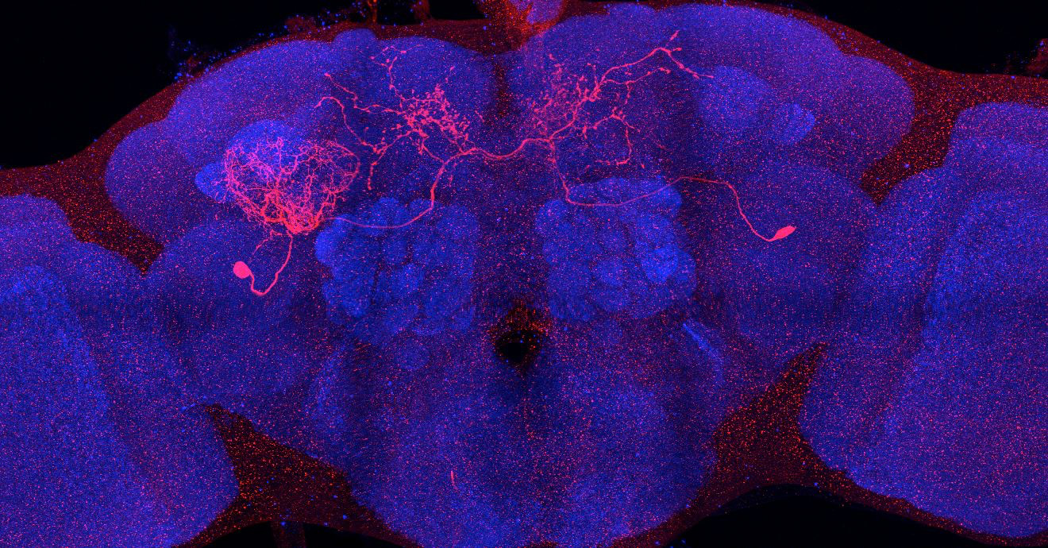
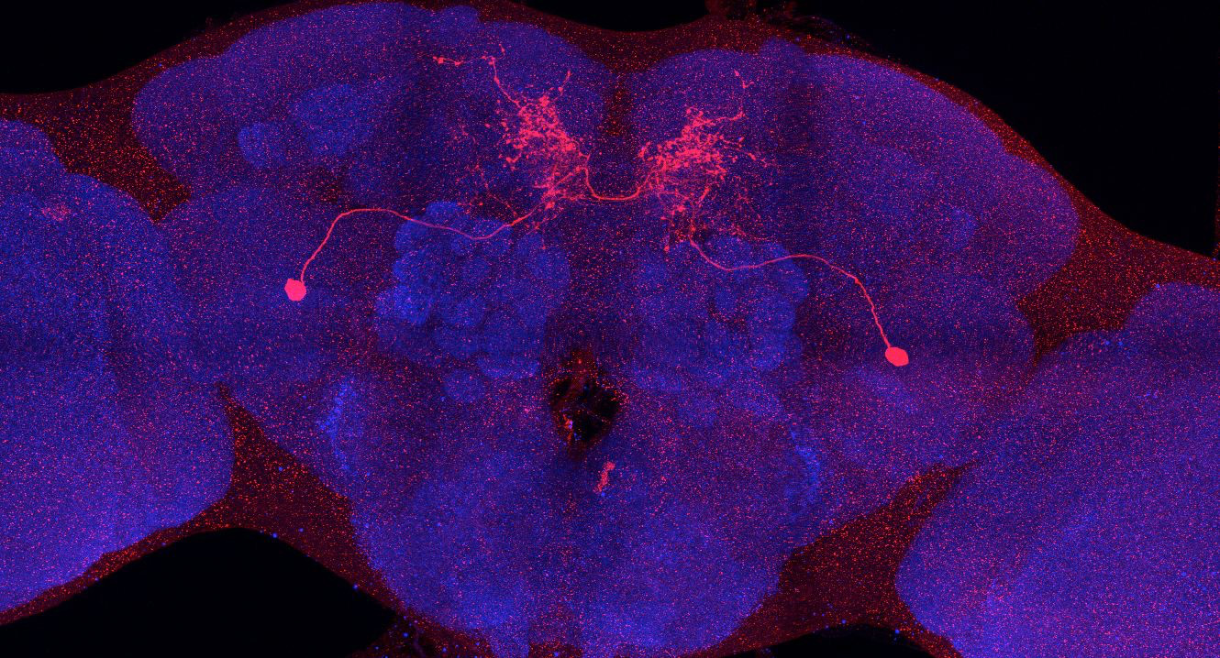
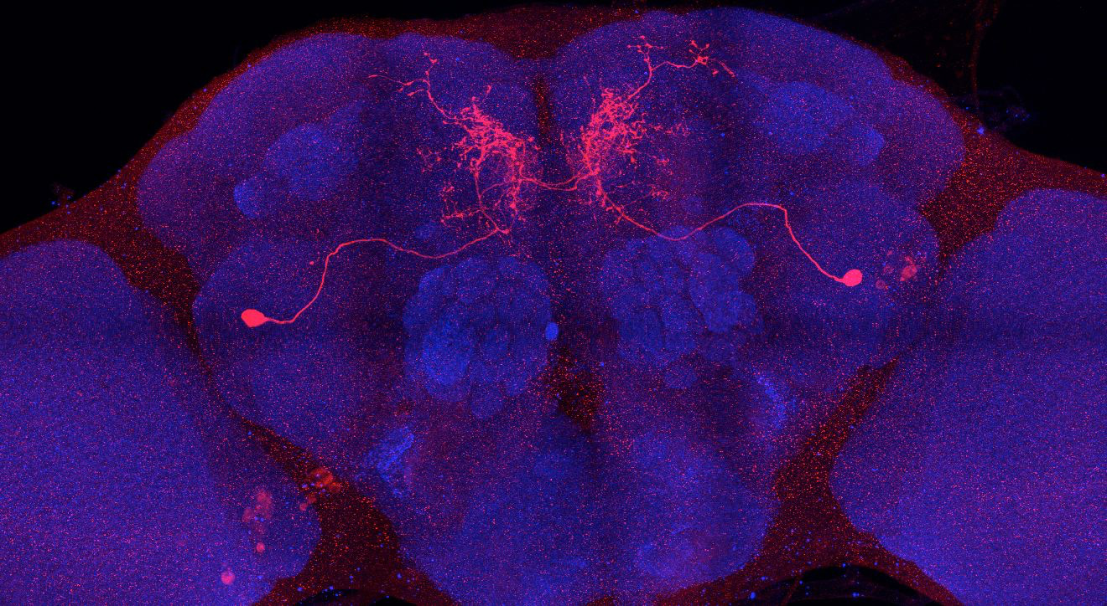
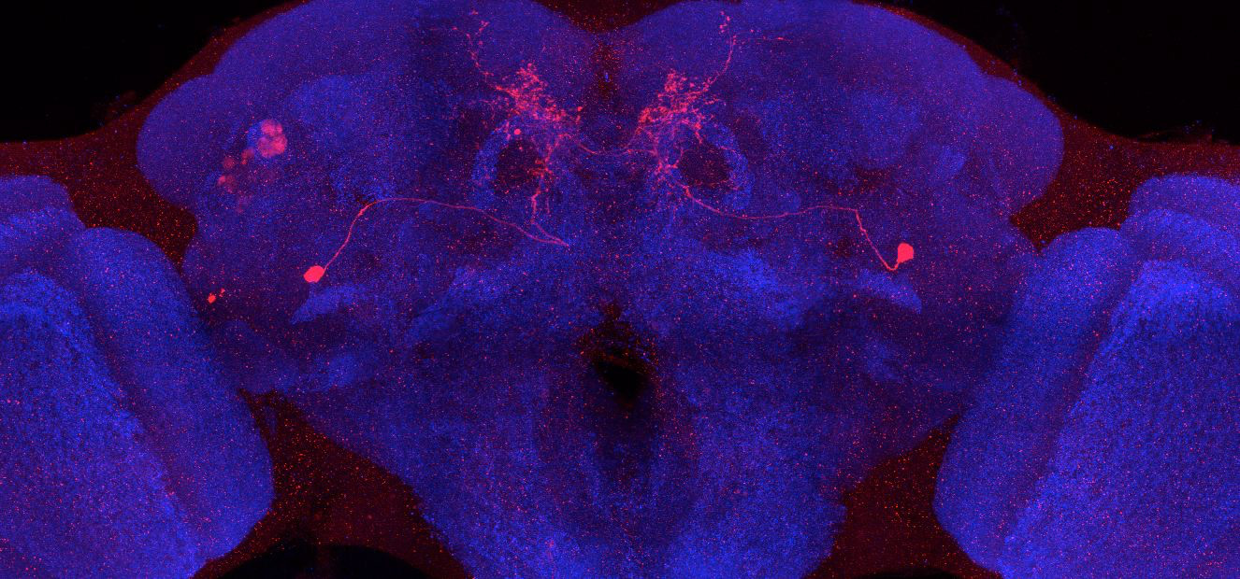
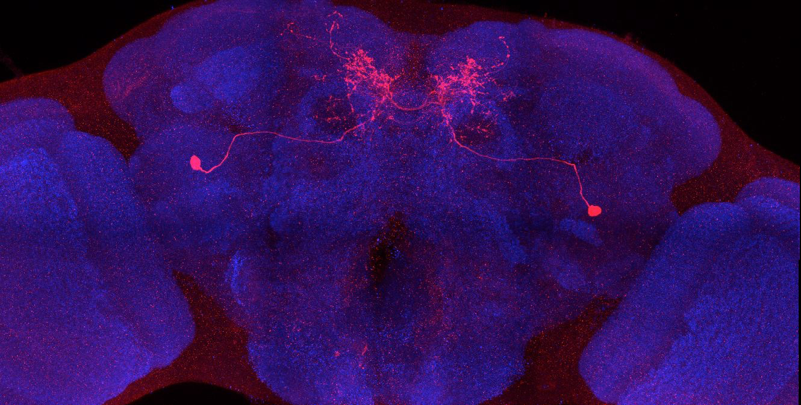
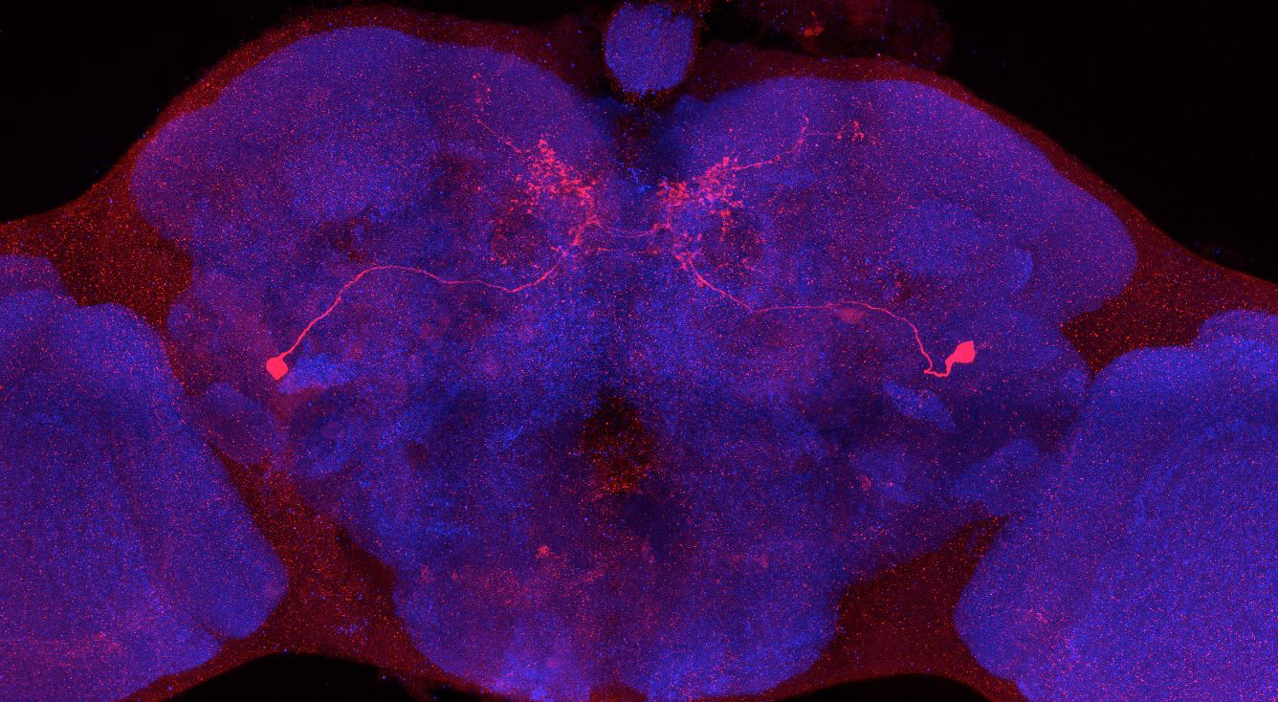
Adult immortalized anatomy of larval neuron MBON-a1
MBON-a2
DAN-d1: axon tufts
DAN-d1
SS01417_Brain 1
SS01417_Brain 2
SS01417_Brain 3
SS00867_Brain 1
SS00867_Brain 2
SS01417_Brain 4
SS00867_Brain 3

