Slide 1
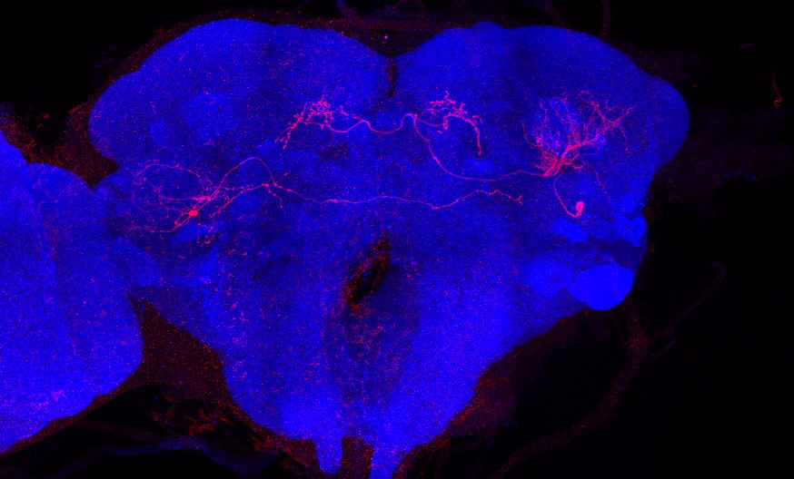
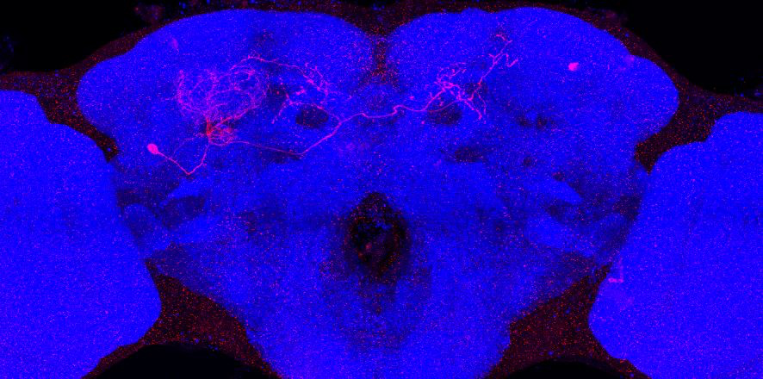
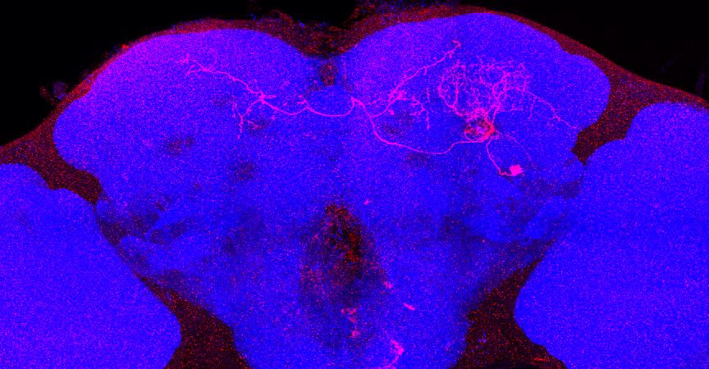
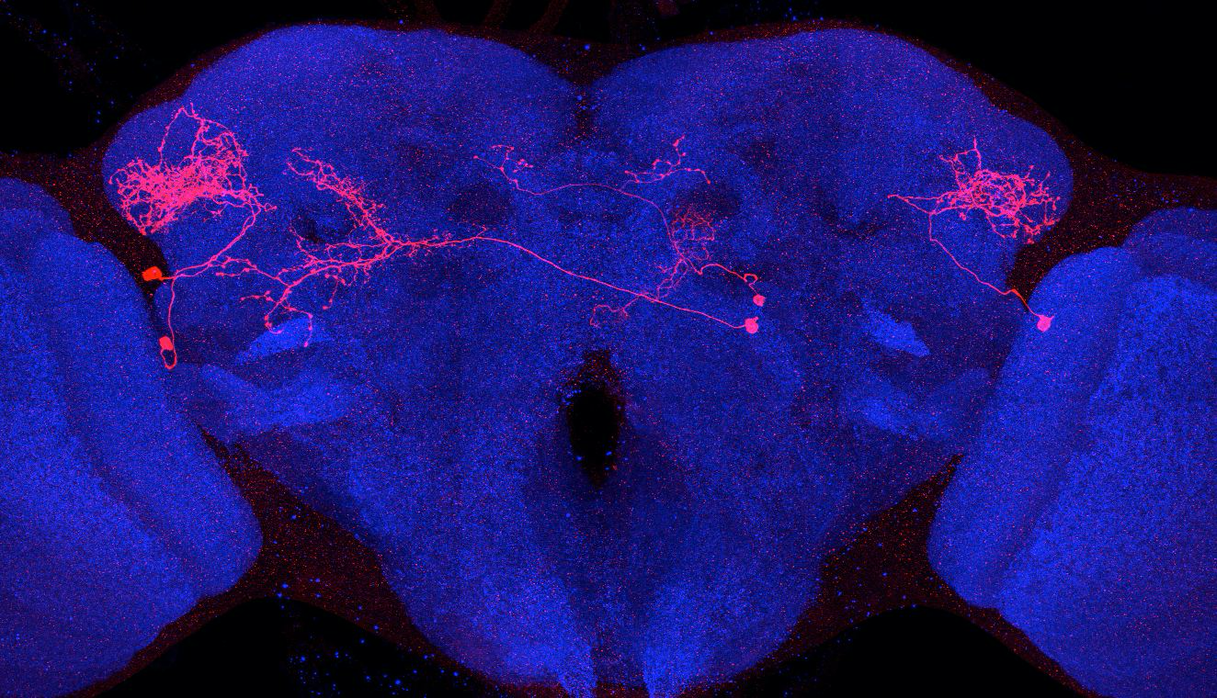
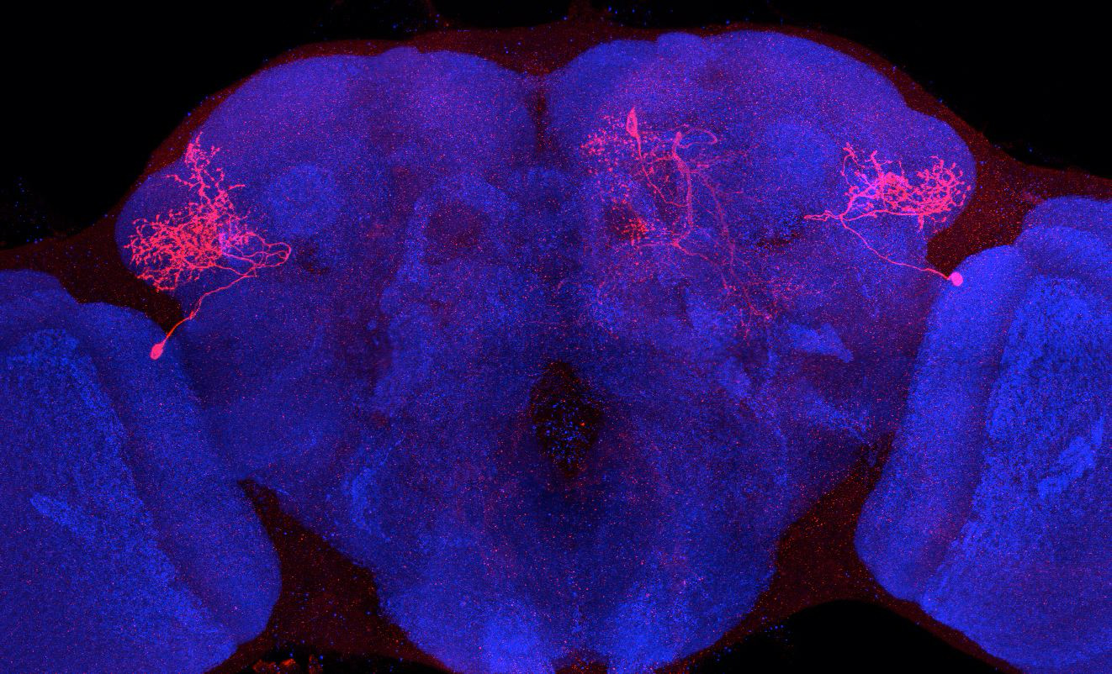
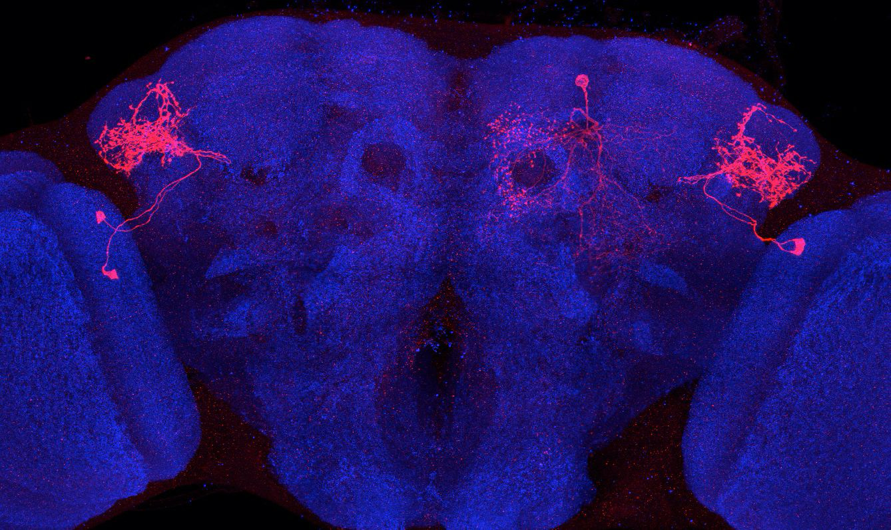
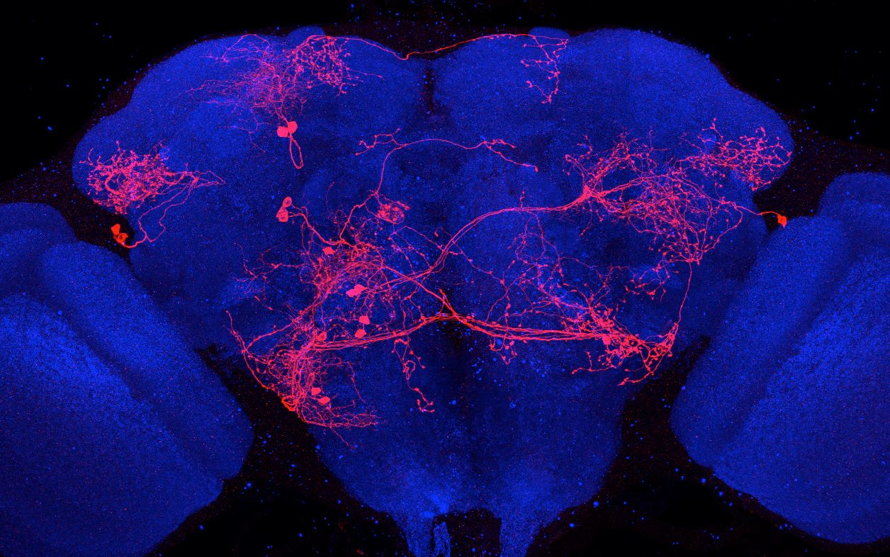
Adult immortalized anatomy of larval neuron MBON-a2
SS02006_Brain 1
SS02006_Brain 2
SS00872_Brain 1
Adult immortalized anatomy of larval neurons MBON-b1, -b2
SS01959_Brain 1
SS01708_Brain 1
SS01708_Brain 2
SS01959_Brain 2

