Slide 1
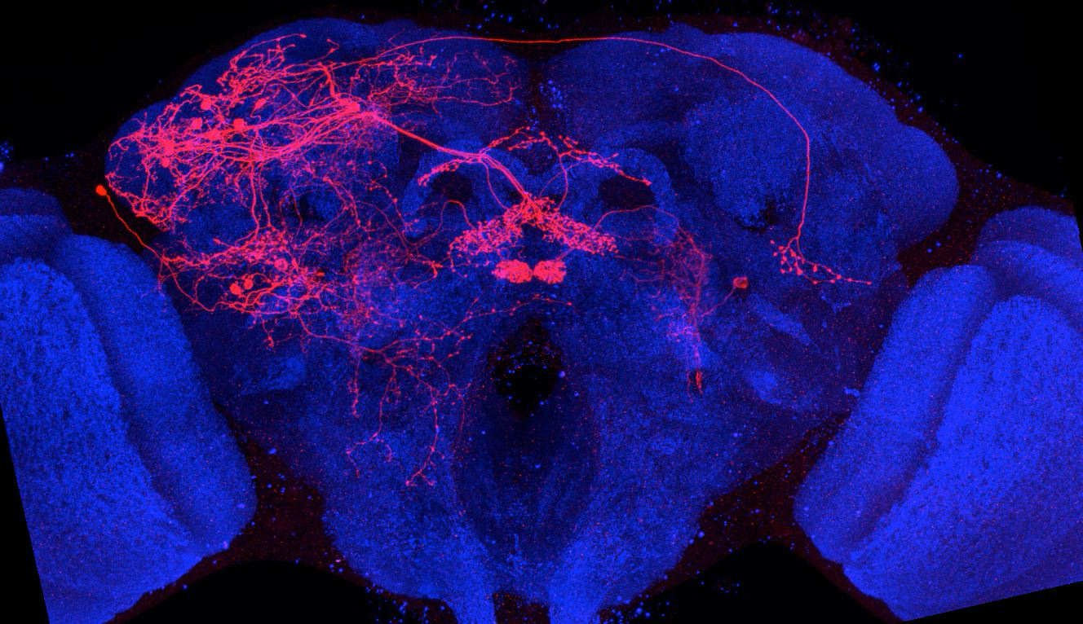
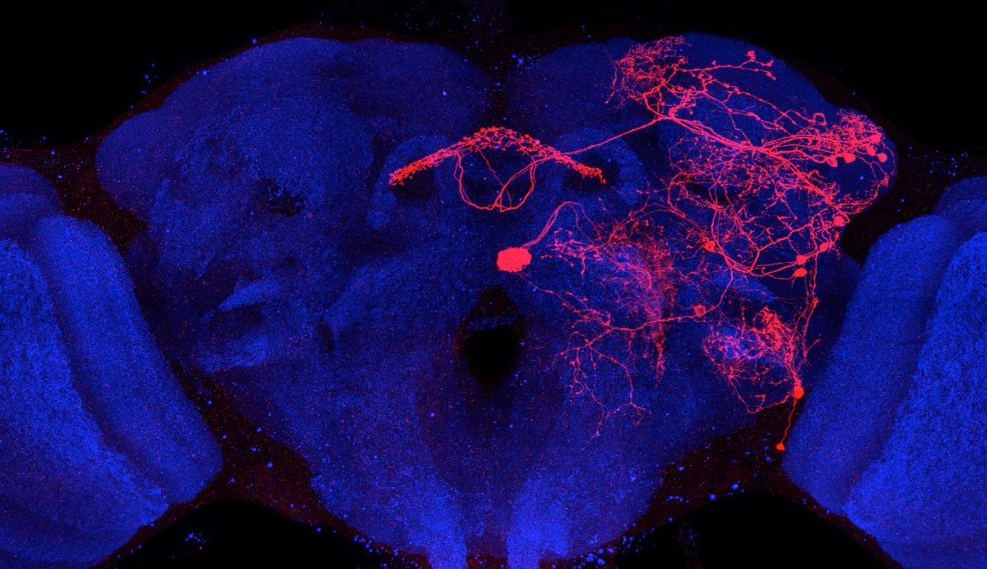
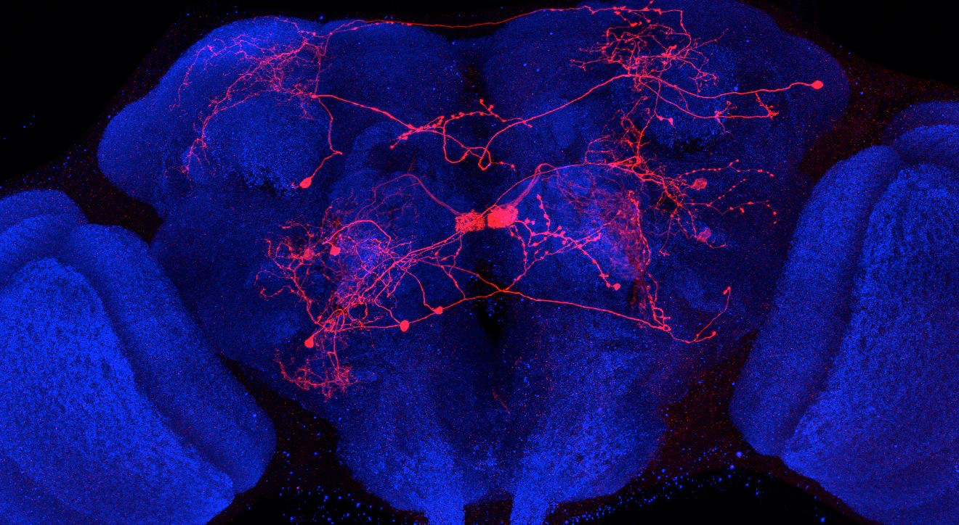
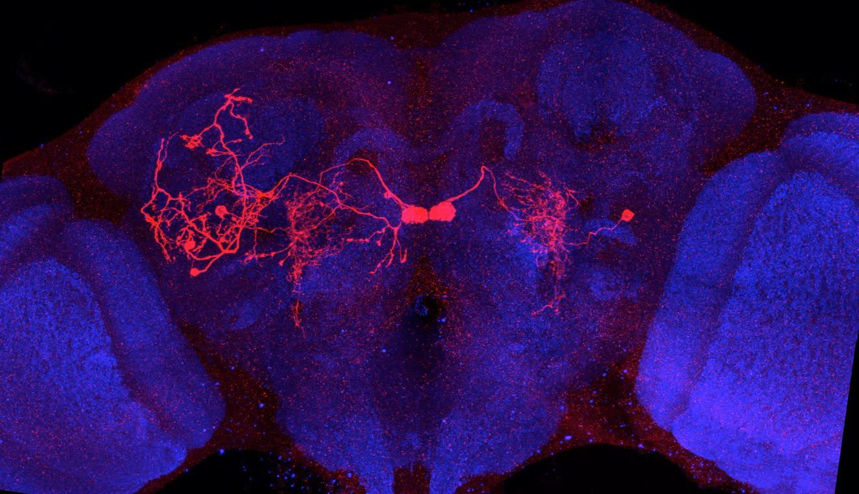
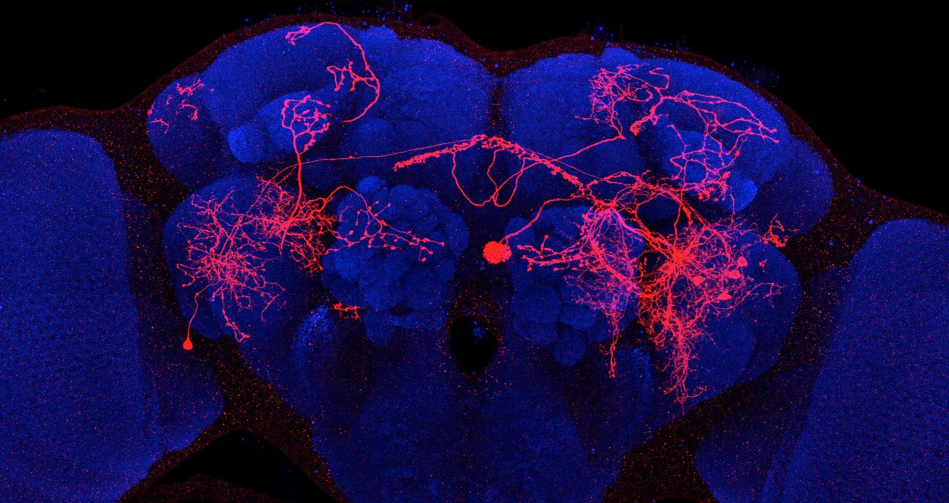
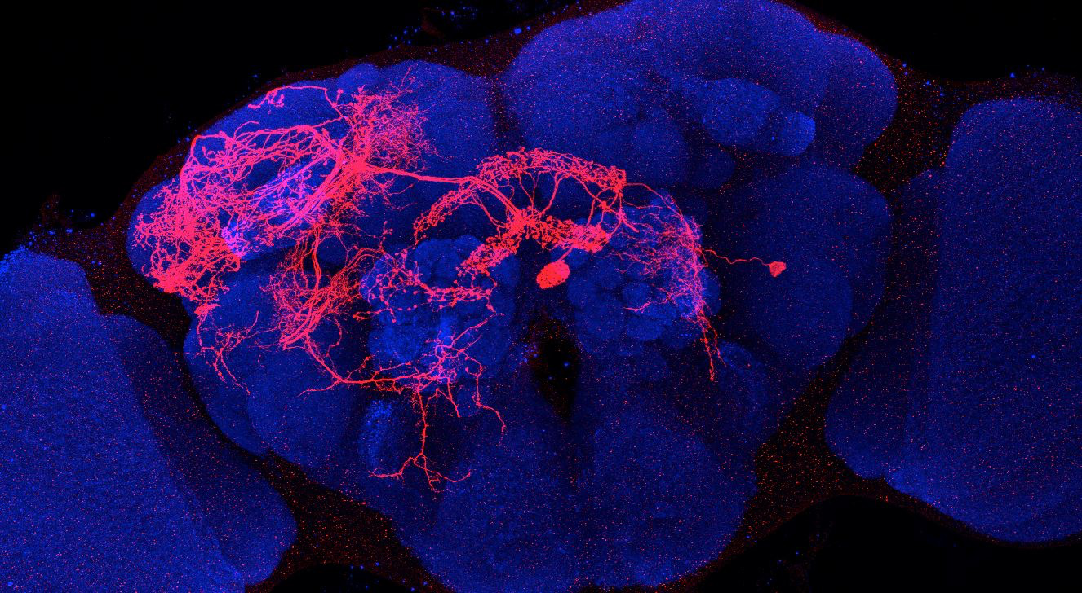
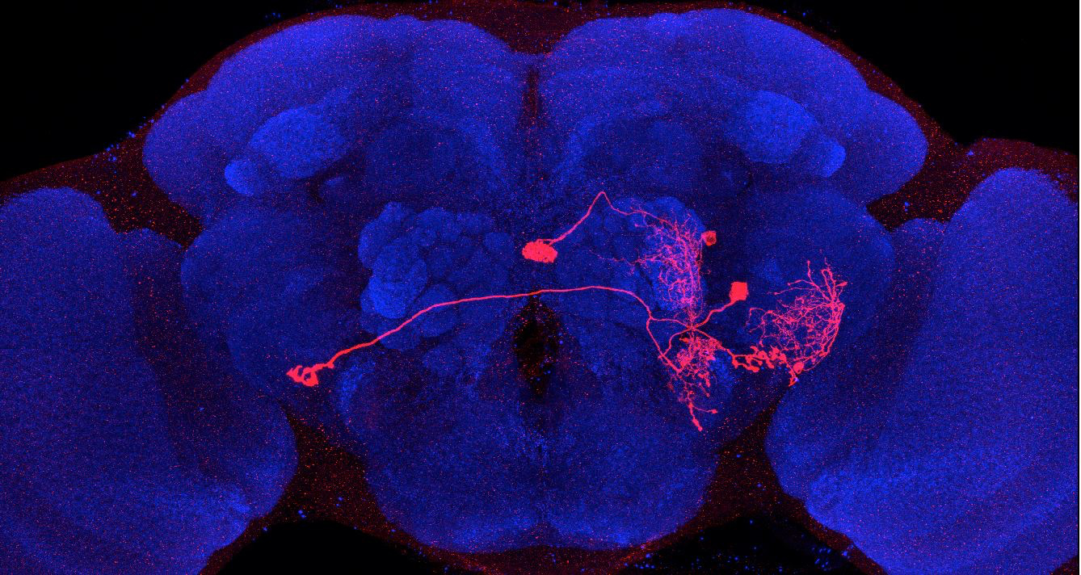
Adult immortalized anatomy of larval neurons MBON-g1, -g2
MBON-g dendritic tufts
SS02130_Brain 1
SS02130_Brain 1
SS02130_Brain 2
SS02130_Brain 3
SS02121_Brain 1
SS02121_Brain 2
SS02130_Brain 4
SS02121_Brain 3

