Slide 1
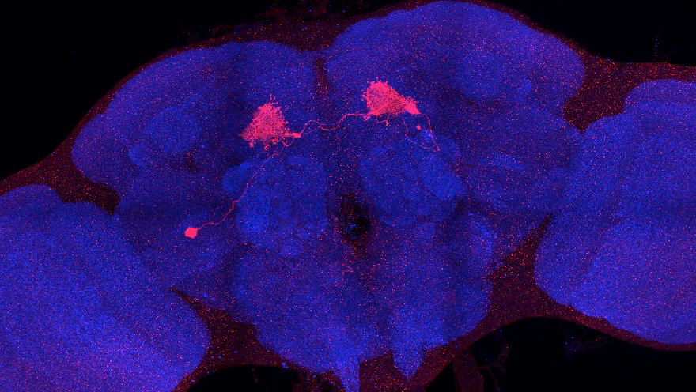
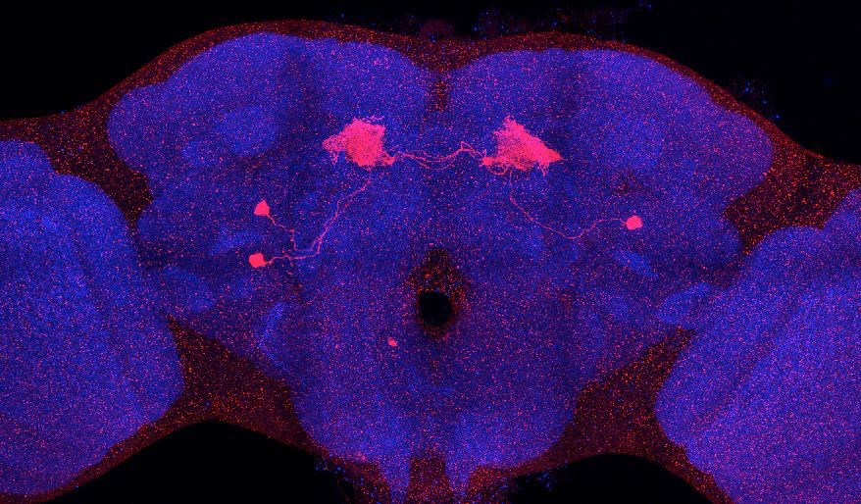
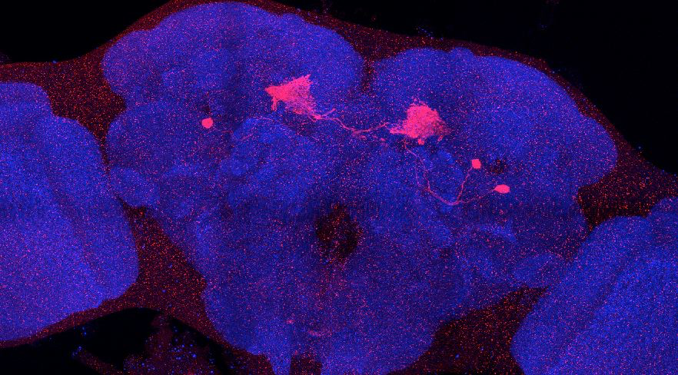
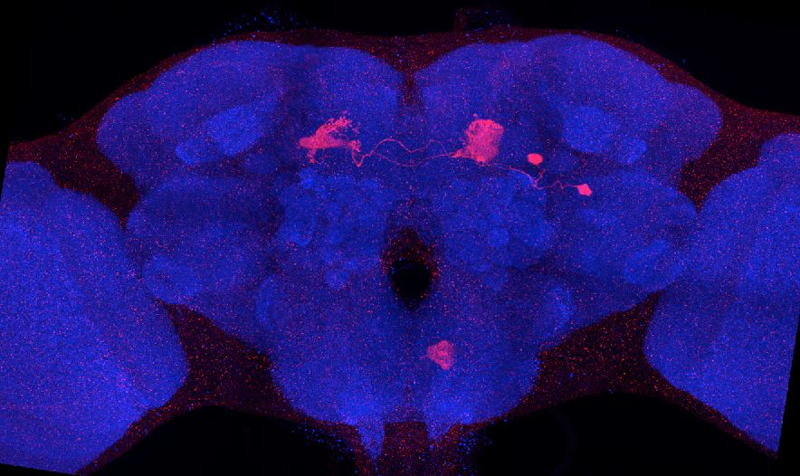
Adult immortalized anatomy of larval neurons MBON-h1,h2
SS01725_Brain 1
SS01725_Brain 2
SS01725_Brain 3
SS01725_Brain 4

