Slide 1
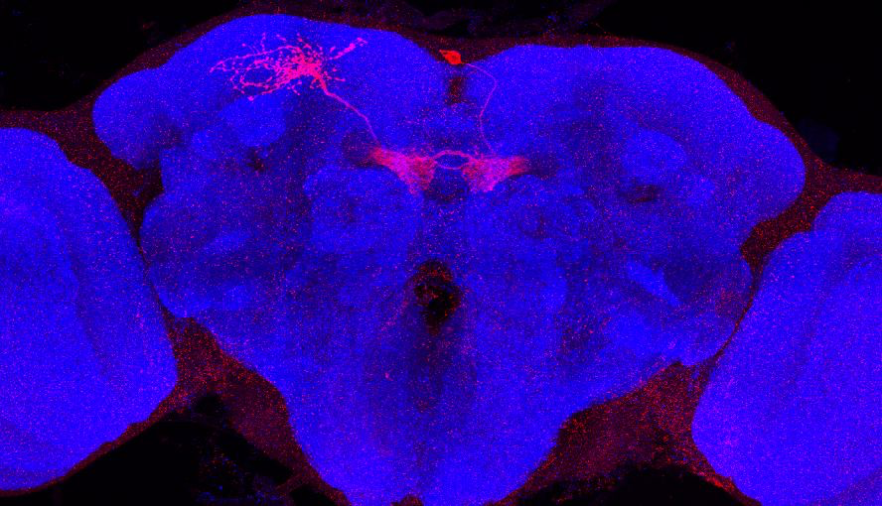
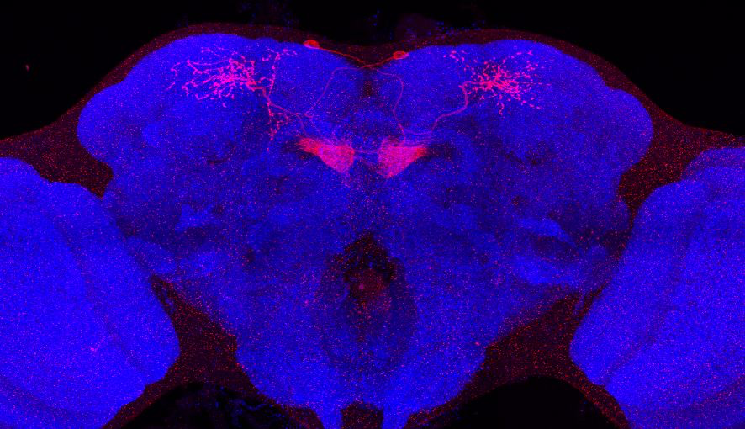
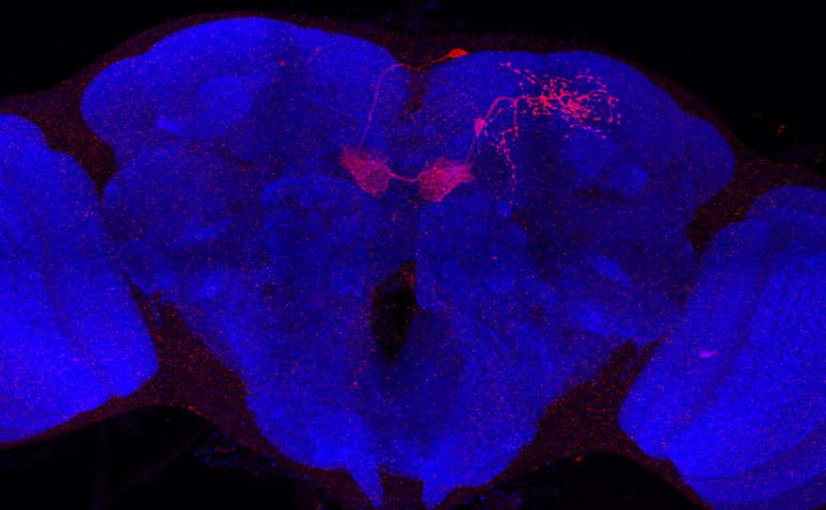
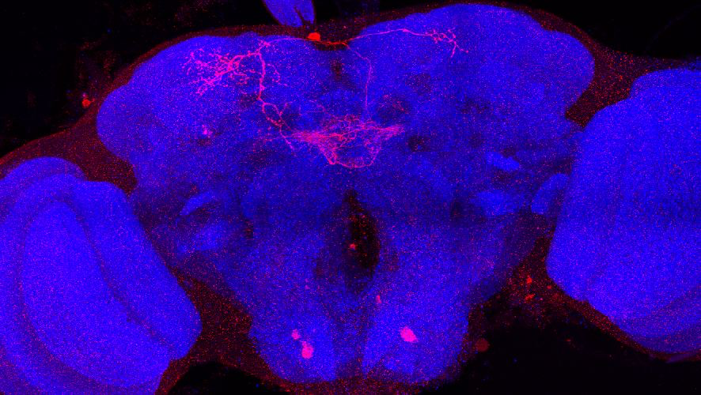
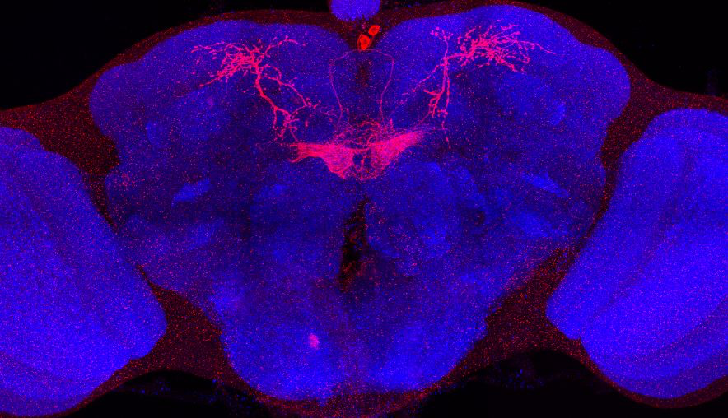
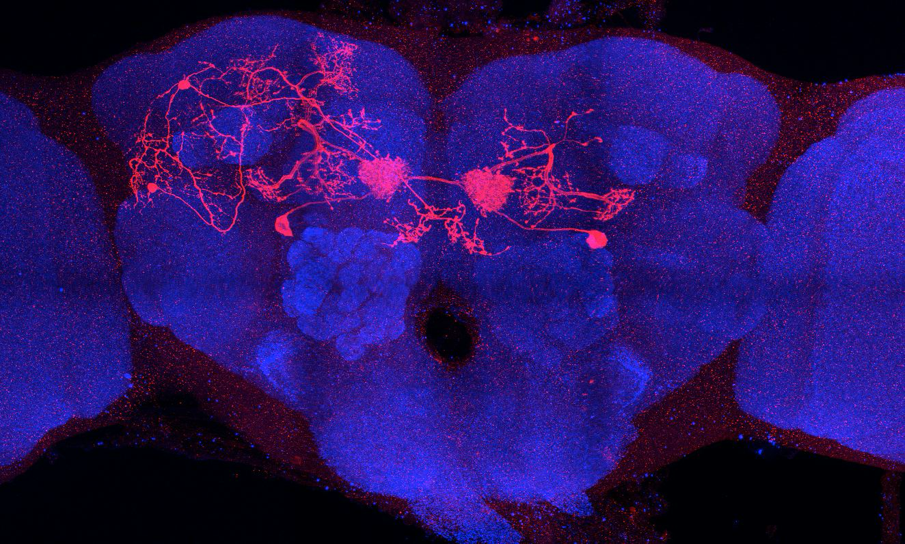
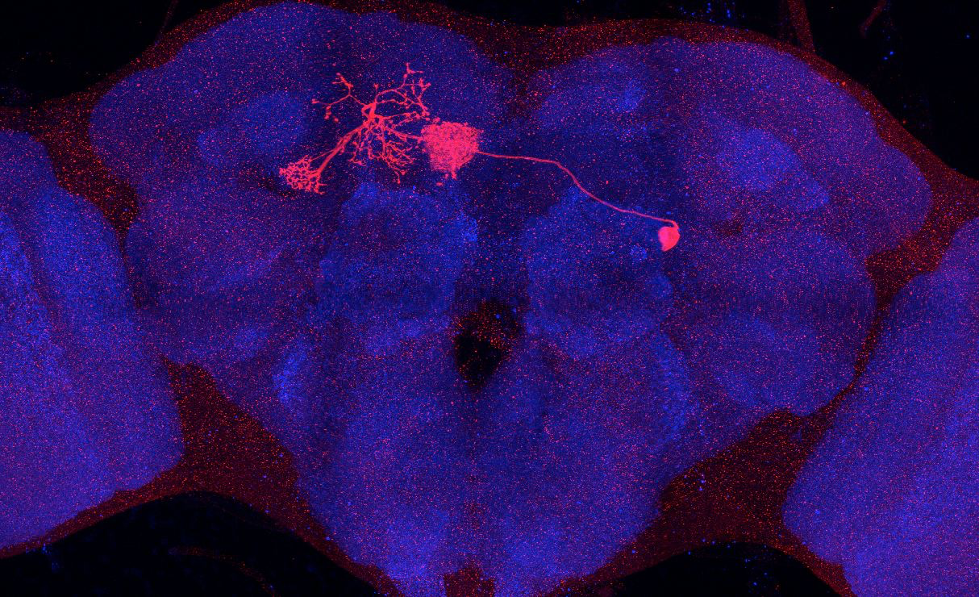
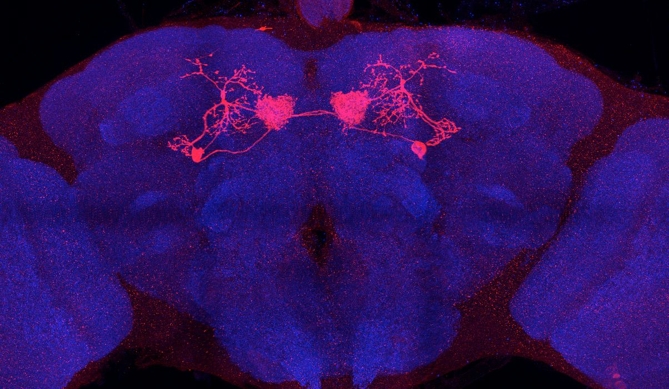
Adult immortalized anatomy of larval neuron MBON-j1
SS01973_Brain 1
SS01973_Brain 2
SS01973_Brain 3
SS01973_Brain 4
SS01973_Brain 5
Adult immortalized anatomy of larval neuron MBON-j2
SS00860_Brain 1
SS00860_Brain 2
SS00860_Brain 3

