Slide 1
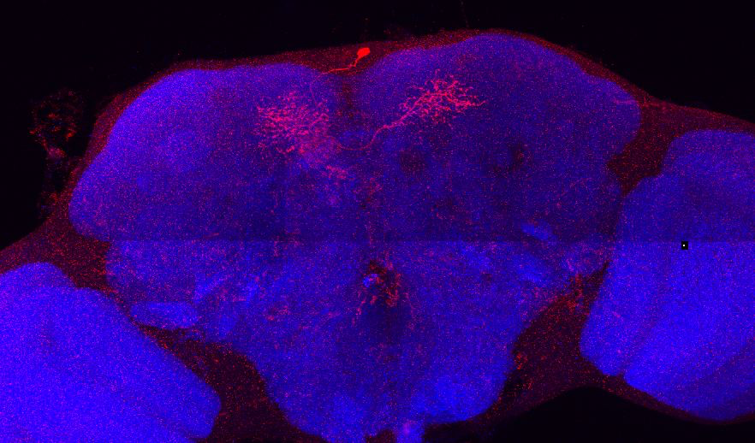
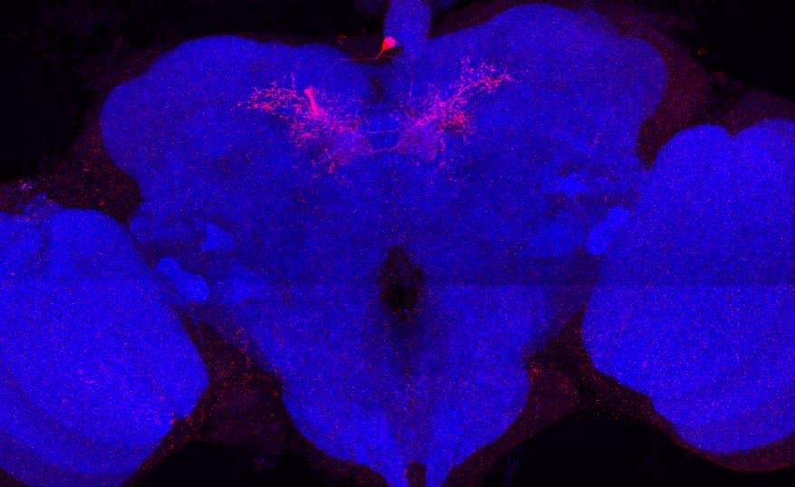
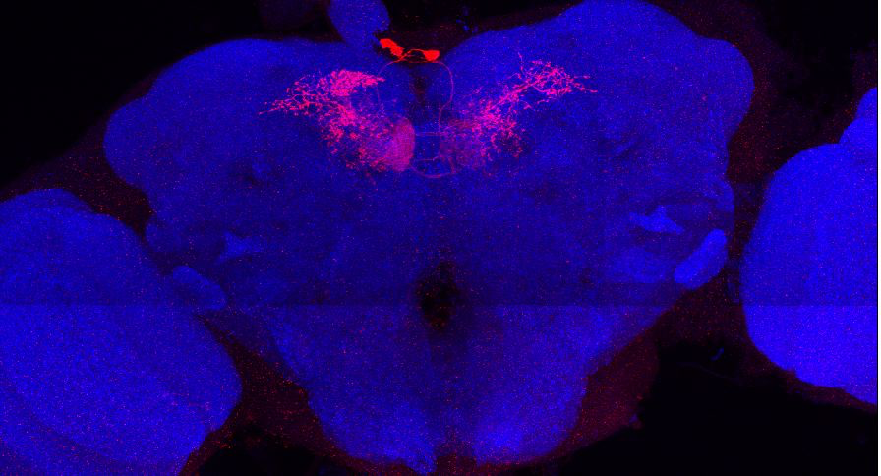
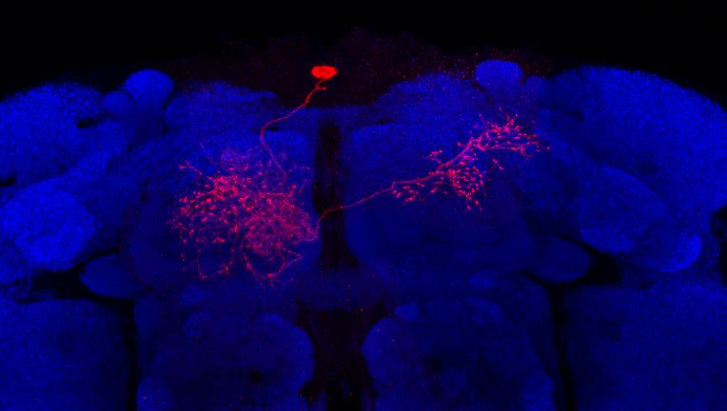
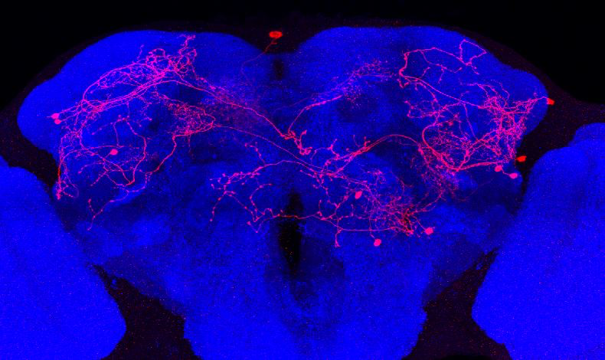
Adult immortalized anatomy of larval neurons MBON-i1 and MBON-k1
MBON-i1
MBON-i1
MBON-i1
MBON-i1
MBON-i1
MBON-k1
SS01962_Brain 1
SS01962_Brain 2
SS01962_Brain 3
Adult immortalized anatomy of larval neuron MBON-i1
MBON-i1
SS04236_Brain 1
SS04236_Brain 2

