Slide 1
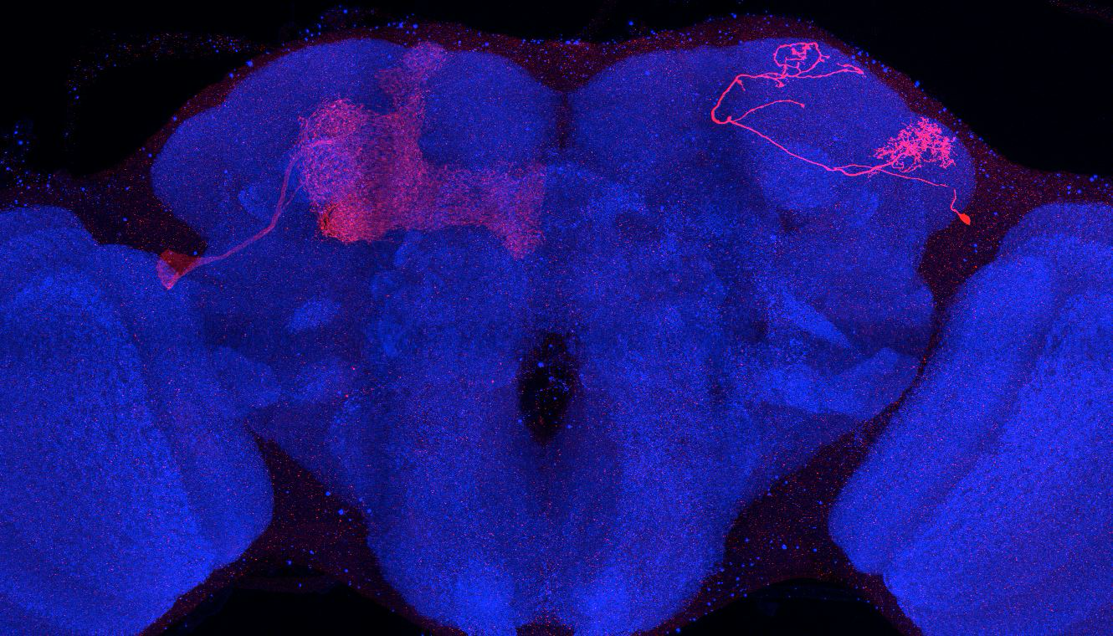
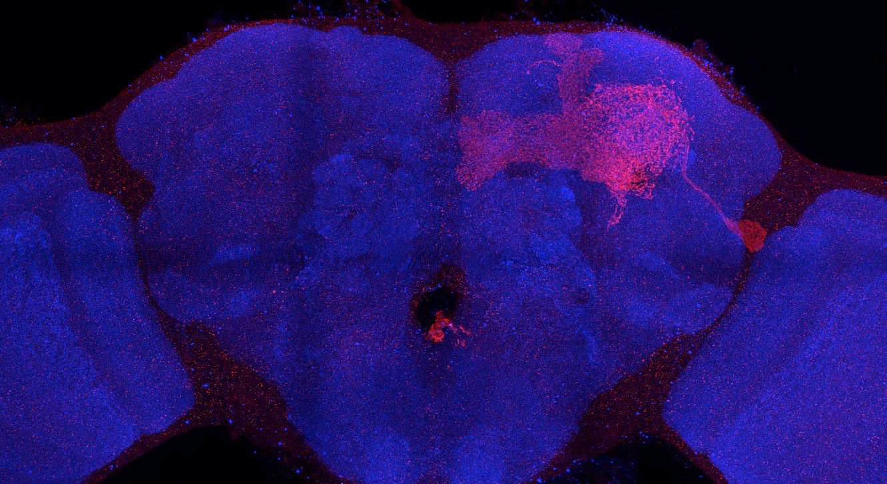
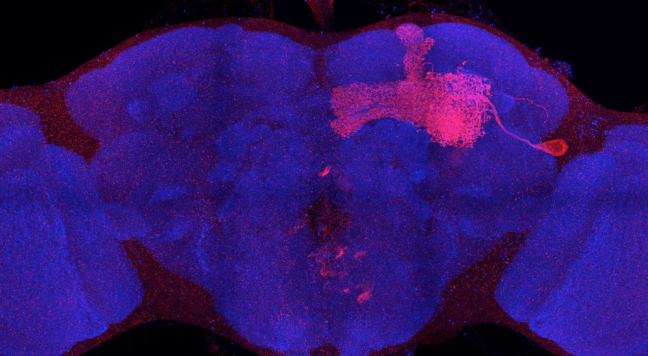
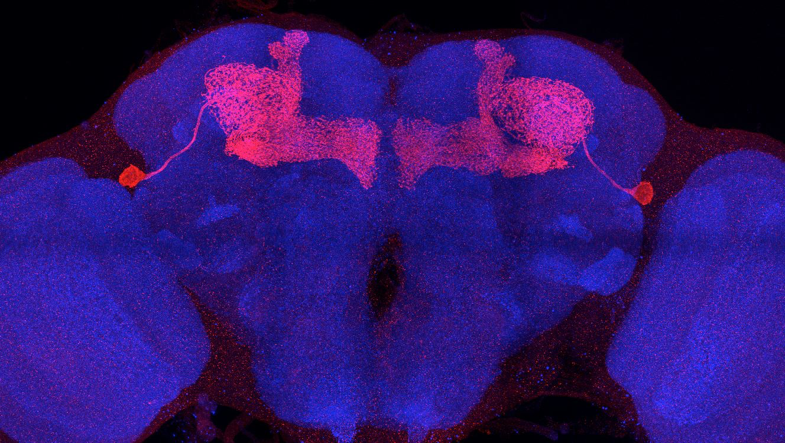
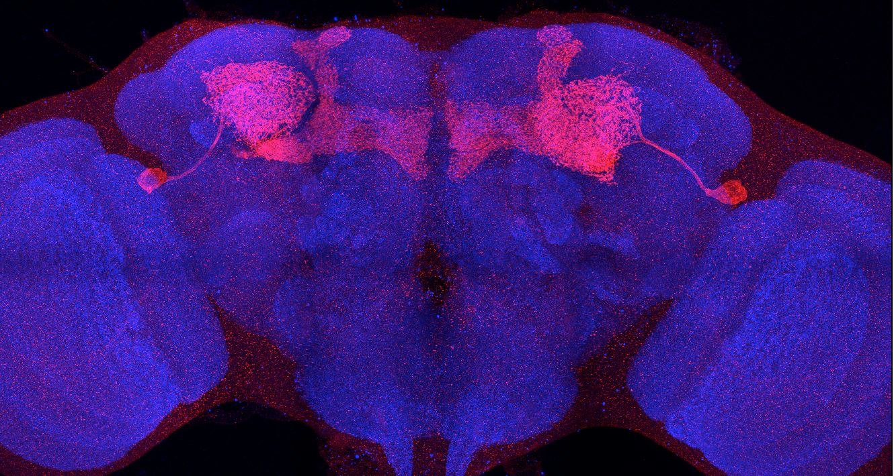
Adult immortalized anatomy of larval neuron APL
MBON-i1
SS01962_Brain 1
SS01671_Brain 2
SS01671_Brain 3
SS01671_Brain 1
SS01671_Brain 4
SS01671_Brain 5

