Slide 1
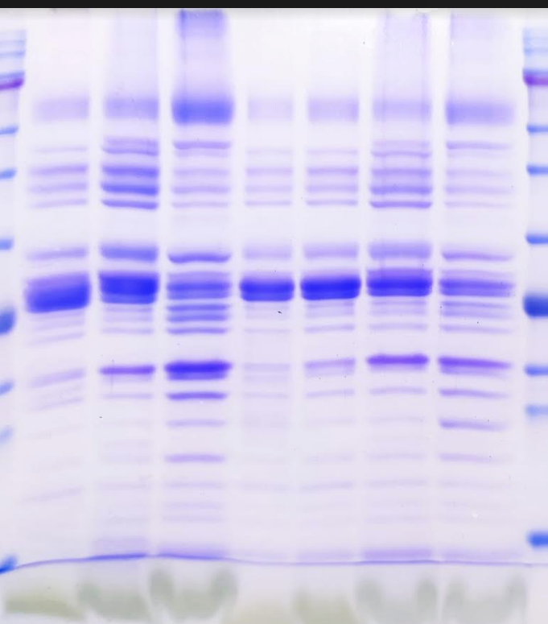

Slide 2
As Bs Cs
1b 2b 3b 4b
75
63
48
35
25
20
17
11

