Slide 1
Fig 1A
A
Sham
TAC
SIRT1
SIRT2
SIRT3
HPRT

Slide 2
Figure 1A
Sham
TAC
SIRT6
GAPDH

Slide 3
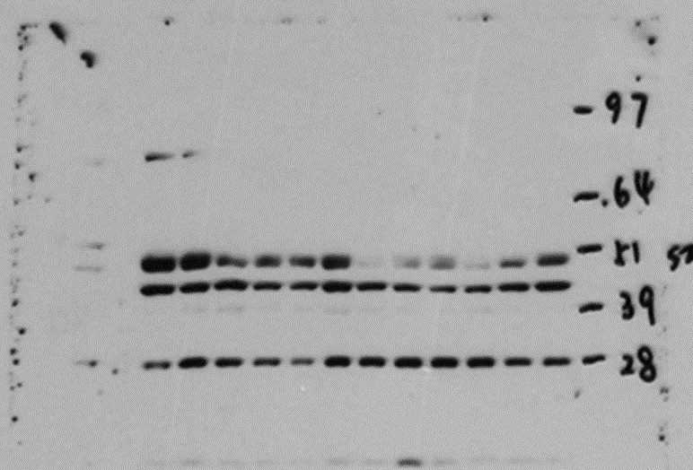
Figure 1B
Non-HF
HF
SIRT2
GAPDH

Slide 4
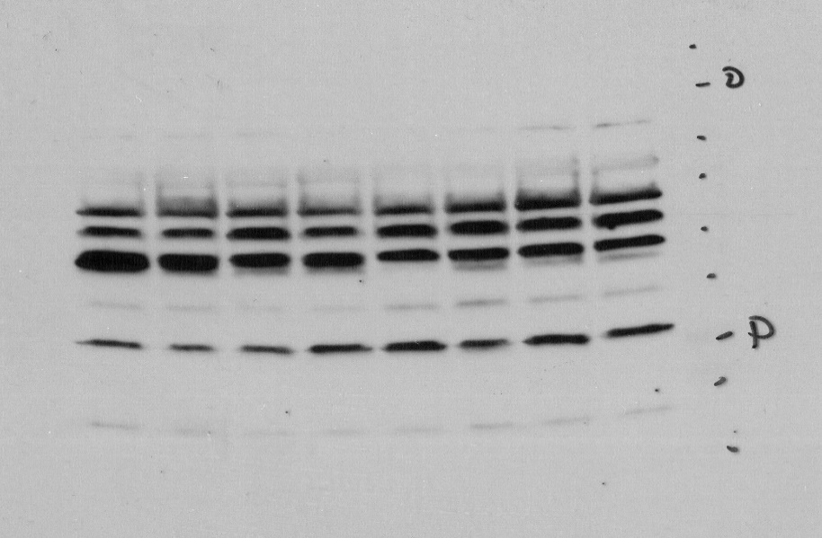
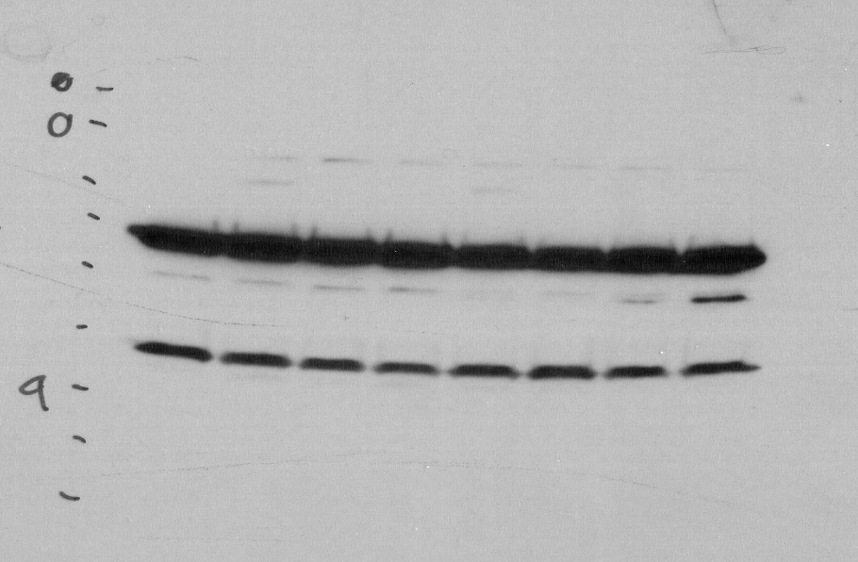
Figure 1C
Non-Failing
Ischemic CM
SIRT2
HPRT1

