Slide 1
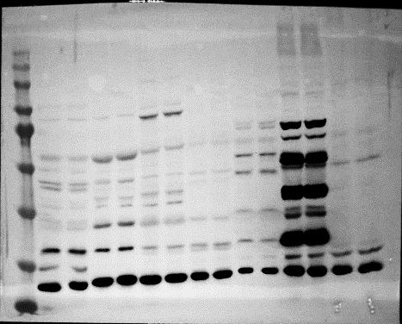
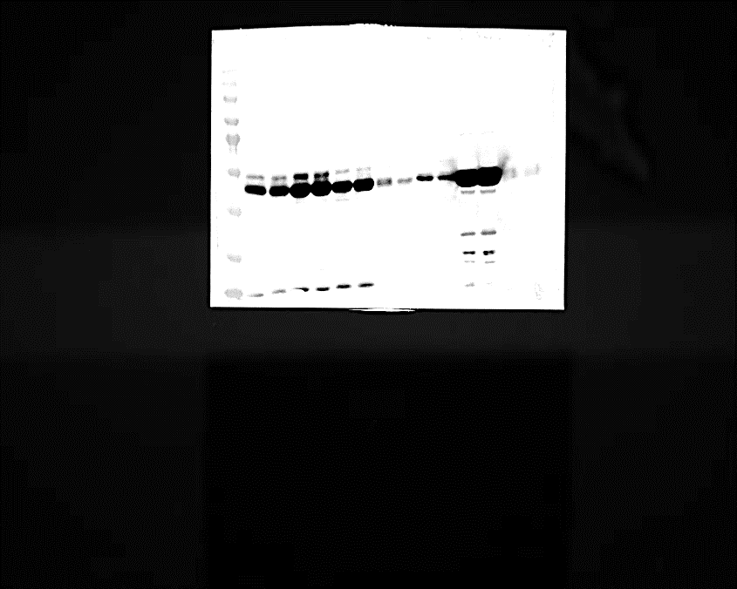
Sirt2
GAPDH
Notes:
Control is Sirt2 KO mice heart, it is a negative control.

Slide 2
Sirt2
GAPDH

