Slide 1
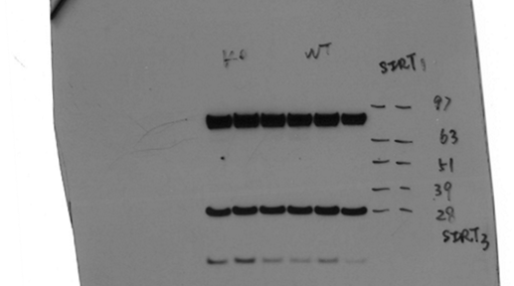
Figure 2-Supplemental Figure 1
WT
Sirt2^{-/-}
WT
Sirt2^{-/-}

