Slide 1
Figure 5A
WT
IP: IgG
SIRT2
Input
NRF2
SIRT2

Slide 2
Figure 5B
IP: anti-Acetyl
IP: IgG
Input
WT
SIRT2^{-/-}
SIRT2^{-/-}
WT
WT
GAPDH

Slide 3
Figure 5C
NRF2

Slide 4
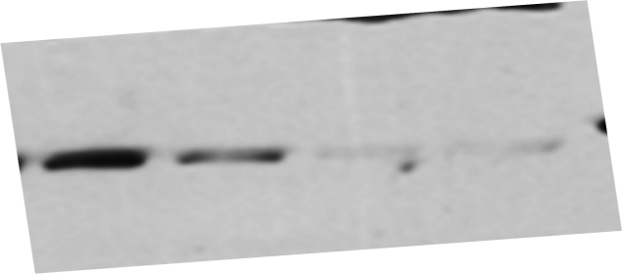
Control siRNA
SIRT2 siRNA
Figure 5D
NRF2
SIRT2
β-actin

Slide 5
Control siRNA
SIRT2 siRNA
Figure 5E
NRF2
TBP

