Slide 1
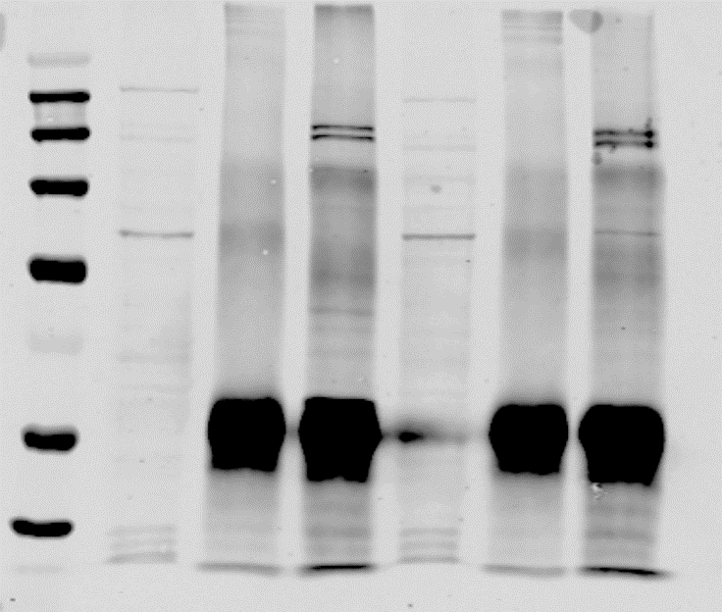
+NEM
-NEM
+NEM
-NEM
Input
ZMYM2
ZMYM2
Input
ZMYM2
ZMYM2
IgG
Input
IgG
kDa
IgG
Input
IgG
kDa
300
300
250
250
180
180
130
130
100
100
70
70
50
50
40
40
IB ADNP
IB ZMYM2
C
IP
Input
ZMYM2
IgG
250-
180-
IB: ZMYM2
180-
IB: ADNP
130-
1
2
3
Figure 1C-source data 1. Raw unedited images of Co-immunoprecipitation analysis of ADNP with ZMYM2. Resulting proteins were detected by immunoblotting (IB) with ZMYM2 and ADNP antibodies. The regions used for creating the final figure are boxed. Molecular weight marker sizes (kDa) are shown on the left.

Slide 2
+NEM
-NEM
+NEM
-NEM
Input
Input
ZMYM2
ZMYM2
ZMYM2
ZMYM2
Input
IgG
IgG
Input
IgG
IgG
kDa
kDa
300
300
250
250
180
180
130
130
100
100
70
70
50
50
40
40
IB ZMYM2
IB TRIM28
+NEM
-NEM
ZMYM2
ZMYM2
Input
Input
IP:
IgG
IgG
250-
180-
IB: ZMYM2
Figure 4A-source data 1. Raw unedited images of Co-immunoprecipitation analysis of TRIM28 with ZMYM2. Resulting proteins were detected by immunoblotting (IB) with ZMYM2 and TRIM28 antibodies. The regions used for creating the final figure are boxed. Molecular weight marker sizes (kDa) are shown on the left.
130-
IB: TRIM28
100-
1
2
3
4
5
6

Slide 3
+NEM
+NEM
+NEM
Input
IgG
ZMYM3
Input
IgG
ZMYM3
Input
IgG
ZMYM3
kDa
kDa
300
250
250
180
180
130
130
100
100
70
50
IB ADNP
40
IB ZMYM3
IB TRIM28
B
Input
ZMYM3
M
IgG
Source data for Figure 1-figure supplement 1B. Raw unedited images of Co-immunoprecipitation analysis of ADNP with ZMYM3. Resulting proteins were detected by immunoblotting (IB) with ZMYM3 and TRIM28 antibodies. The regions used for creating the final figure are boxed. Molecular weight marker sizes (kDa) are shown on the left.
250-
αZMYM3
180-
180-
αADNP
130-

Slide 4
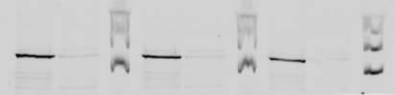

siNT
siADNP
siNT
siADNP
siNT
siADNP
kDa
M
M
M
300
250
αADNP
180
130
100
70
αTublin
50
40
Exp1
Exp2
Exp3
C
siADNP
siADNP
siADNP
siNT
siNT
siNT
M
M
M
αADNP
Source data for Figure 1-figure supplement 1C. Raw unedited images of Western blot of ADNP expression in U2OS cells following treatment with siADNP or a non-targeting (NT) siRNA (top). αTubulin was used as a loading control (bottom). Molecular weight markers (M) are shown. The regions used for creating the final figure are boxed. Molecular weight marker sizes (kDa) are shown on the right.
αTubulin
Exp1
Exp2
Exp3

Slide 5

+NEM
-NEM
Input
ZMYM2
ZMYM2
IgG
Input
IgG
kDa
300
250
180
130
100
70
50
40
IB: ZMYM2
Figure 3-figure supplement 1C-source data 1. Raw unedited images of Co-immunoprecipitation analysis of TRIM28 with ZMYM2. Resulting proteins were detected by immunoblotting (IB) with ZMYM2 antibody. This is a longer exposure of Fig. 4A top panel to better visualize the input protein. The regions used for creating the final figure are boxed. Molecular weight marker sizes (kDa) are shown on the left.
A
+NEM
-NEM
ZMYM2
ZMYM2
Input
Input
IP:
IgG
IgG
250-
IB: ZMYM2
180-
1
2
3
4
5
6
7

Slide 6
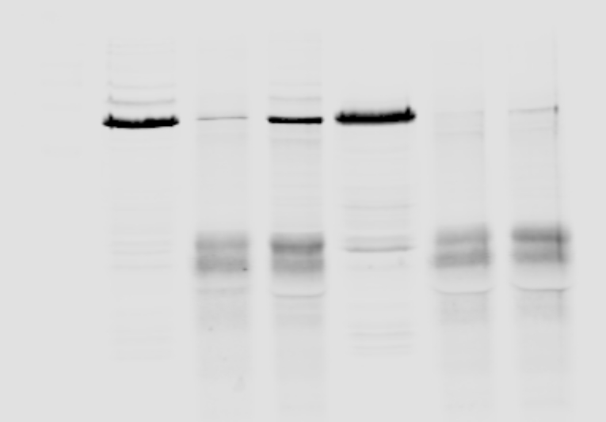

+NEM
-NEM
+NEM
-NEM
Input
IgG
ZMYM2
Input
IgG
ZMYM2
: IP
Input
IgG
ZMYM2
Input
IgG
ZMYM2
: IP
M
M
kDa
300
250
180
130
100
70
50
40
IB: SUMO2
IB: TRIM28
B
+NEM
-NEM
ZMYM2
ZMYM2
Input
Input
M
IgG
IgG
: IP
250-
180-
100-
250-
IB: TRIM28
180-
100-
Figure 3-figure supplement 1B-source data 1. Raw unedited images of Co-immunoprecipitation analysis of TRIM28 or SUMO2 with ZMYM2. Resulting proteins were detected by immunoblotting (IB) with SUMO2 or TRIM28 antibodies. The regions used for creating the final figure are boxed. Molecular weight marker sizes (kDa) are shown on the left.
1
2
3
4
5
6
7

Slide 7
EGFPC1-ZMYM2
EGFPC1-ZMYM2
NMYM 1-824aa
NMYM 1-824aa
WT
SIM123
PV-del
SIM2
-
WT
SIM123
PV-del
SIM2
-
kDa
180
130
100
IP TRIM28 IB GFP
IP TRIM28 IB TRIM28
C
EGFPC1-ZMYM2
-
WT
SIMmut
IP:
TRIM28
IB: GFP
IB: TRIM28
Figure 3-figure supplement 1C (top)-source data 2. Raw unedited images of co-immunoprecipitation (IP) analysis of endogenous TRIM28 with the indicated EGFP-tagged ZMYM2 proteins. IPs (top) were immunoblotted (IB) with the indicated antibodies. Resulting proteins were detected by immunoblotting (IB) with GFP or TRIM28 antibodies. The regions used for creating the final figure are boxed. Molecular weight marker sizes (kDa) are shown on the left.
IB: GFP
Input
IB: TRIM28
IB: β-Actin

Slide 8
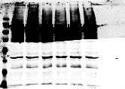
EGFPC1-ZMYM2
NMYM 1-824aa
EGFPC1-ZMYM2
SIM123
PV-del
SIM2
NMYM 1-824aa
EGFPC1-ZMYM2
NMYM 1-824aa
-
WT
SIM123
PV-del
SIM2
SIM123
PV-del
-
WT
-
WT
SIM2
IB: GFP
IB: TRIM28
IB: β-Actin
C
EGFPC1-ZMYM2
-
WT
SIMmut
IP:
TRIM28
IB: GFP
IB: TRIM28
IB: GFP
Figure 3-figure supplement 1C (bottom)-source data 3. Raw unedited images of co-immunoprecipitation (IP) analysis of endogenous TRIM28 with the indicated EGFP-tagged ZMYM2 proteins. Input samples were immunoblotted (IB) with the indicated antibodies. The regions used for creating the final figure are boxed.
Input
IB: TRIM28
IB: β-Actin

Slide 9
+NEM
Input
IgG
ZMYM3
kDa
M
:IP
300
250
180
130
100
70
50
IB: TRIM28
F
+NEM
ZMYM3
Figure 3-figure supplement 1F-source data 1. Raw unedited images of co-immunoprecipitation analysis of TRIM28 with ZMYM3. Immunoprecipitation (IP) was performed with ZMYM2 or control IgG antibody from U2OS cells in the presence of NEM and the resulting TRIM28 detected by immunoblotting (IB). 10% input is shown. The regions used for creating the final figure are boxed. Molecular weight marker sizes (kDa) are shown on the left.
IgG
M
Input
: IP
130-
100-
IB: TRIM28

Slide 10
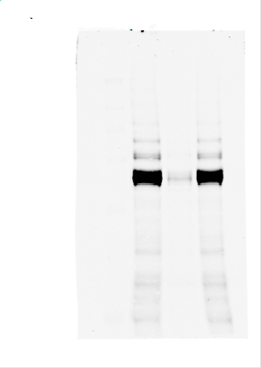
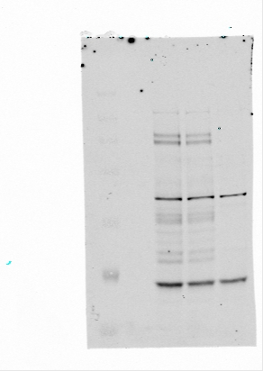
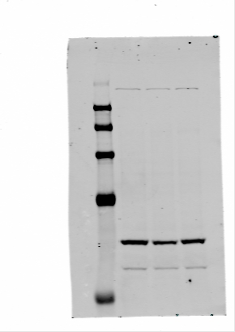
G
siZMYM2
siZMYM2
siTRIM28
siTRIM28
siZMYM2
siNT
siNT
siNT
siTRIM28
kDa
300
130-
250
180
130
100
70
50
IB: TRIM28
IB: ZMYM2
IB: Lamin B
G
siZMYM2
siNT
siTRIM28
180-
IB: TRIM28
130-
180-
IB: ZMYM2
70-
IB: Lamin B
Figure 3-figure supplement 1G-source data 1. Raw unedited images of Western blot analysis of lysates from U2OS cells treated with the indicated targeting or non-targeting (NT) siRNAs. Lamin B (loading control), TRIM28 and ZMYM2 were detected by immunoblotting (IB). The regions used for creating the final figure are boxed. Molecular weight marker sizes (kDa) are shown on the left.

Slide 11
1st
2nd
3rd
1st
2nd
3rd
Marker
Marker
Marker
Marker
Marker
Marker
siZMYM2:
-
+
-
+
-
+
siZMYM2:
-
+
-
+
-
+
kDa
kDa
180
180
130
130
100
100
70
70
55
55
40
40
35
35
IB: ZMYM2
IB: β-Actin
Figure 5-figure supplement 1A-source data 1. Raw unedited images of Western blot illustrating the knockdown efficiencies of ZMYM2 in the RT-qPCR experiments. β-actin is shown as a loading control. The regions used for creating the final figure are boxed. Molecular weight marker sizes (kDa) are shown on the left.
A
1st
2nd
siZMYM2:
Marker
Marker
-
+
-
+
IB: ZMYM2
180 kDa-
50 kDa-
IB: β-Actin
40 kDa-

