Slide 1
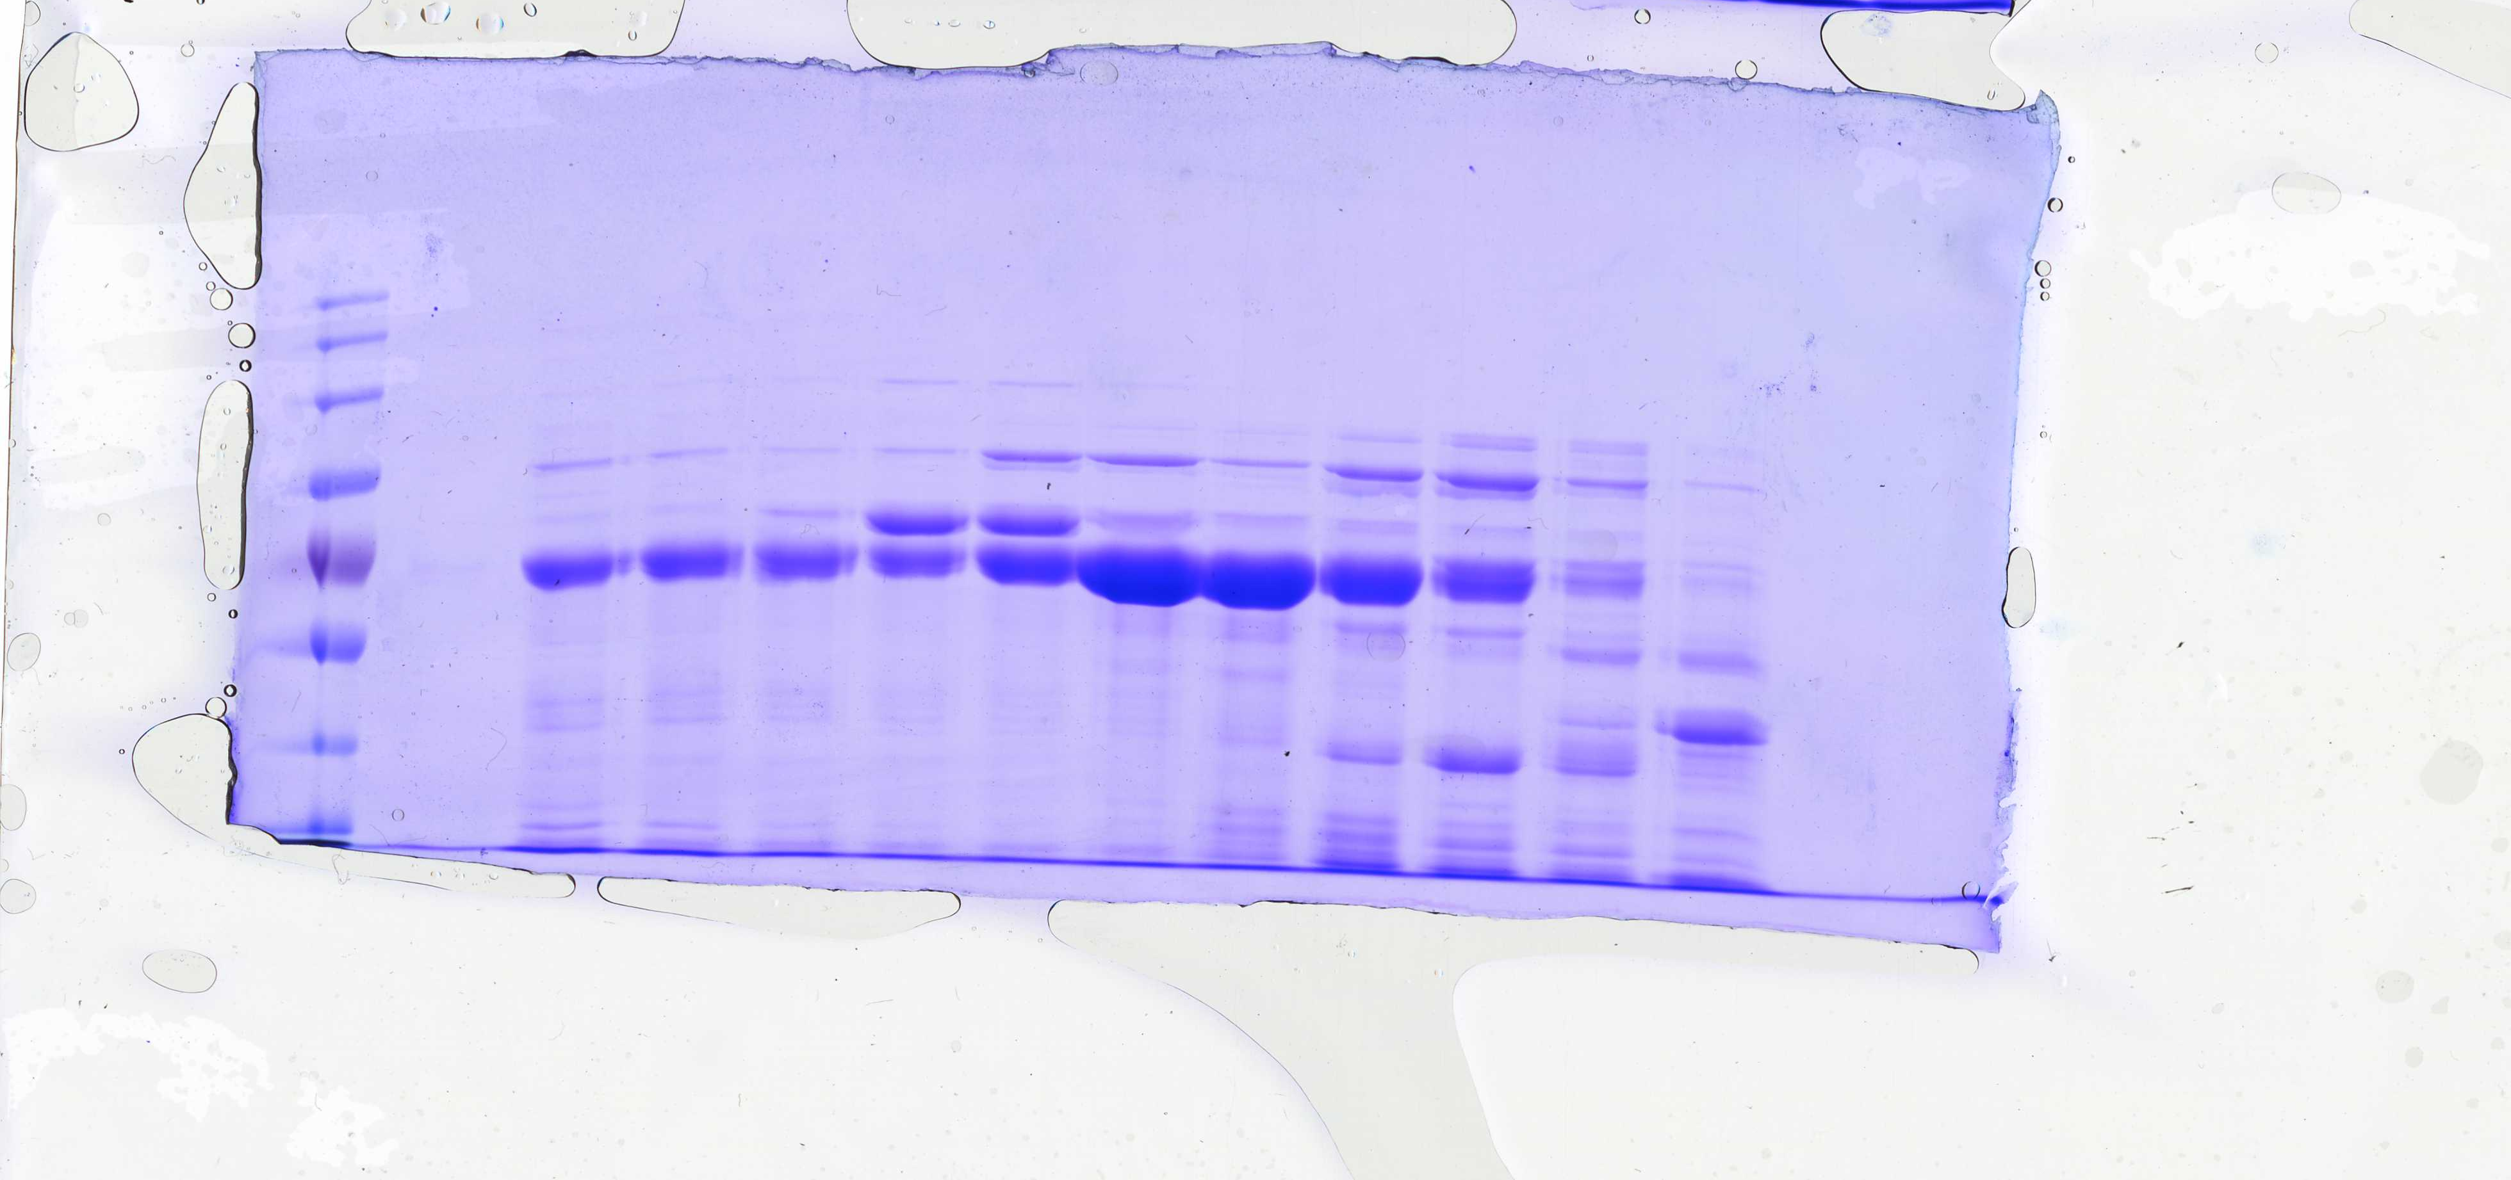
Fig 3B (TOP)
6His-GST-3C DCLK1
(351-689) WT

Slide 2
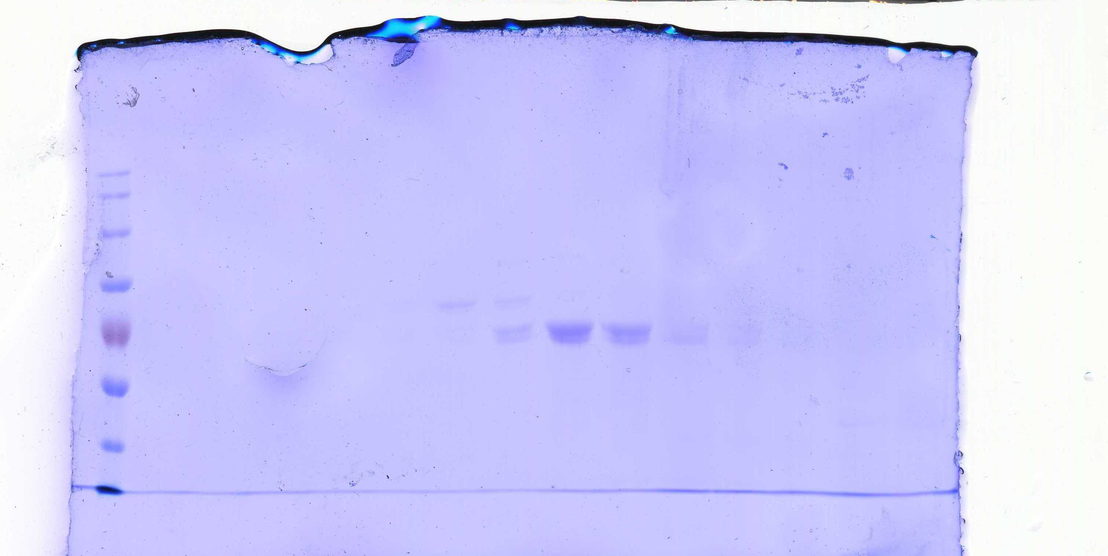
Fig 3B (bottom)
6His-GST-3C DCLK1
(351-689) D553A

Slide 3
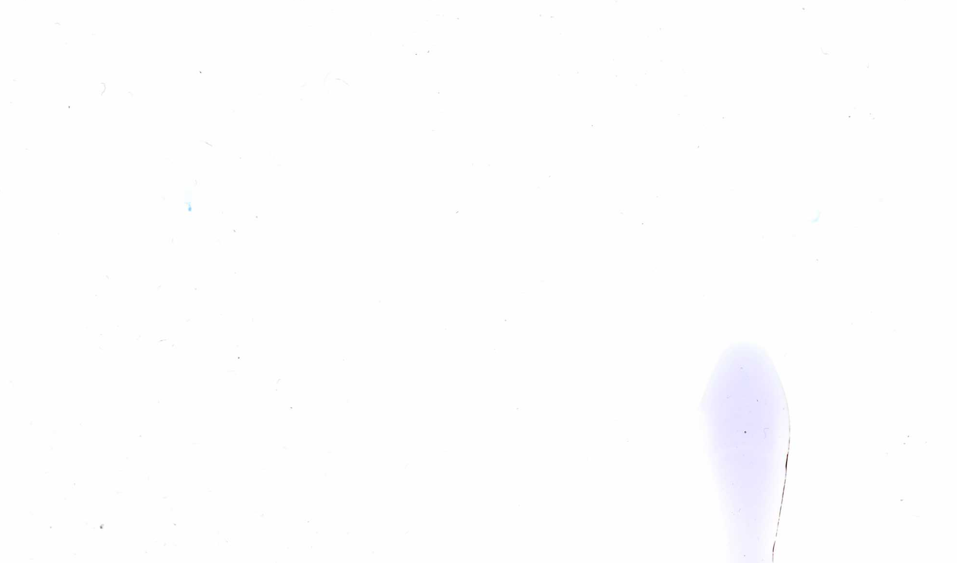
+ 3C
- 3C
6His-GST-3C DCLK1
(351-689) WT
DCLK1
(351-689) WT

