Slide 1
FigS4A
FigS4A
TNFAIP2
IQGAP1-L
FigS4A
IQGAP1-S
FigS4C
FigS4C
TNFAIP2
IQGAP1
FigS4C
GAPDH

Slide 2
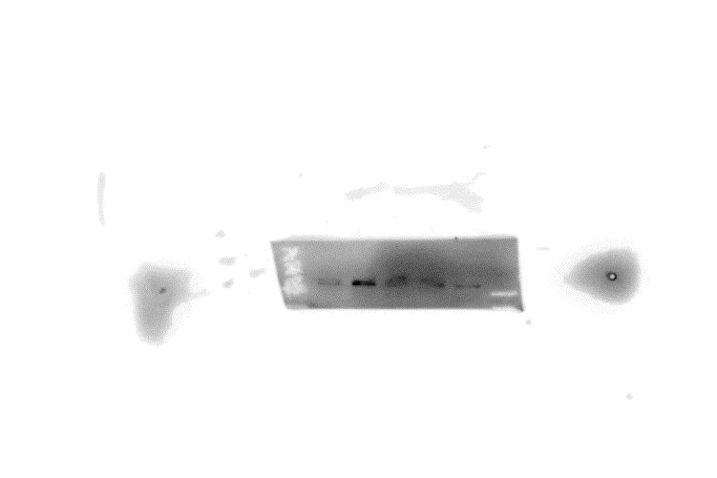
Fig S4B
Flag
Input-IQGAP1
IP-IQGAP1

