Slide 1
Fig5A
Fig5A
TNFAIP2
ITGB4
Fig5B
Fig5B
TNFAIP2
ITGB4
Fig5C
Fig5C
ITGB4
ITGB4

Slide 2
Fig 5D
ITGB4
β-Actin
Fig 5G
ITGB4
β-Actin
Fig 5O-HCC1806-EPI
ITGB4
γH2AX
PARP，cl-PARP
β-Actin

Slide 3
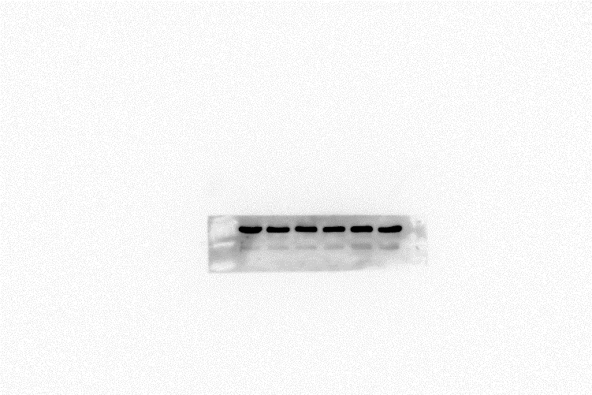
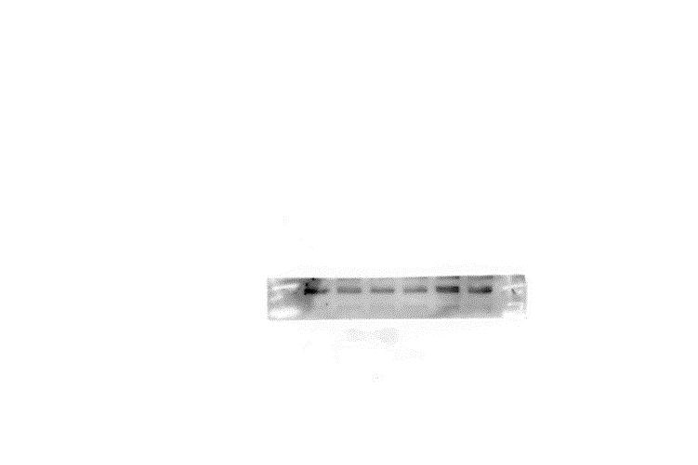
Fig 5O-HCC1806-BMN
ITGB4
γH2AX
PARP
cl-PARP
β-Actin

Slide 4
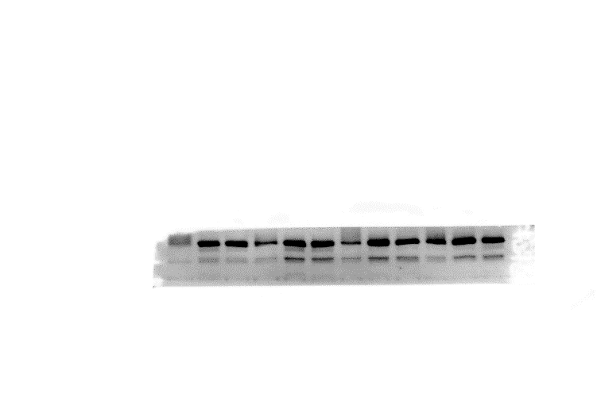
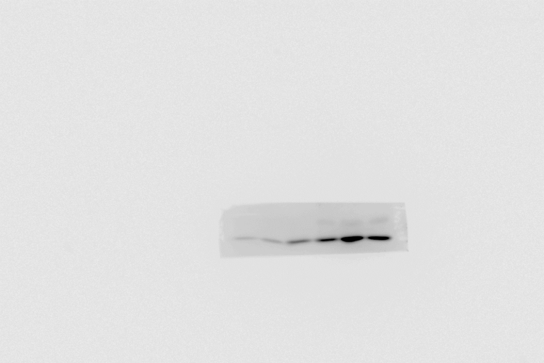
Fig 5O-HCC1937-EPI
ITGB4
γH2AX
PARP，cl-PARP
β-Actin
Fig 5O-HCC1937-BMN
ITGB4
γH2AX
PARP，cl-PARP
β-Actin

