Slide 1
FigS5A
ITGB4
ITGB4
FigS5D
β-Actin
β-Actin
Fig S5G-HCC1806-DDP
ITGB4
γH2AX
PARP，cl-PARP
β-Actin

Slide 2
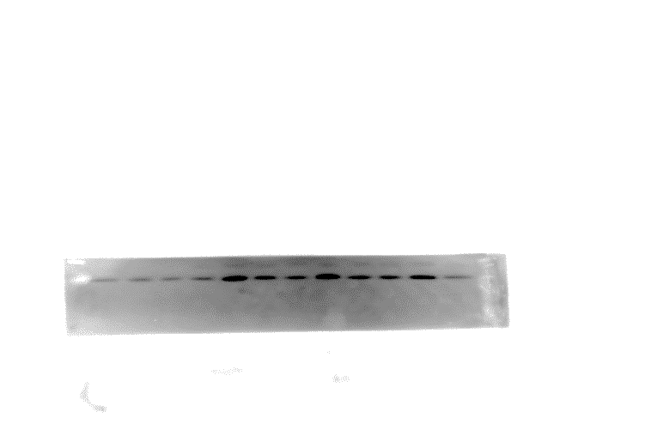
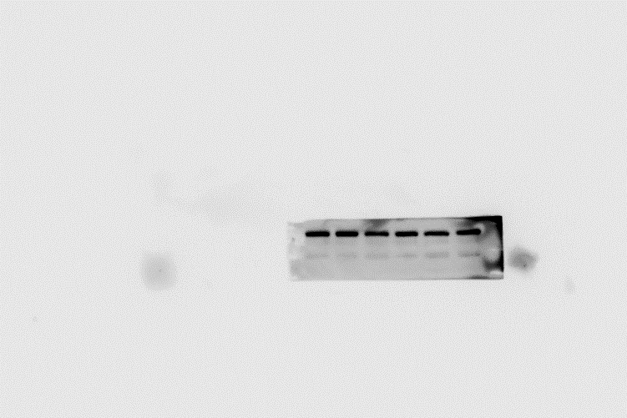
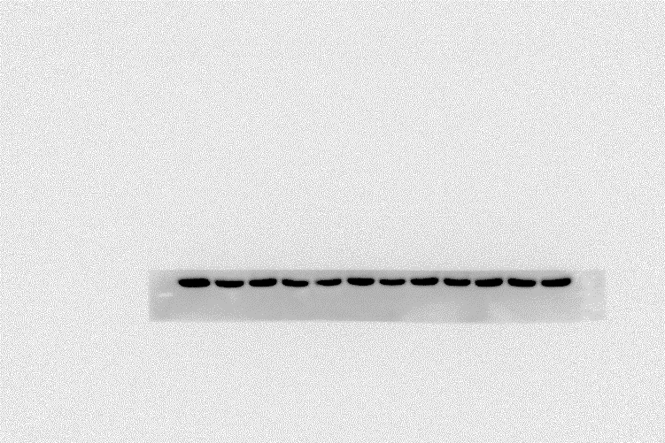
Fig S5G-HCC1806-AZD
ITGB4
γH2AX
PARP
cl-PARP
β-Actin

Slide 3
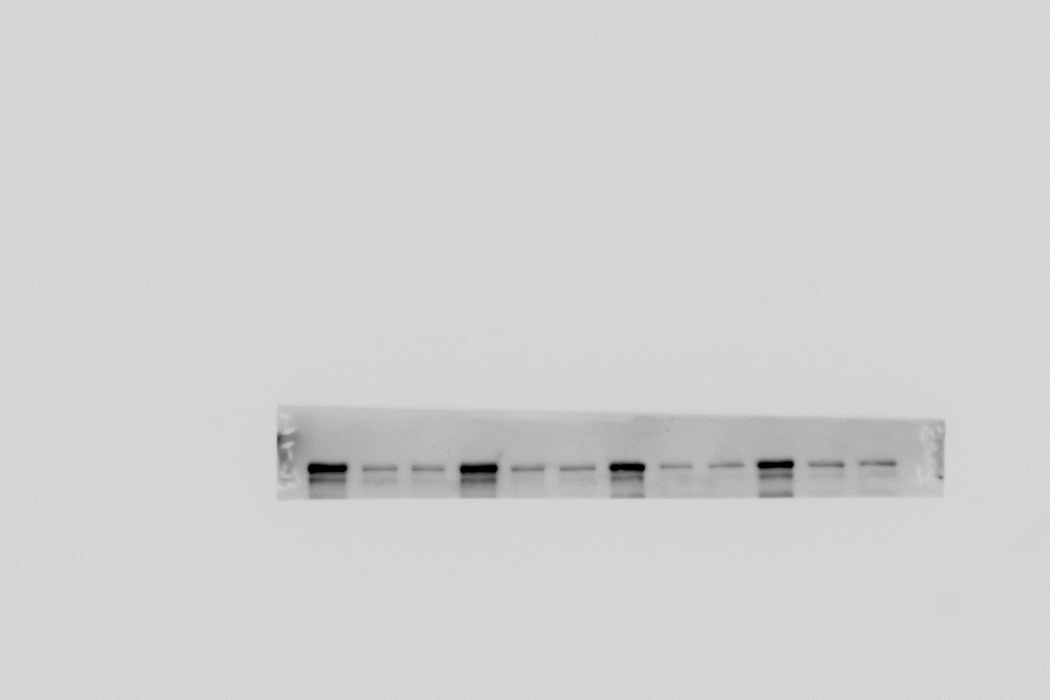
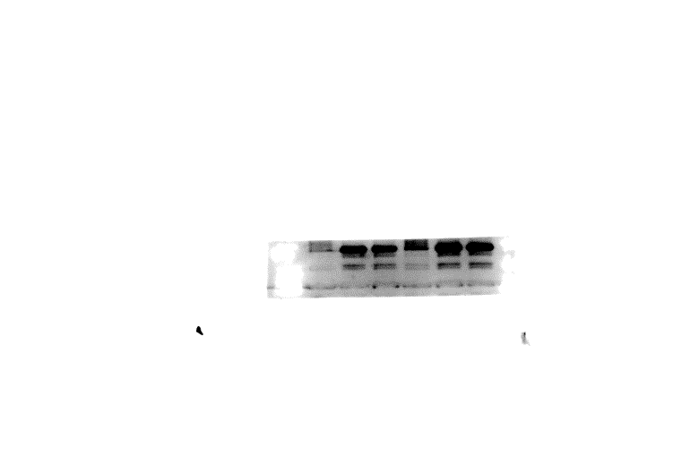
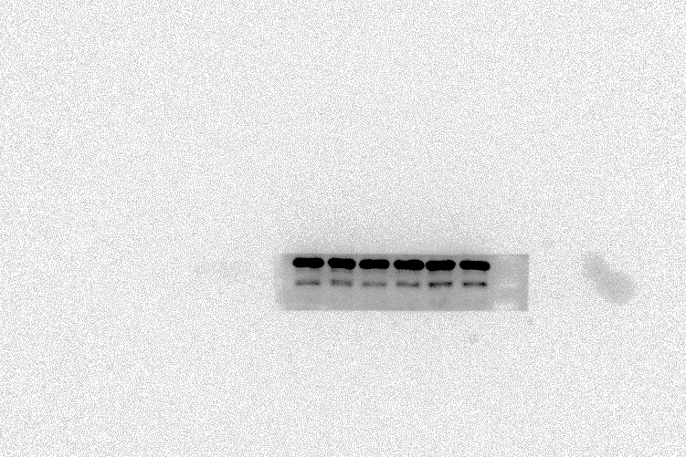
Fig S5G-HCC1937-DDP
ITGB4
γH2AX
PARP， cl-PARP
β-Actin
Fig S5G-HCC1937-AZD
ITGB4
γH2AX
PARP， cl-PARP
β-Actin

