Slide 1
Fig 7A
ITGB4
TNFAIP2
β-Actin
Fig 7D
ITGB4
IQGAP1
β-Actin

Slide 2
Fig 7G
ITGB4
Rac1
β-Actin

Slide 3
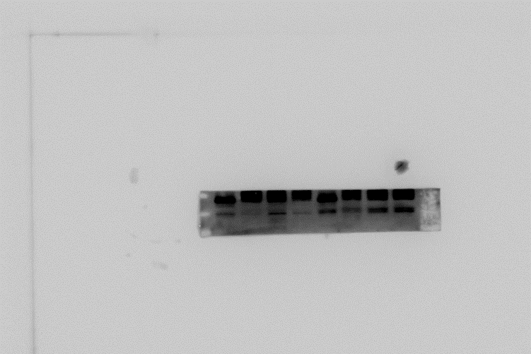
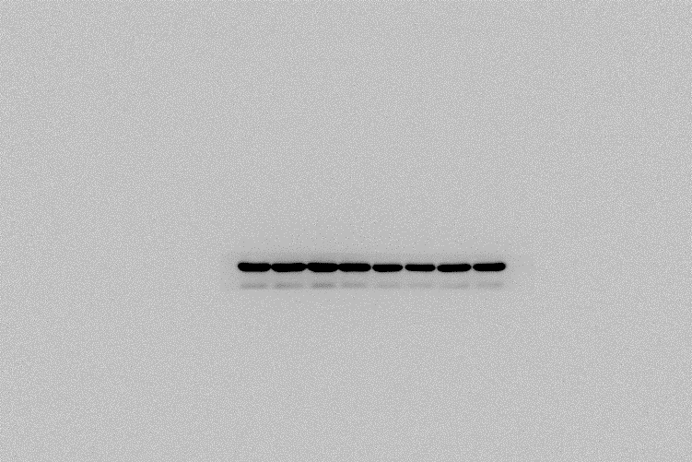
Fig 7J-HCC1806-EPI
ITGB4
γH2AX
TNFAIP2
PARP， cl-PARP
β-Actin

Slide 4
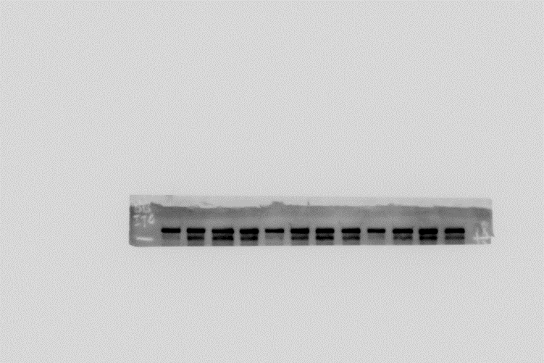
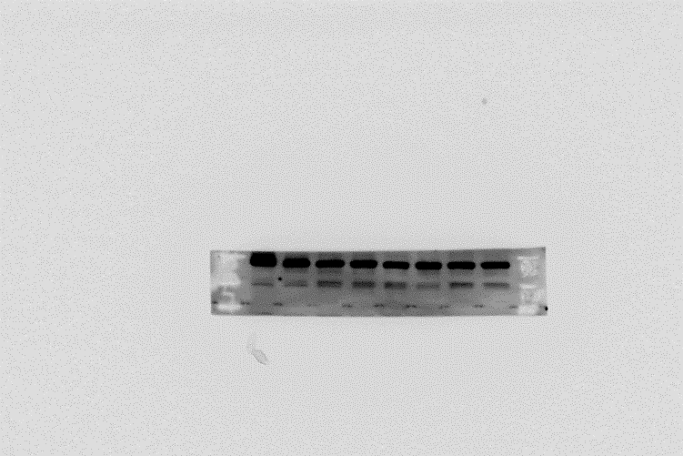
Fig 7J-HCC1806-BMN
ITGB4
γH2AX
TNFAIP2
PARP， cl-PARP
β-Actin

Slide 5
Fig 7K-HCC1806-EPI
ITGB4
γH2AX
IQGAP1
PARP， cl-PARP
β-Actin

Slide 6
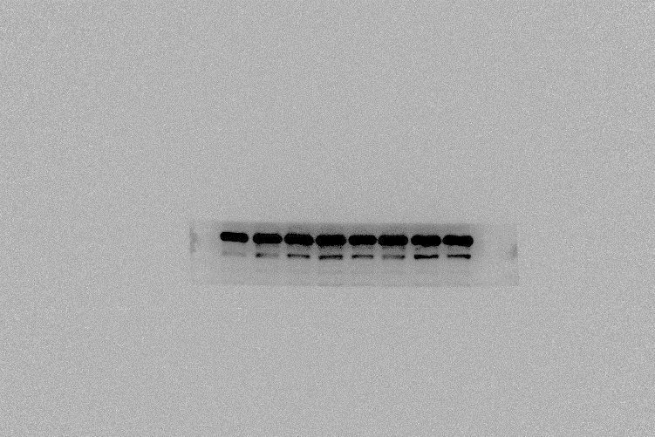
Fig 7K-HCC1806-BMN
ITGB4
γH2AX
IQGAP1
PARP， cl-PARP
β-Actin

Slide 7
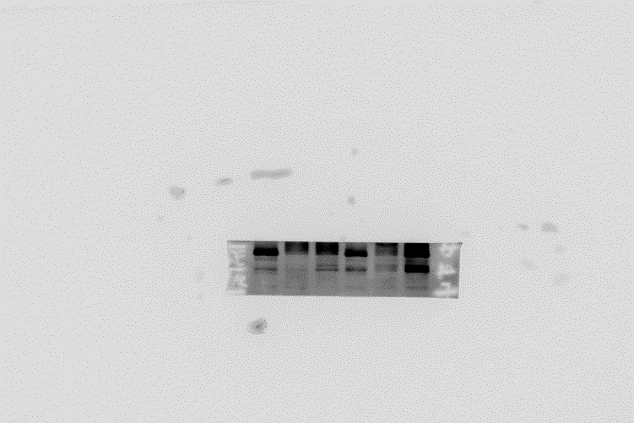
Fig 7L-HCC1806-EPI
ITGB4
γH2AX
Rac1
PARP， cl-PARP
β-Actin

Slide 8
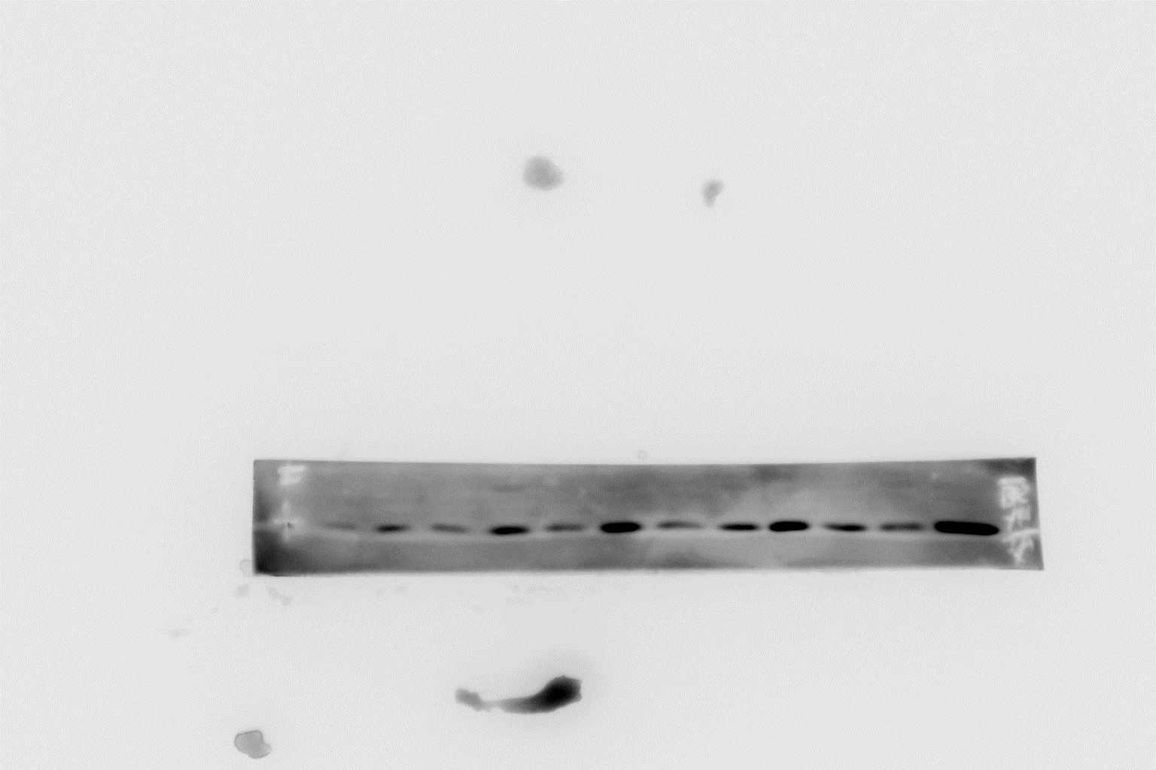
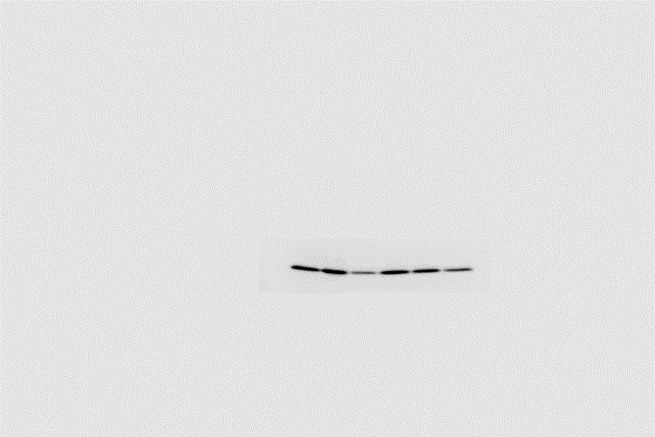
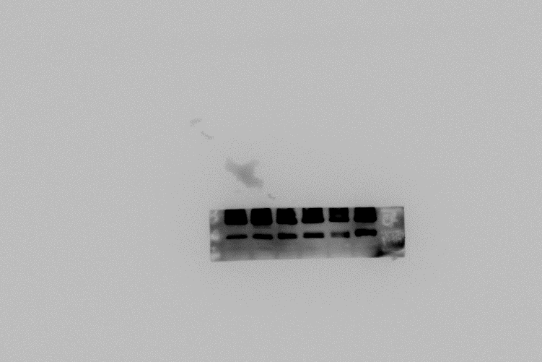
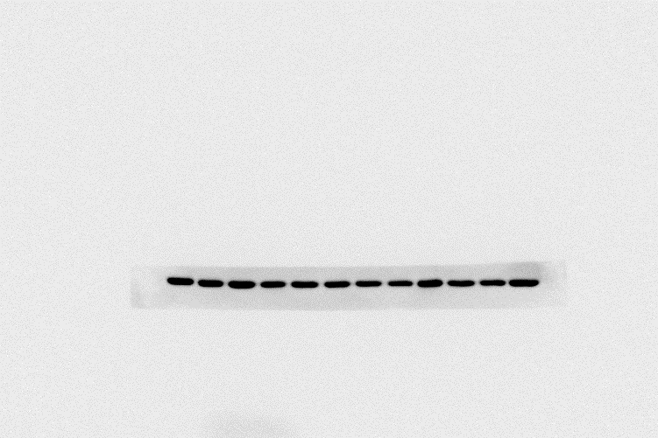
Fig 7L-HCC1806-BMN
ITGB4
γH2AX
Rac1
PARP， cl-PARP
β-Actin

