Slide 1
Fig S7A
ITGB4
TNFAIP2
β-Actin
Fig S7D
ITGB4
TNFAIP2
β-Actin

Slide 2
Fig S7G
ITGB4
Rac1
β-Actin
Fig S7J
ITGB4
Rac1
β-Actin

Slide 3
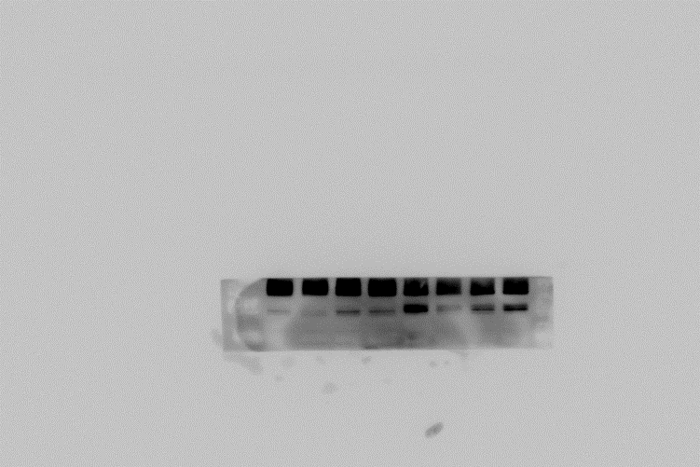
Fig S7M-HCC1806-DDP
ITGB4
γH2AX
TNFAIP2
PARP， cl-PARP
β-Actin

Slide 4
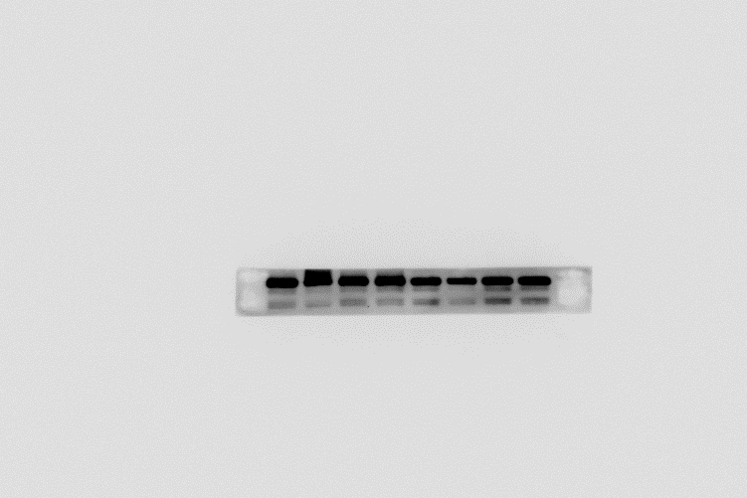
Fig S7M-HCC1806-AZD
ITGB4
γH2AX
TNFAIP2
PARP
cl-PARP
β-Actin

Slide 5
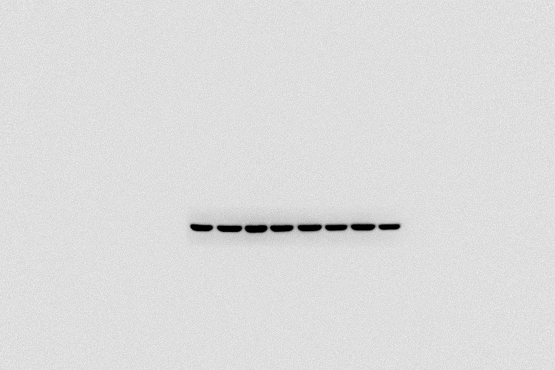
Fig S7M-HCC1937-DDP
ITGB4
γH2AX
TNFAIP2
PARP， cl-PARP
β-Actin

Slide 6
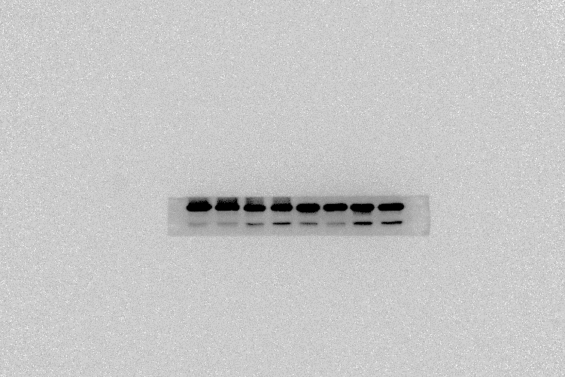
Fig S7M-HCC1937-AZD
ITGB4
γH2AX
TNFAIP2
PARP， cl-PARP
β-Actin

Slide 7
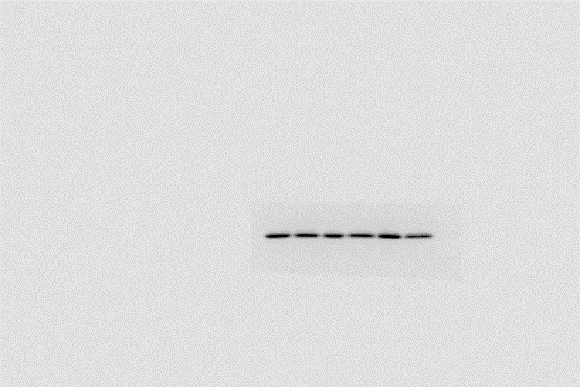
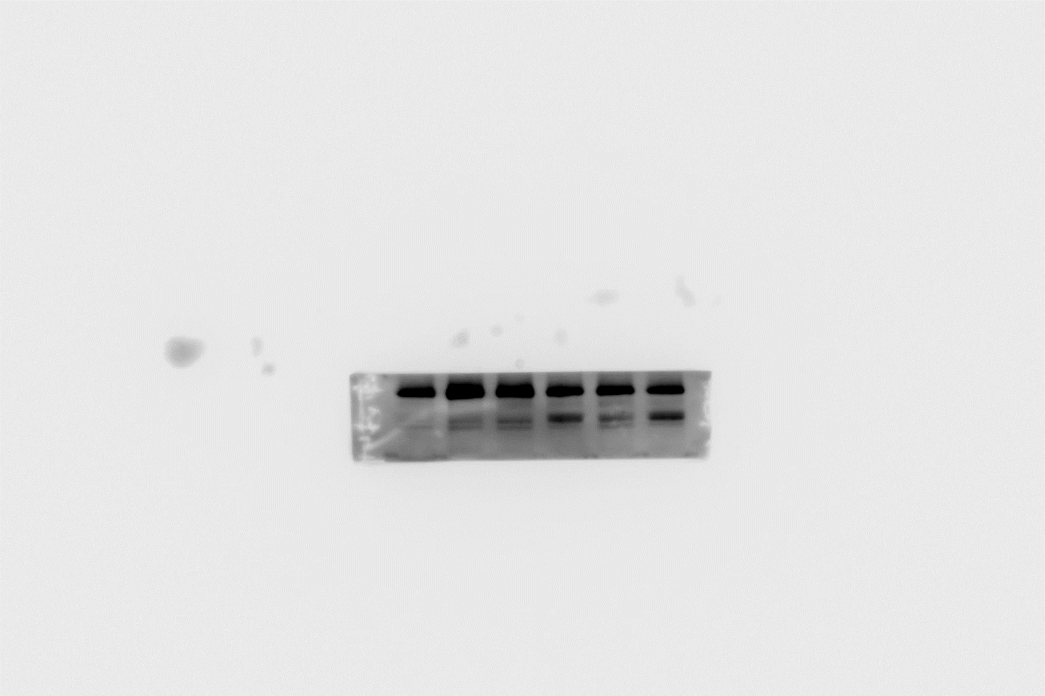
Fig S7N-HCC1806-DDP
ITGB4
γH2AX
Rac1
PARP， cl-PARP
β-Actin

Slide 8
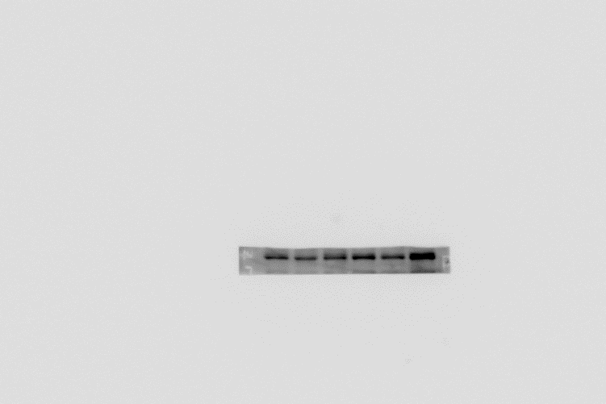
Fig S7N-HCC1806-AZD
ITGB4
γH2AX
Rac1
PARP
cl-PARP
β-Actin

Slide 9
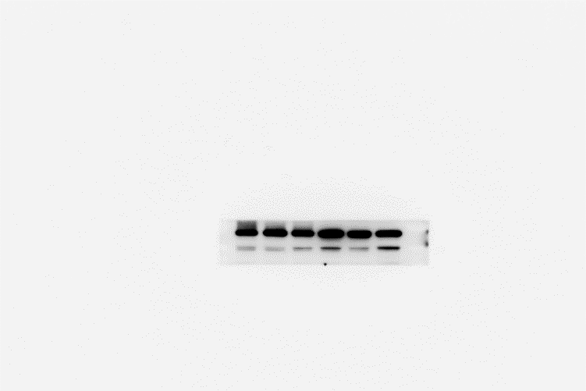
Fig S7N-HCC1937-DDP
ITGB4
γH2AX
Rac1
PARP， cl-PARP
β-Actin

Slide 10
Fig S7N-HCC1937-AZD
ITGB4
γH2AX
Rac1
PARP， cl-PARP
β-Actin

