Slide 1
Fig S7O
ITGB4
TNFAIP2
β-Actin
Fig S7R
ITGB4
IQGAP1
β-Actin

Slide 2
Fig S7U
ITGB4
Rac1
β-Actin

Slide 3
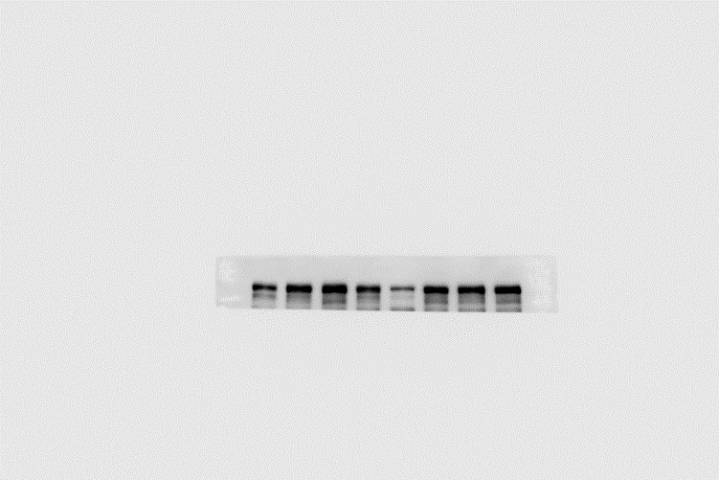
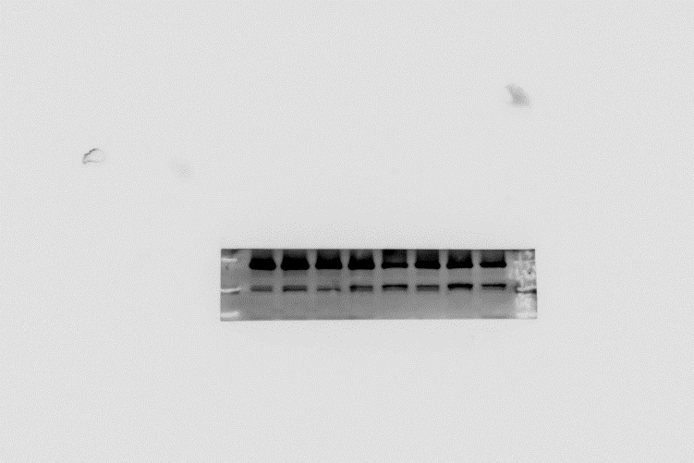
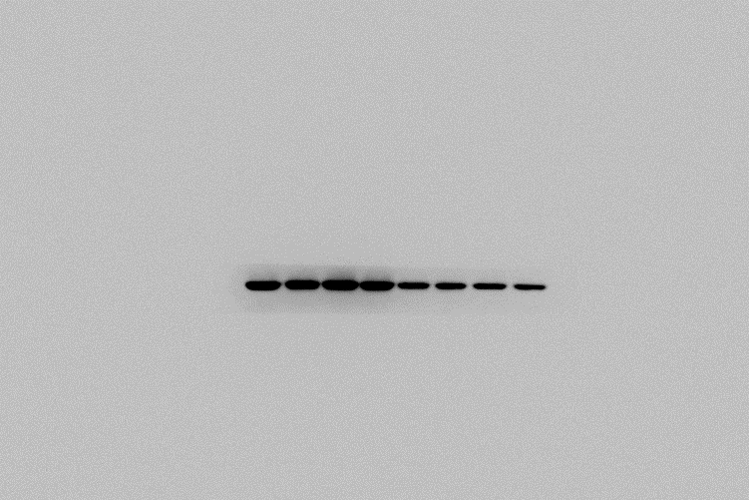
Fig S7X-HCC1937-EPI
ITGB4
γH2AX
TNFAIP2
PARP， cl-PARP
β-Actin

Slide 4
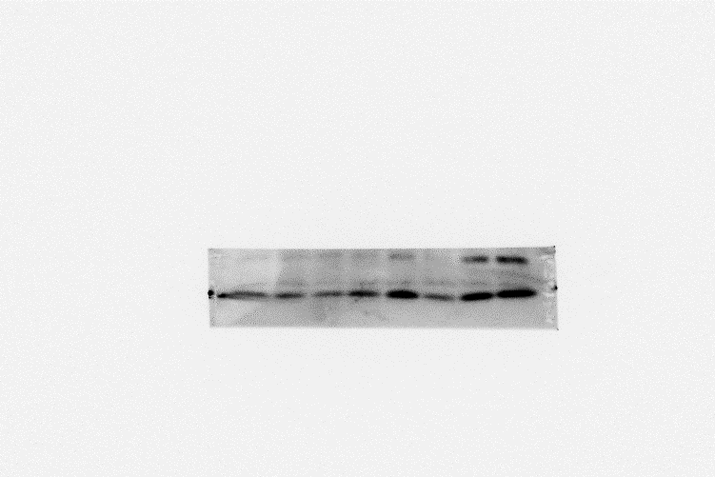
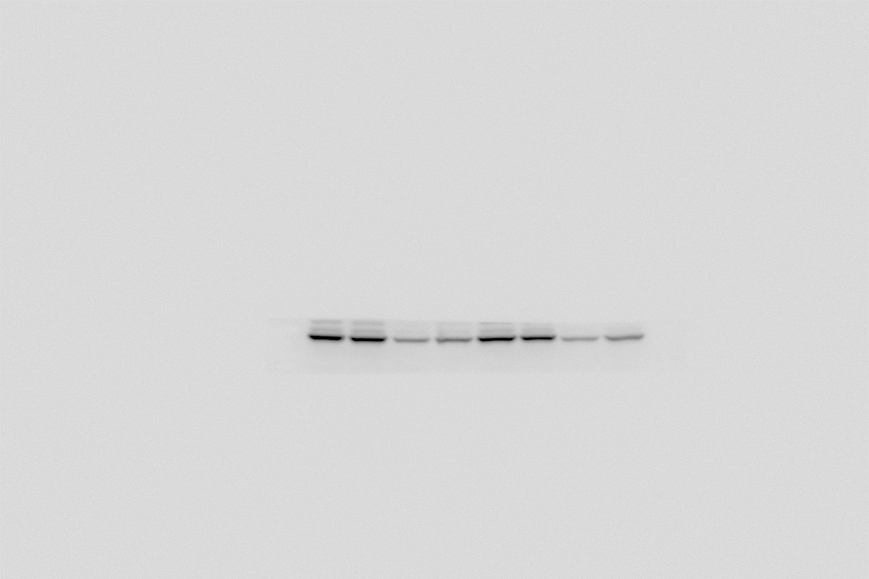
Fig S7X-HCC1937-BMN
ITGB4
γH2AX
TNFAIP2
PARP， cl-PARP
β-Actin

Slide 5
Fig S7Y-HCC1937-EPI
ITGB4
γH2AX
IQGAP1
PARP， cl-PARP
β-Actin

Slide 6
Fig S7Y-HCC1937-BMN
ITGB4
γH2AX
IQGAP1
PARP
cl-PARP
β-Actin

Slide 7
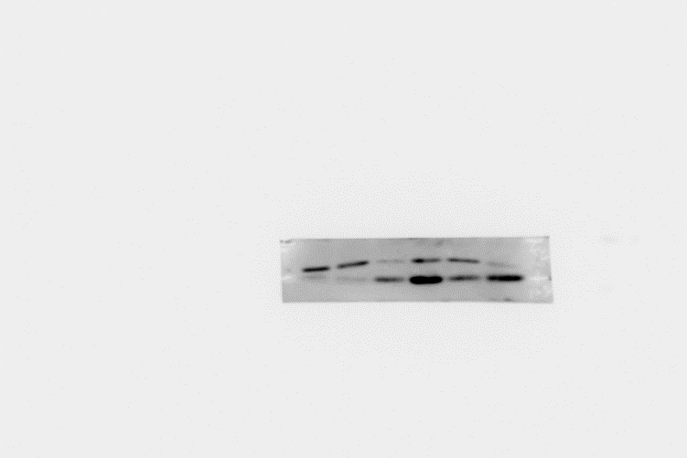
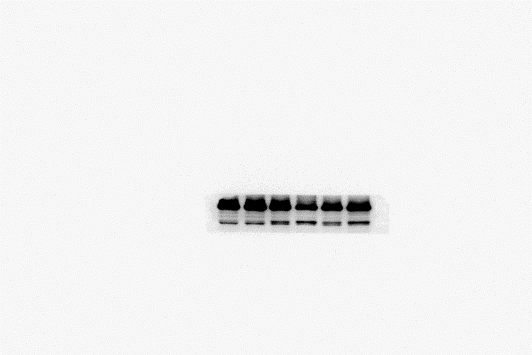
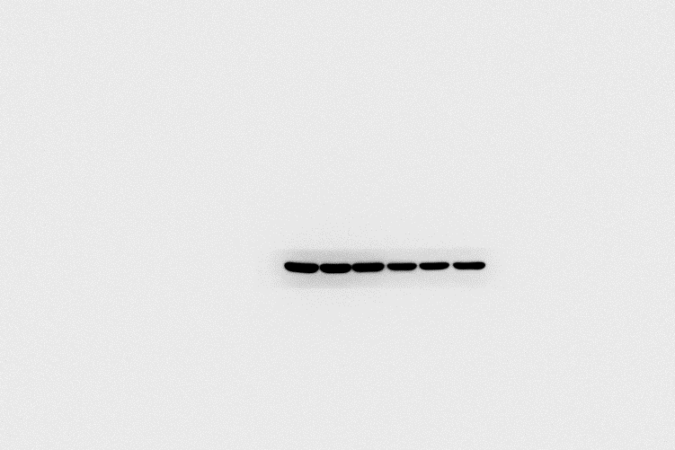
Fig S7Z-HCC1937-EPI
ITGB4
γH2AX
Rac1
PARP， cl-PARP
β-Actin

Slide 8
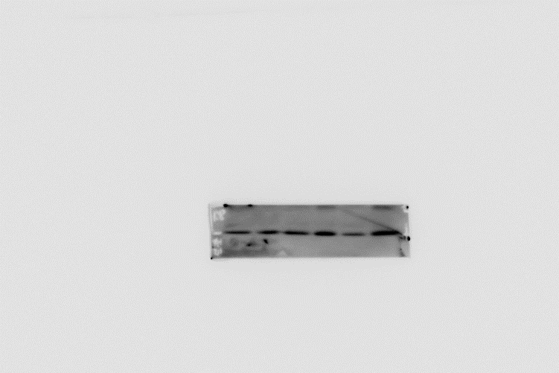
Fig S7Z-HCC1937-BMN
ITGB4
γH2AX
Rac1
PARP， cl-PARP
β-Actin

