Slide 1
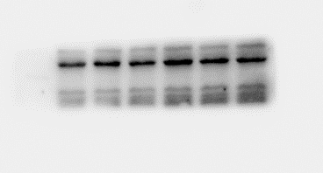
GLI1
β-actin
Notes:
Figure 1-figure supplement 1.

