Slide 1
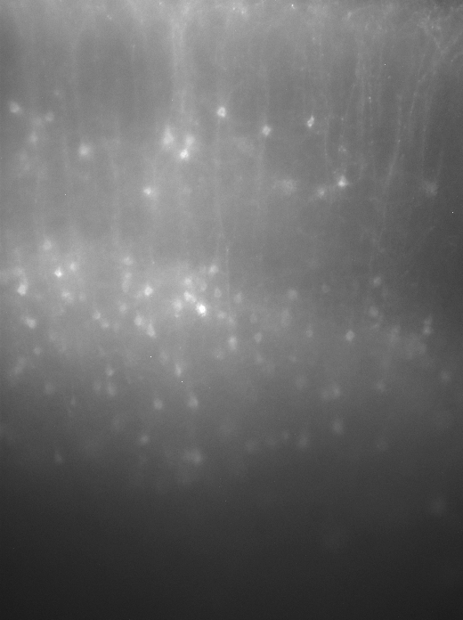
D1CRE M1 mCherry Positive Neurons
2/3
5A
5B

Slide 2
D1CRE M1 mCherry Positive Neurons
Patched M1 Cell
DIC
mCherry Positive

Slide 3
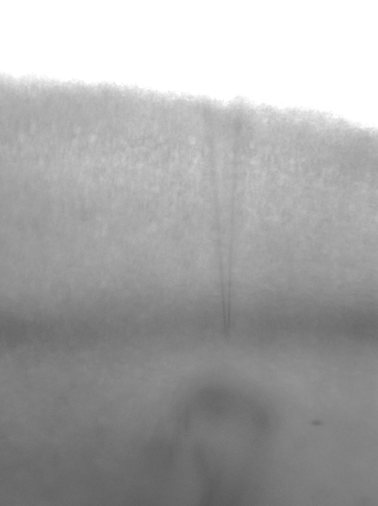
Electrode Placement

Slide 4
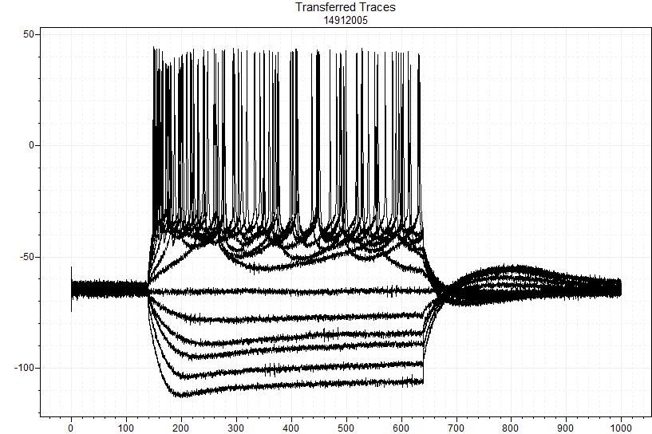
D1CRE M1 layer 5 cell
Baseline IV -250pA to +400pA +50pA steps
Ih Current

Slide 5
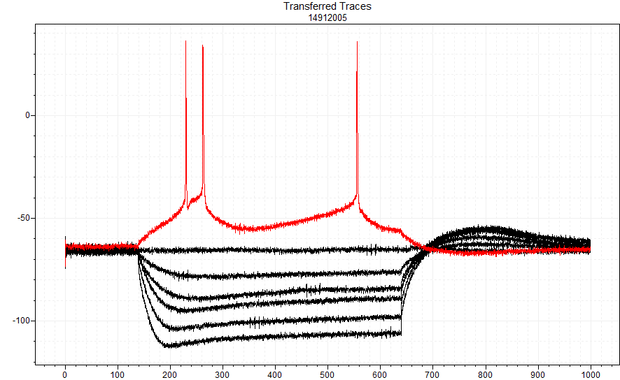
D1CRE M1 layer 5 cell
Baseline IV -250pA to +400pA +50pA steps
Intrinsic Burst Type Cell (IB)
+50pA
Ih Current

Slide 6
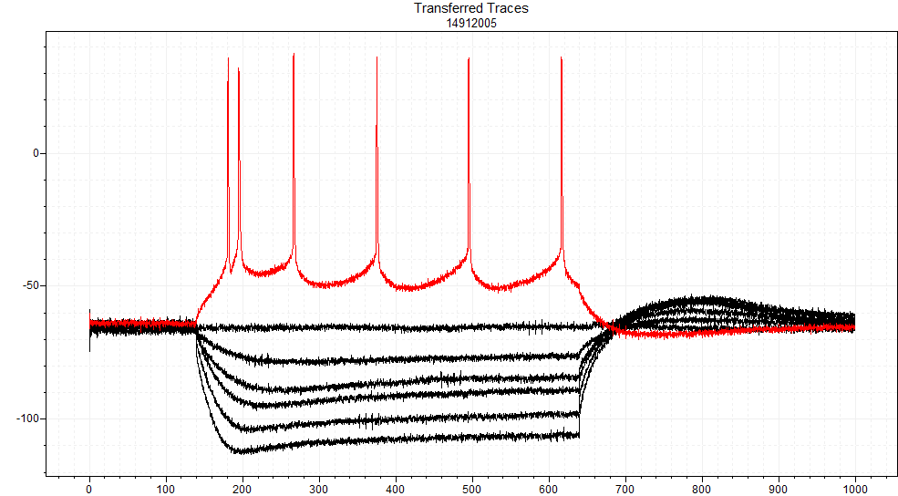
D1CRE M1 layer 5 cell
Baseline IV -250pA to +400pA +50pA steps
+100pA

Slide 7
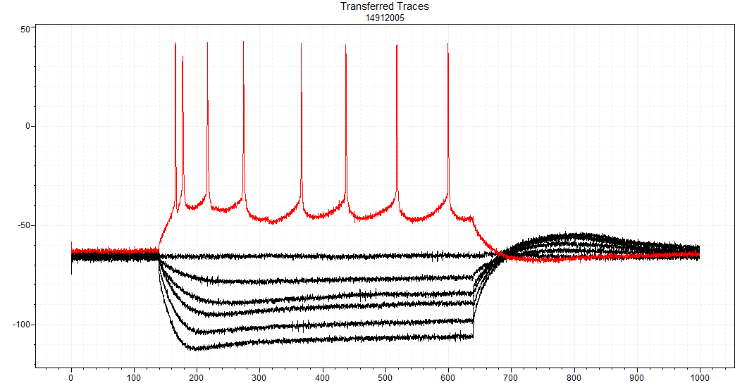
D1CRE M1 layer 5 cell
Baseline IV -250pA to +400pA +50pA steps
+150pA

Slide 8
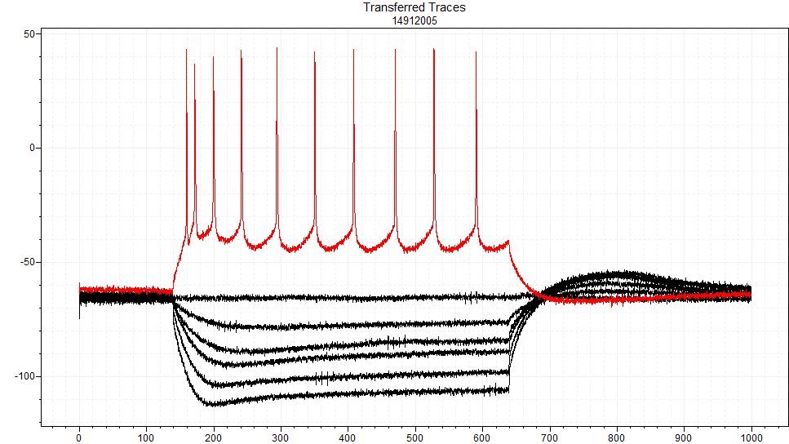
D1CRE M1 layer 5 cell
Baseline IV -250pA to +400pA +50pA steps
+200pA

Slide 9
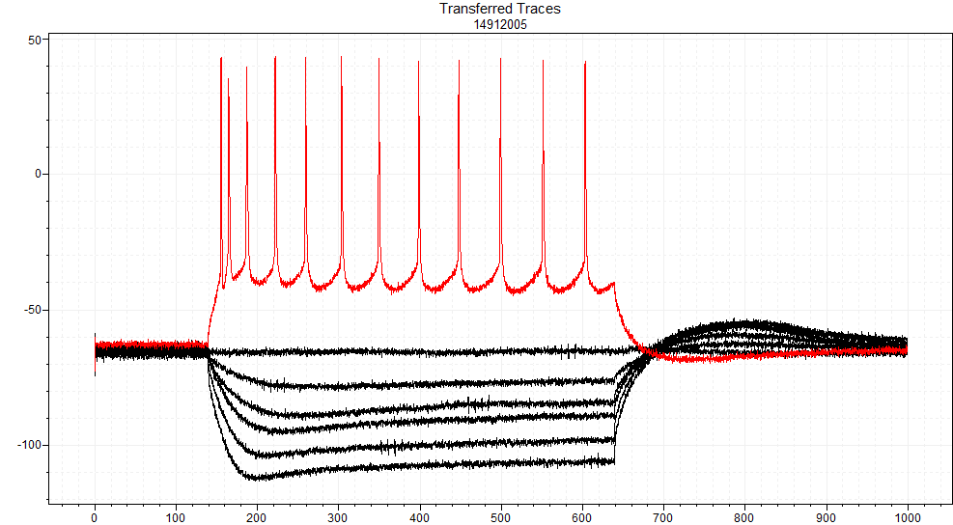
D1CRE M1 layer 5 cell
Baseline IV -250pA to +400pA +50pA steps
+250pA

Slide 10
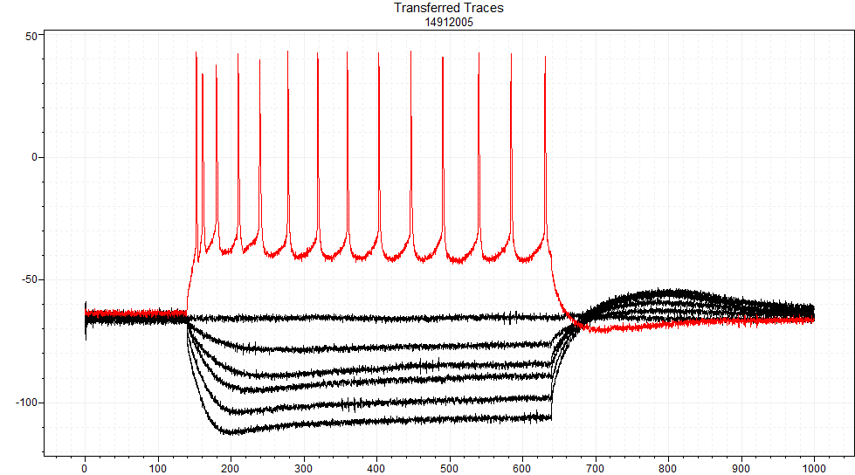
D1CRE M1 layer 5 cell
Baseline IV -250pA to +400pA +50pA steps
+300pA

Slide 11
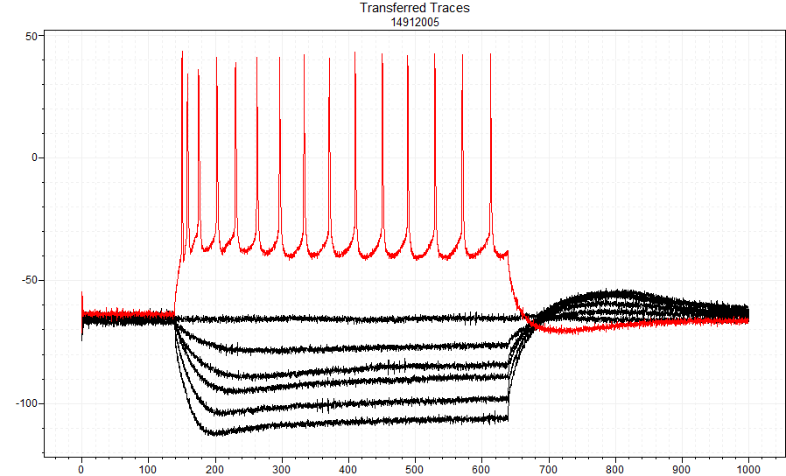
D1CRE M1 layer 5 cell
Baseline IV -250pA to +400pA +50pA steps
+350pA

Slide 12

D1CRE M1 layer 5 cell
Baseline IV -250pA to +400pA +50pA steps
+400pA

Slide 13
10µM Quinpirole (D2 agonist)
Wash in 8min

Slide 14
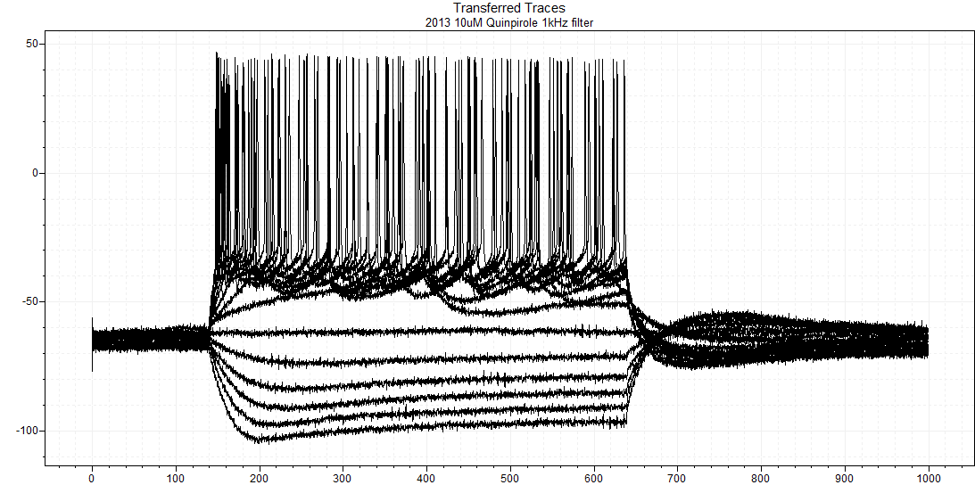
D1CRE M1 layer 5 cell
10uM Quinpirole IV -250pA to +400pA +50pA steps

Slide 15
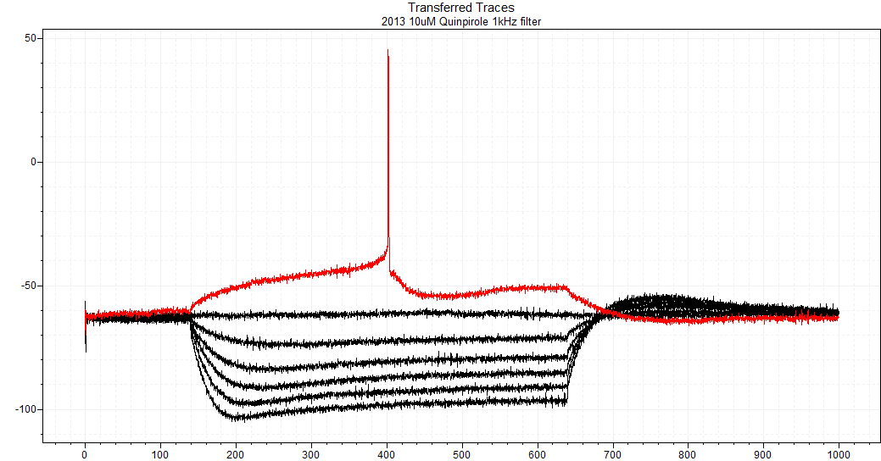
D1CRE M1 layer 5 cell
10uM Quinpirole IV -250pA to +400pA +50pA steps
+50pA

Slide 16
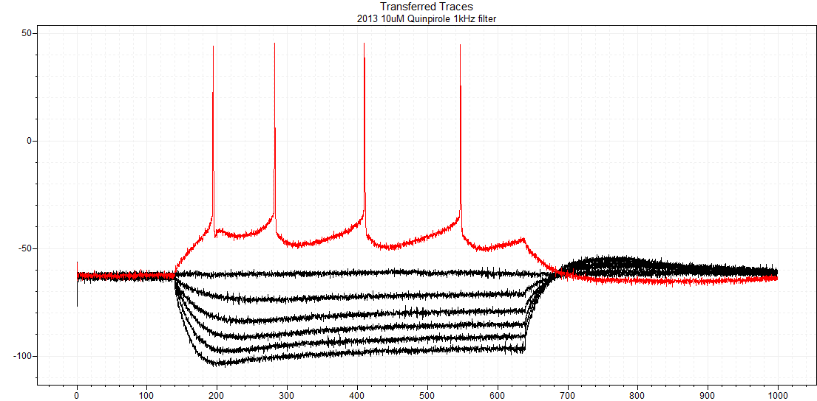
D1CRE M1 layer 5 cell
10uM Quinpirole IV -250pA to +400pA +50pA steps
+100pA

Slide 17

D1CRE M1 layer 5 cell
10uM Quinpirole IV -250pA to +400pA +50pA steps
+150pA

Slide 18
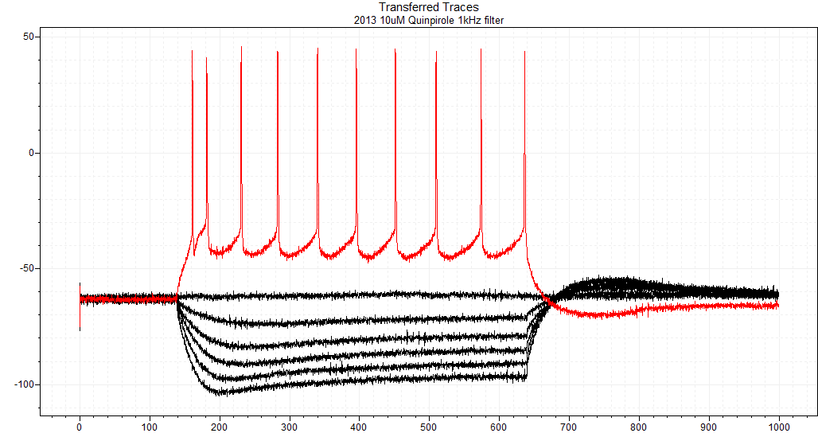
D1CRE M1 layer 5 cell
10uM Quinpirole IV -250pA to +400pA +50pA steps
+200pA

Slide 19
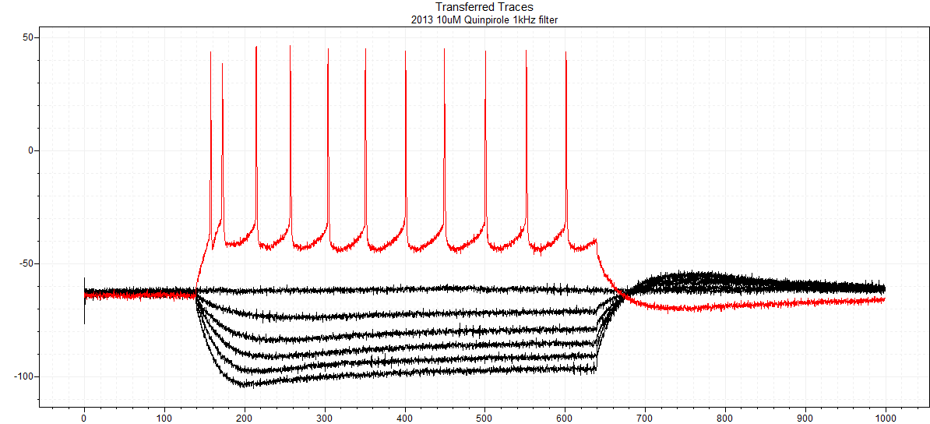
D1CRE M1 layer 5 cell
10uM Quinpirole IV -250pA to +400pA +50pA steps
+250pA

Slide 20

D1CRE M1 layer 5 cell
10uM Quinpirole IV -250pA to +400pA +50pA steps
+300pA

Slide 21
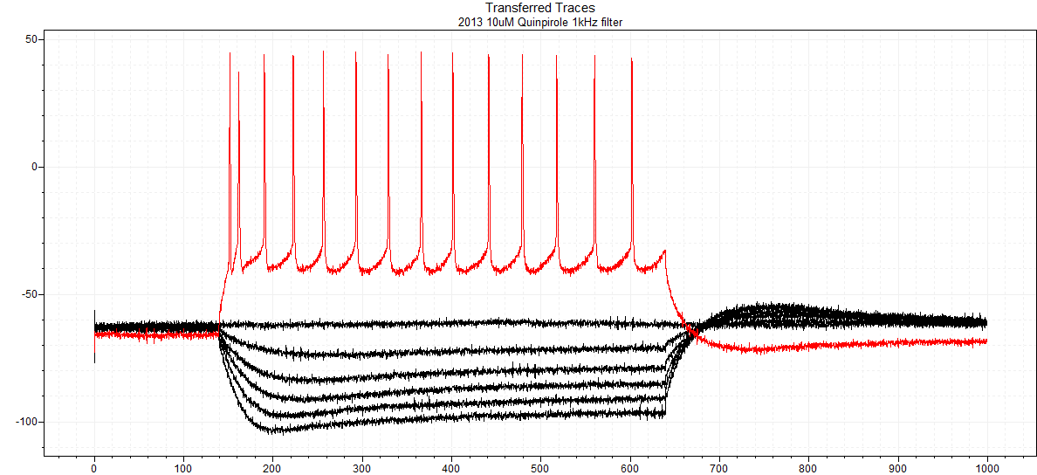
D1CRE M1 layer 5 cell
10uM Quinpirole IV -250pA to +400pA +50pA steps
+350pA

Slide 22
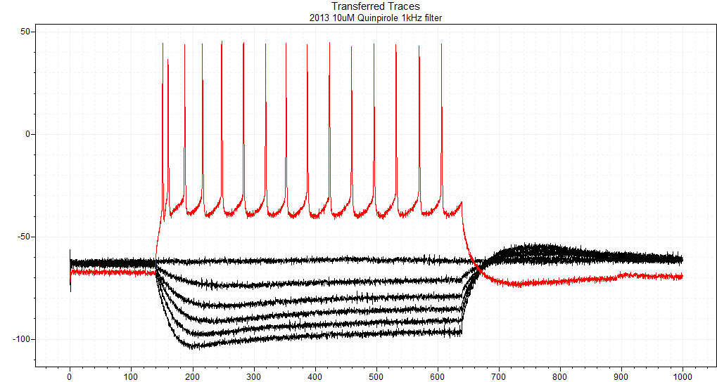
D1CRE M1 layer 5 cell
10uM Quinpirole IV -250pA to +400pA +50pA steps
+400pA

Slide 23

D1CRE M1 layer 5 cell
10uM Quinpirole IV -250pA to +400pA +50pA steps
+450pA

Slide 24

D1CRE M1 layer 5 cell
10uM Quinpirole IV -250pA to +400pA +50pA steps
+500pA

Slide 25
Wash

Slide 26
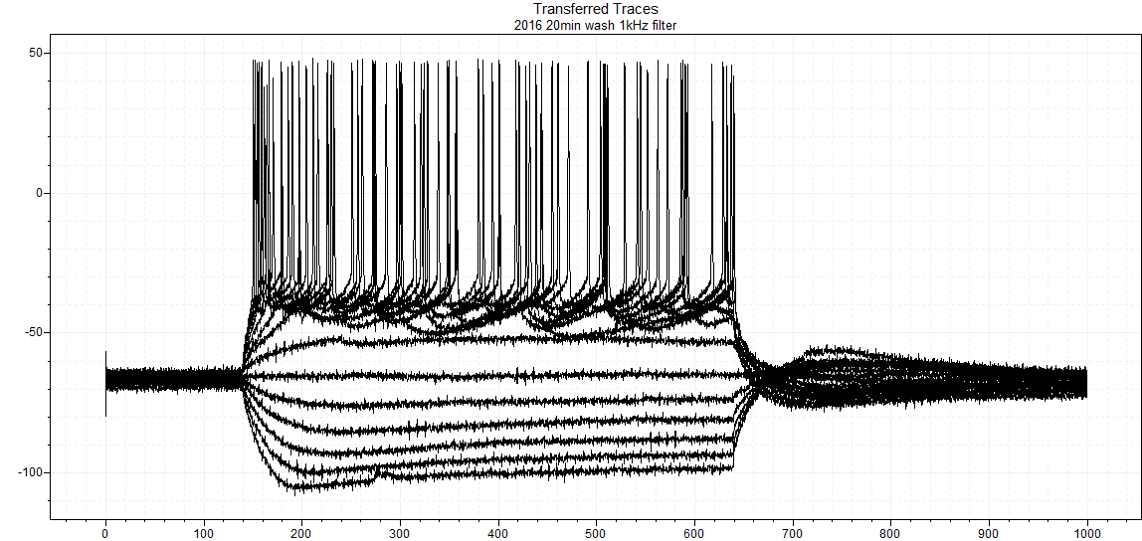
D1CRE M1 layer 5 cell
Wash 20min IV -250pA to +400pA +50pA steps

Slide 27
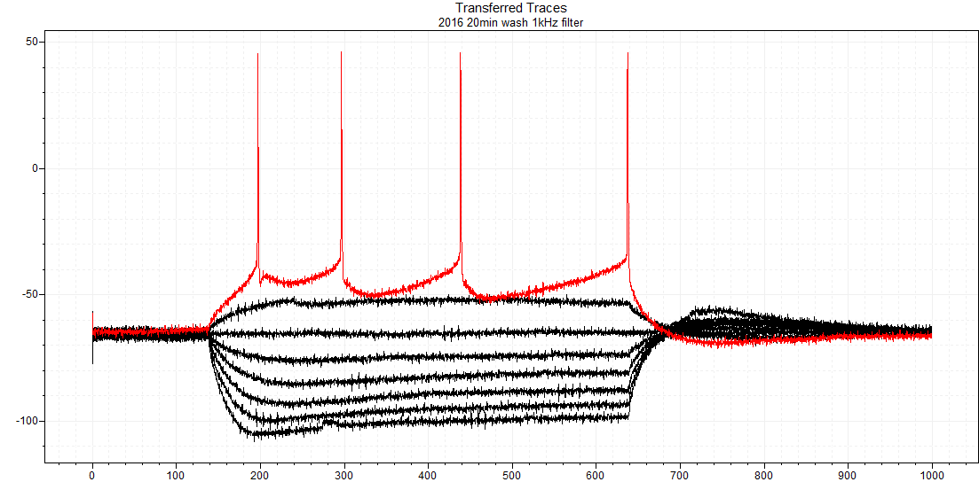
D1CRE M1 layer 5 cell
Wash 20min IV -250pA to +400pA +50pA steps
+100pA
+50pA

Slide 28
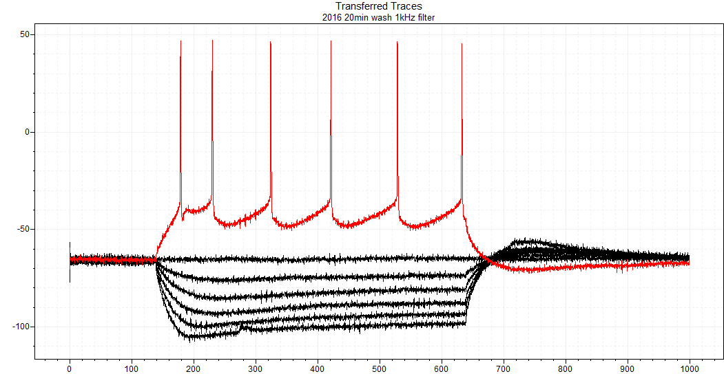
D1CRE M1 layer 5 cell
Wash 20min IV -250pA to +400pA +50pA steps
+150pA

Slide 29
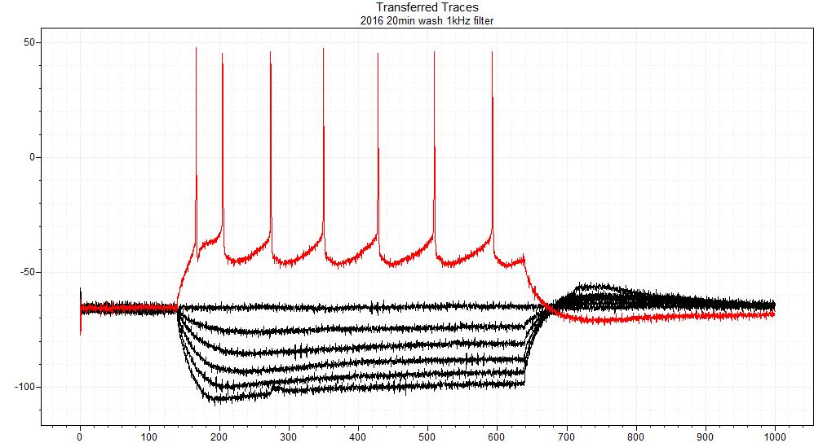
D1CRE M1 layer 5 cell
Wash 20min IV -250pA to +400pA +50pA steps
+200pA

Slide 30
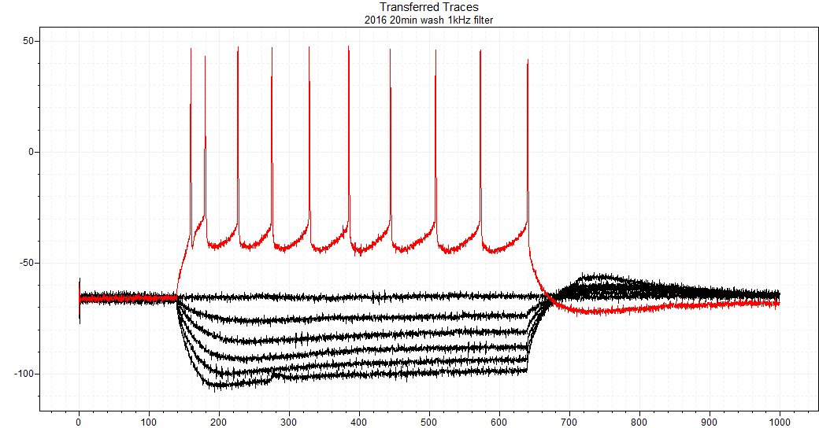
D1CRE M1 layer 5 cell
Wash 20min IV -250pA to +400pA +50pA steps
+250pA

Slide 31
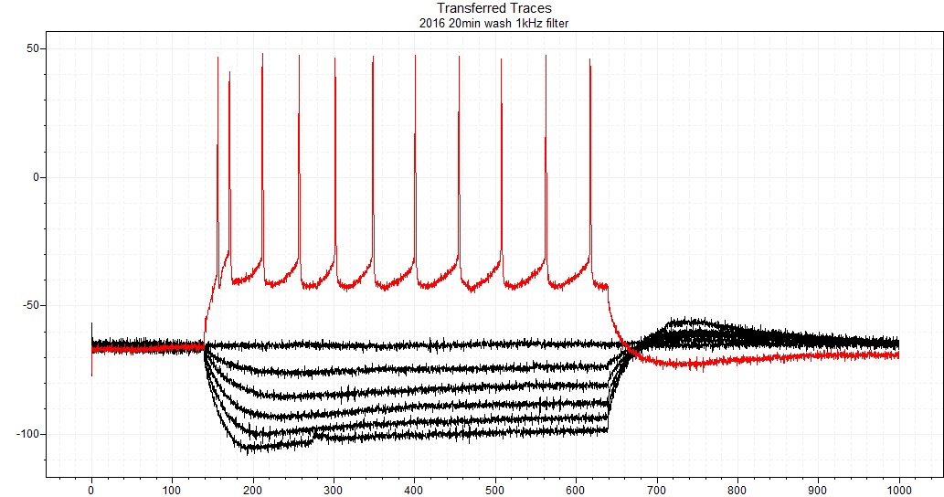
D1CRE M1 layer 5 cell
Wash 20min IV -250pA to +400pA +50pA steps
+300pA

Slide 32

D1CRE M1 layer 5 cell
Wash 20min IV -250pA to +400pA +50pA steps
+350pA

Slide 33
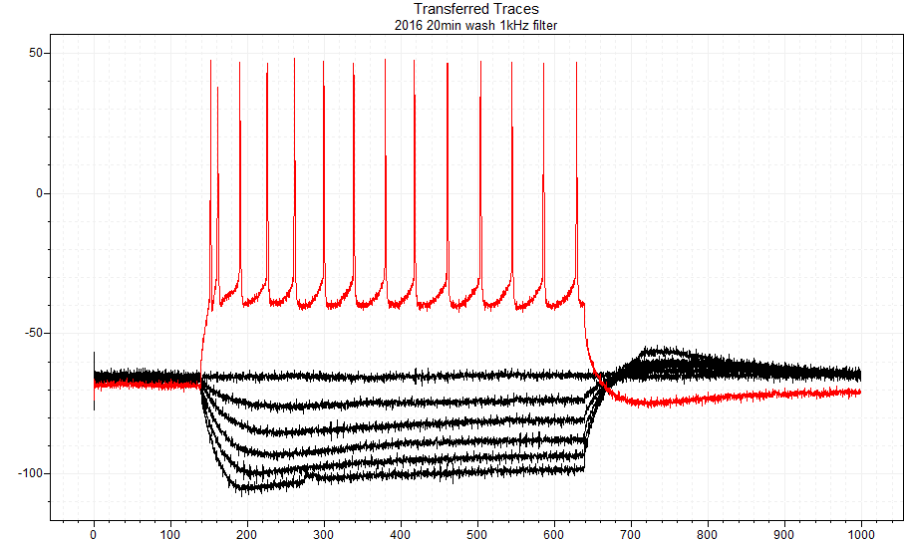
D1CRE M1 layer 5 cell
Wash 20min IV -250pA to +400pA +50pA steps
+400pA

Slide 34

D1CRE M1 layer 5 cell
Wash 20min IV -250pA to +400pA +50pA steps
+450pA

Slide 37
IV Steady State
Membrane inward rectification

Slide 38
IV Ih current

Slide 39
Ih Current Amplitude

Slide 44
+50pA 1st Sweep

Slide 45
+100pA 2nd Sweep

Slide 46
+150pA 3rd Sweep

Slide 47
+200pA 4th Sweep

Slide 48
+250pA 5th Sweep

Slide 49
+300pA 6th Sweep

Slide 50
+350pA 7th Sweep

Slide 52
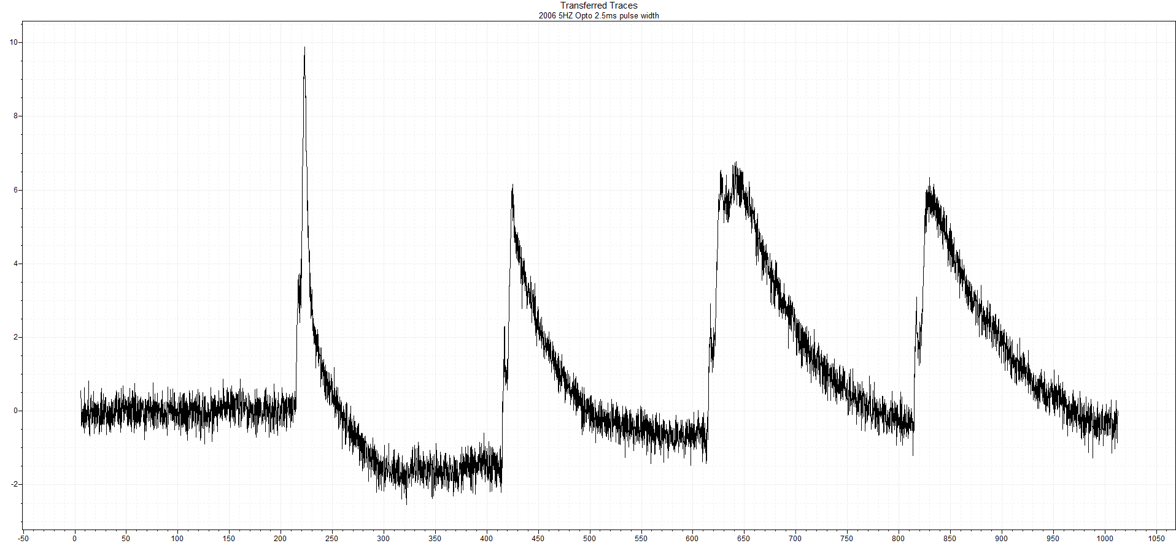
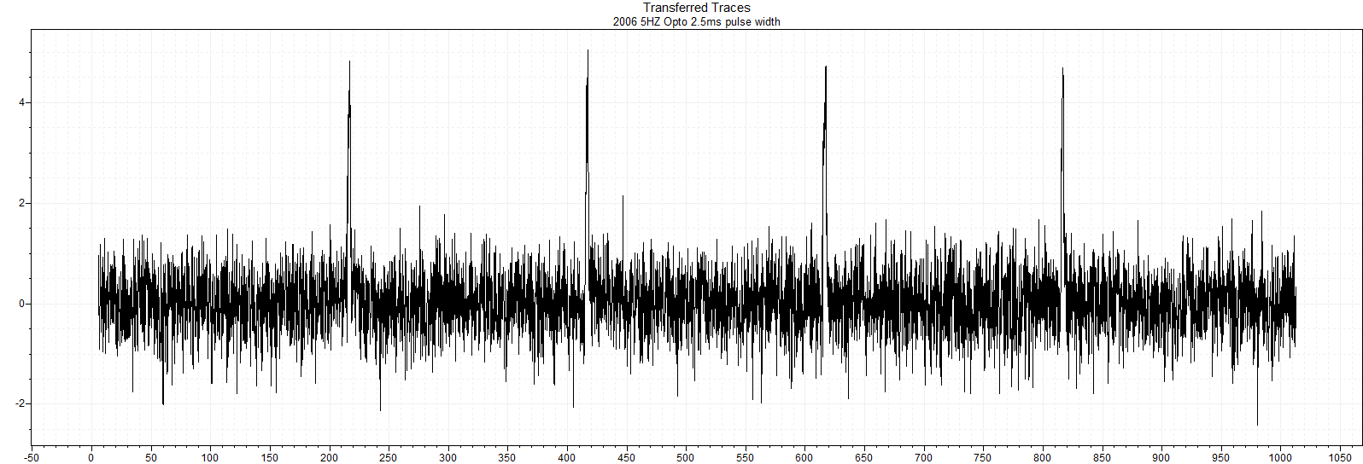
Opto 5Hz 2.5ms pulse width

Slide 53
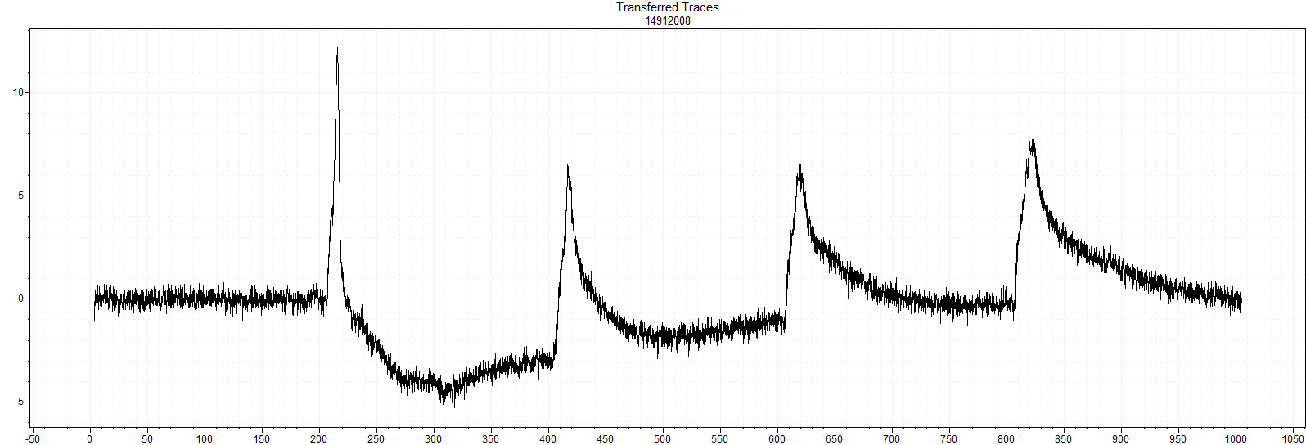
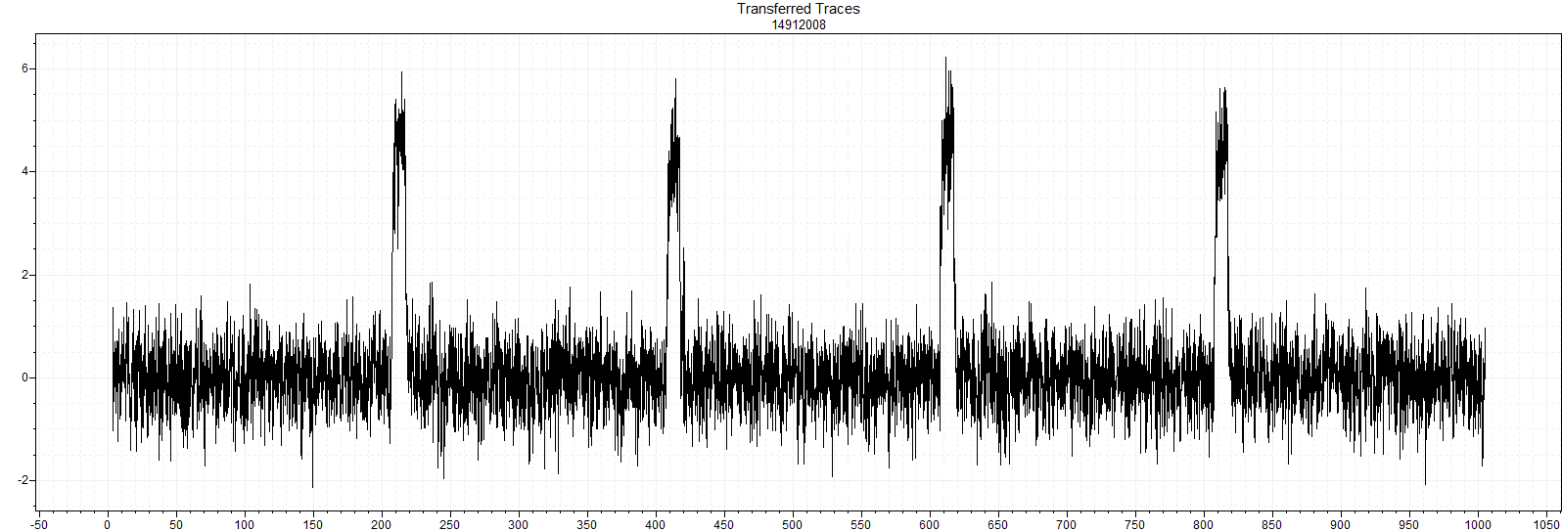
Opto 5Hz 10ms pulse width

Slide 54
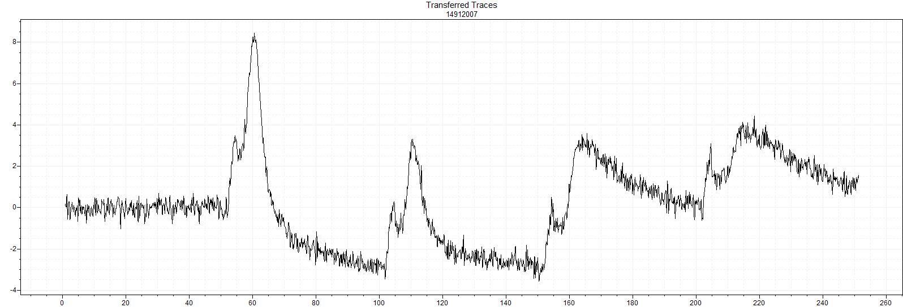
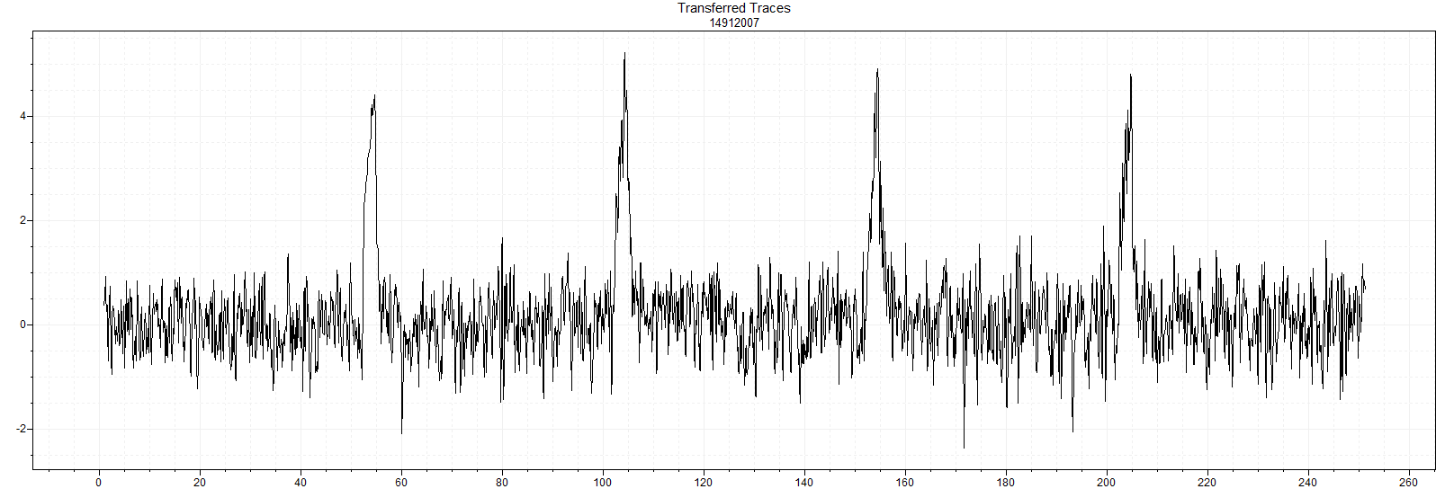
Opto 20Hz 2.5ms pulse width

Slide 55
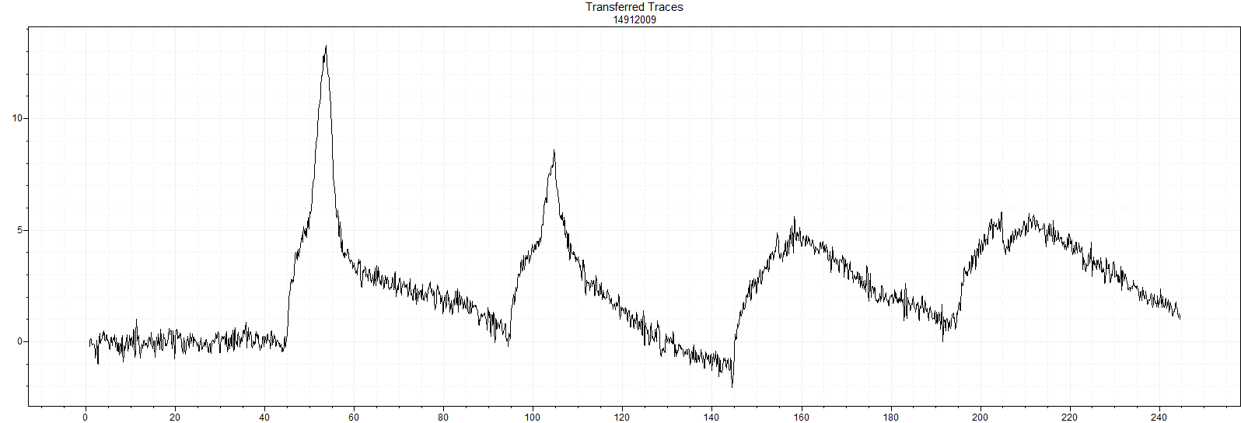
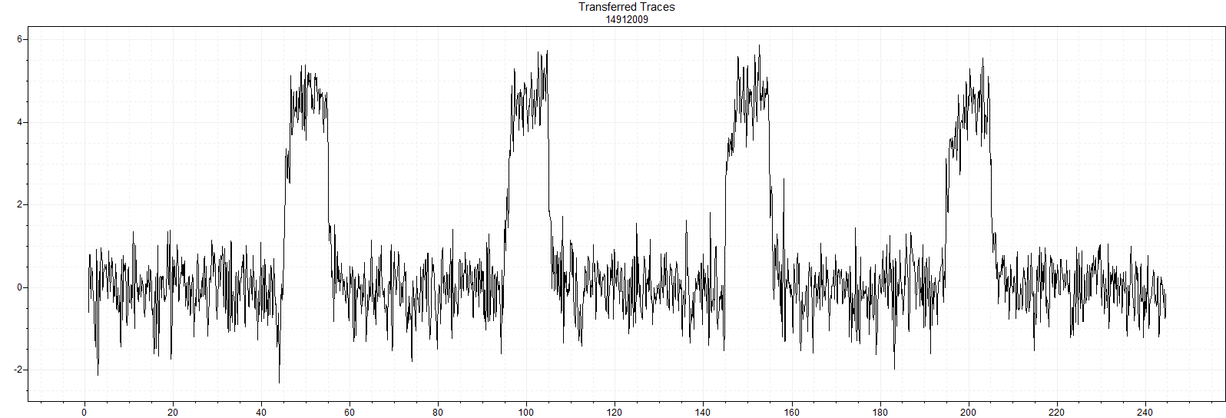
Opto 20Hz 10ms pulse width

Slide 56
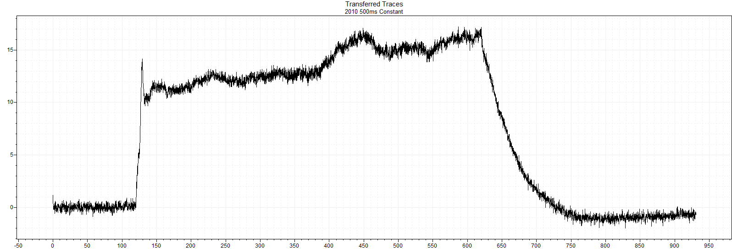
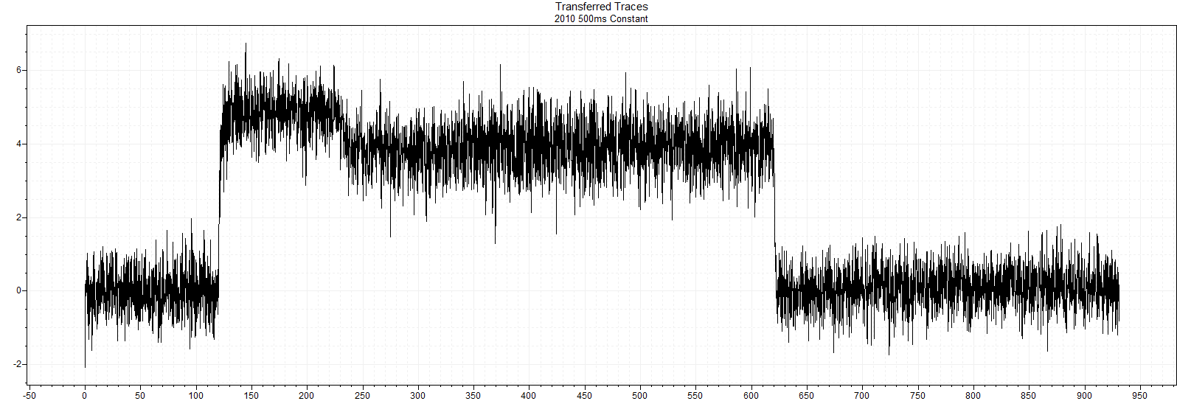
Opto 500ms Constant

