Slide 1
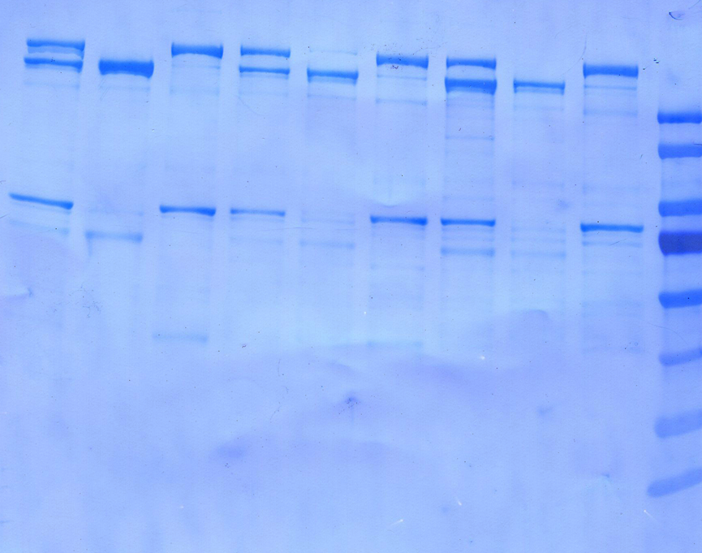
Figure 1A – original image

