Slide 1
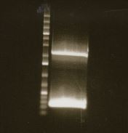
CRISPR
Knock-in (het)
kbp
Ladder
5
4
3
DHC +
Integration
cassette
2
1.5
0.5
0.4
0.3
0.2
DHC
Figure 3, Source Data 1. Original agarose gel corresponding to Figure 3, panel H. Digital imaging of an ethidium bromide-stained agarose gel showing PCR products amplified from genomic DNA isolated from DHC-EGFP CRISPR knock-in (heterozygote) cell line. The upper band was excised and subjected to amplicon sequencing, which is reported in Figure 1 – figure supplement 1.

