Slide 1
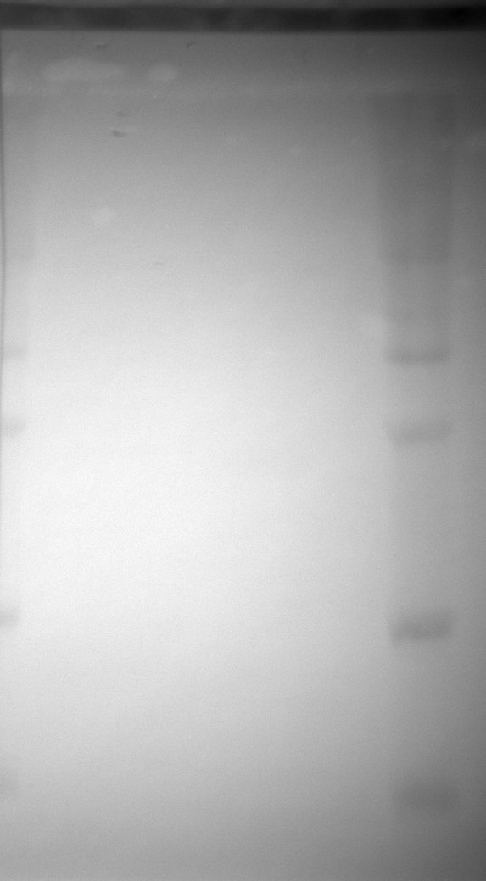
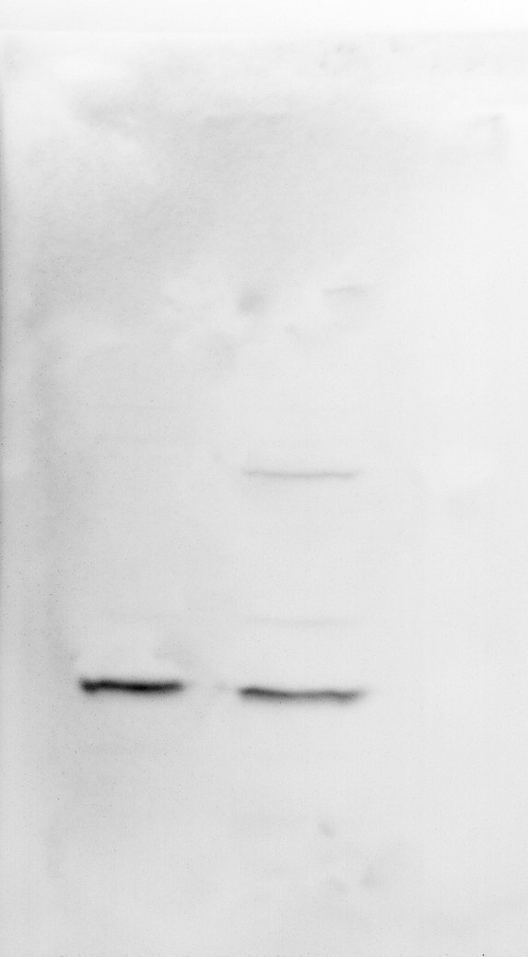
Parental
HeLa
CRISPR
Knock-in (het)
Parental
HeLa
CRISPR
Knock-in (het)
Lane w/
Ladder
Ladder
kDa
150
100
75
p50-EGFP
50
p50
37
ambient light
anti-p50 western blot
Figure 3, Source Data 3. Original membrane corresponding to Figure 3, panel I. Digital imaging of the membrane with ambient light (left panel) showing the molecular weight ladder followed by chemiluminescent detection of p50 by western blot (right panel).

