Slide 1

eLife
An introduction to eLife
May 2019

Slide 2
What is eLife?
Notes:
eLife is:
an unprecedented move by research funders to drive reform in research communication, by providing strategic guidance and significant resources
a non-profit led by researchers for the benefit of science and scientists
eLife was founded in 2011 by the Howard Hughes Medical Institute, the Max Planck Society and the Wellcome Trust​. These organisations continue to provide financial and strategic support, and were joined by the Knut and Alice Wallenberg Foundation in 2018. ​
eLife’s work is guided by the communities we serve.
Further reading at https://elifesciences.org/about

Slide 3
Helping scientists accelerate discovery
Notes:
eLife’s mission is...

Slide 4
… by operating a platform for research communication that encourages and recognises the most responsible behaviours in science
Notes:
Clarification - what do we mean by “responsible behaviours”?
Sharing of findings, data, tools and resources
Honest and comprehensive reporting
Cooperation and collaboration
Constructive and respectful feedback
Transparency in reviewing

Slide 5


What eLife publishes
Notes:
eLife seeks to:
Reduce researchers’ dependence on a limited set of journals
Improve presentation of results constrained by legacy of print
Make publishing a positive experience, especially for early-career researchers, with processes that are transparent and efficient
Refocus incentives on research accomplishments and contributions rather than perceived journal reputation
Stimulate scientific progress and advance careers

Slide 6
Highly influential research across all disciplines of life sciences and biomedicine
Biochemistry and Chemical Biology
Cancer Biology
Cell Biology
Chromosomes and Gene Expression
Computational and Systems Biology
Developmental Biology
Ecology
Epidemiology and Global Health
Evolutionary Biology
Genetics and Genomics
Human Biology and Medicine
Immunology and Inflammation
Microbiology and Infectious Disease
Neuroscience
Physics of Living Systems
Plant Biology
Stem Cells and Regenerative Medicine
Structural Biology and Molecular Biophysics
Notes:
eLife publishes work of the highest scientific standards and importance in all areas of the life and biomedical sciences. The research is selected and evaluated by working scientists and is made freely available to all readers without delay.
eLife does not support the Impact Factor.
eLife does not limit the number of articles they publish, or have a set acceptance rate.
Regularly updated metrics relating to the eLife editorial process are available in our Author Guide at https://submit.elifesciences.org/html/elife_author_instructions.html#metrics

Slide 7
Article types
eLife Magazine publishes Editorials, Feature and Insight Articles
Research Articles There is no maximum length and there are no limits on the number of display items (eg. figures, videos)
Tools & Resources These articles do not have to report major new biological insights or mechanisms, but it must be clear that they will enable such advances.
Short Reports Reporting the results of a single set of experiments, where the findings are novel and judged to be of high importance; should not exceed 1,500 words.
Research Advances This format is for substantial developments that build upon any article published previously by eLife.
Scientific Correspondence For a manuscript that challenges the central findings of a paper published in eLife, and for the formal response to such a manuscript.
Research Communications Articles that have been through an editorial process in which the authors decide how to respond to the issues raised during peer review.
Notes:
Each scientific article in eLife is accompanied by the decision letter, detailing the main points raised by the reviewers, and the author response.

Slide 8

Consultative peer review
Learn more from the short video on eLife peer review: The author's perspective
Notes:
eLife’s goal is to make peer review constructive and collaborative:
working scientists make all editorial decisions
we facilitate open discussion among reviewers
revision requests are consolidated following an open, internal consultation among reviewers to deliver a single, concise set of the essential revisions
Post-review decisions and author responses for published papers are available for all to read.
Reviewers identities are revealed to one another during the consultations. We believe that added transparency is conducive of a more constructive scholarly discussion.
Reviewers are encouraged to embrace full transparency and reveal their identities to authors too.

Slide 9


How is eLife working with early-career researchers?

Slide 10
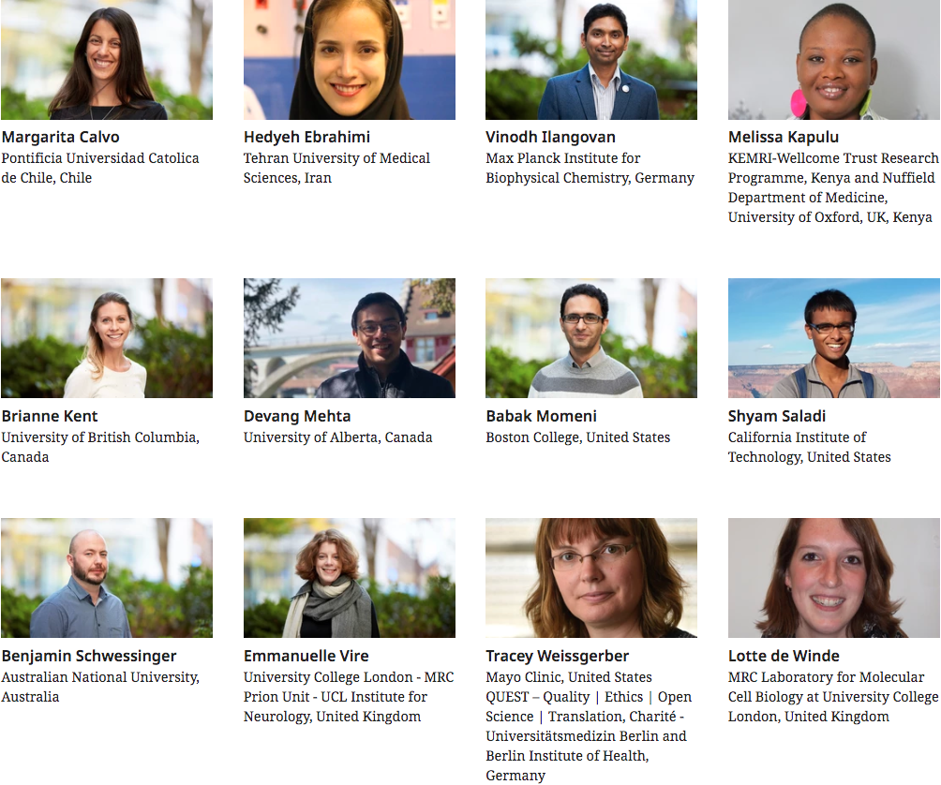
Early-Career Advisory Group (ECAG)
A group of talented graduate students, postdocs and junior group leaders from across the world – the eLife ECAG – acts as a voice for early-career researchers (ECRs) within eLife.
Notes:
eLife has invited a group of talented graduate students, postdocs and junior group leaders from across the world to our Early-Career Advisory Group. The ECAG acts as a voice for early-career researchers (ECRs) within eLife, representing their needs and aspirations and helping to develop new initiatives and shape current practices to change academic publishing for the better.
The role of the ECAG includes:
Offering ideas and advice on new and ongoing efforts with the potential to help early-career scientists
Providing direct support for ongoing programs, such as monthly webinars
Leading efforts to reach out to early-stage colleagues, to gather their feedback and/or connect them to the network
Participating in online or in-person events about issues of concern to early-stage researchers
Attending quarterly phone calls and an annual in-person meeting

Slide 11



elifesciences.org/Community
#ECR Wednesday webinars
Involvement in peer review
Travel grants
Interview series with and about early-career scientists
Posts from groups coalescing and supporting early-career researchers
Updates about eLife’s programmes for early-career researchers
On the last Wednesday of each month, members of the eLife Early-Career Advisory Group invite experts to share their views and advice on subjects pertinent to research careers.
eLife encourages reviewers to involve junior colleagues as co-reviewers
we involve outstanding early-stage researchers as reviewers in their own right
we enable all reviewers to receive credit for their contributions through services such as Publons and ORCID
Funding up to $1,000 for early-career authors who published their research with eLife
Approximately 20 awards a year
Tears and conditions apply
Notes:
To keep up-to-date with events and opportunities for early-career researchers at eLife, please sign-up to receiving our monthly newsletter at https://crm.elifesciences.org/crm/community-news

Slide 12


eLife Community Ambassadors
A worldwide community of like-minded researchers who promote responsible behaviours in science
They do that by pursuing a number of initiatives: from running preprint journal clubs, to delivering workshops on rigour and reproducibility, to advocating for more inclusive career and funding opportunities in science, and more
Read about outcomes of the first edition of the programme in 2018 in our report
Resources they’ve created so far:
Their blog: ecrlife.org
Funding opportunities platform: ECRcentral.org

Slide 13


How is eLife changing scholarly publishing?
Notes:
eLife also invests in innovation through open-source tool development to accelerate research communication and discovery.

Slide 14

Promoting openness
Providing open access to research results
Promoting understanding of research
Supporting reproducibility
Promoting deposit of preprints
Encouraging open dialogue over scientific results
Notes:
eLife publishes using the Creative Commons Attribution (CC-BY) license so that users can read, download and reuse text and data for free – provided the authors are given appropriate credit. We also distribute content to digital repositories and other networks.
For selected papers, eLife prepares non-technical summaries (eLife science digests) so that the research we publish is accessible to a broader audience, including scientists in other fields, students, funders, policy makers and others.

Slide 15

Supporting reproducibility
Reproducibility Project: Cancer Biology
Promoting publication of peer-reviewed protocols
Depositing code used in eLife papers
Transparency and rigour in reporting of resources
Routine screening of scientific images
Notes:
eLife authors are encouraged to publish their work in full and are required to provide the key underlying data as part of their paper. We support projects such as Research Resource Identifiers (RRIDs) that promote unambiguous identification of reagents and materials. eLife is also the publishing partner for the Reproducibility Project in Cancer Biology.

Slide 16

Investing in open-source tools for better scholarly communication
Innovation Initiative – supporting community projects that promote better discovery, reproducibility or assessment of research outputs, eg. Annotations for open commenting on published research
Innovation Sprint – a two-day hackathon with open-source software developers and researchers to create and progress new applications, for example: Plaudit, Swipe4Science
Development of the Reproducible Document Stack – infrastructure for publishing computationally reproducible manuscripts online
eLife Libero – end-to-end editorial and publishing software to help lower the costs of running journals to democratise scholarly publishing
Notes:
We post regular blog posts about innovations in this space at https://elifesciences.org/labs
You can find out more about eLife’s investment in technology development for scholarly communications at https://elifesciences.org/about/innovation

Slide 17

Thank you

